Slide 1
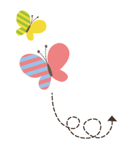
Module 7
WY 六年级下册
Unit 1 He spent about twenty one hours in space.
WWW.PPT818.COM

Slide 2
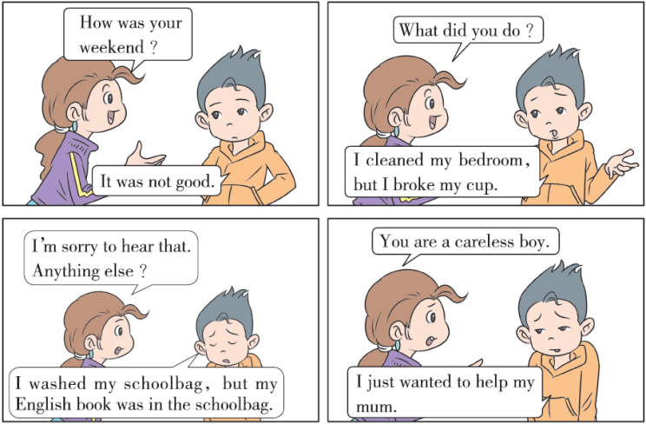

Slide 3
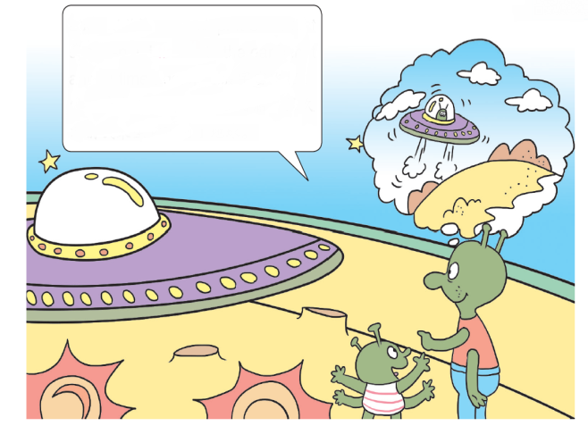
1. Look, listen and say.
Look at this spaceship. It’s our first spaceship. I flew to the earth in it a long time ago.

Slide 4
知识点 1
flew / fluː / v. (动词) （fly的过去式）飞，飞行
例句：
We flew to Beijing last week.
我们上一周飞往了北京。
短语：
fly to the earth 飞到地球fly into space 飞入太空
整体记忆法：

Slide 5
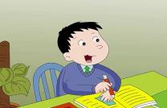
2. Listen and read.
My father, Yang Liwei, is a taikonaut, and he is very famous.
In October 2003, my father flew into space in Shenzhou V. He spent about twenty one hours in space. He did a lot of work there. He also made a video in space. Then he came back to the earth.
My mother and I went to the airport to meet my father. We were very happy. It was a great day! I was very proud of him. Now he still tells me about his space travel. I want to go into space someday too.

Slide 6
知识点 2
He spent about twenty one hours in space.
他在太空中度过了大约21 个小时。
用法：
此句是一般过去时的陈述句，描述过去发生的事情。
句型结构：
主语+ 动词过去式+ 其他.
He left here five years ago.他5 年前就离开这里了。
例句：

Slide 7
易错点
提示
在一般过去时的肯定句中，无论主语是第几
人称，谓语动词都用过去式。

Slide 8
拓展
一般过去时的其他句型结构：
疑问句：Did + 主语+ 动词原形+ 其他？
例句：Did he do his homework last night?
昨晚他做他的家庭作业了吗？
否定句：主语+ didn’t + 动词原形+ 其他.
例句：He didn’t do his homework last night.
昨晚他没有做他的家庭作业。

Slide 9
魔法记忆：
一般过去时，表示过去发生的事；
谓语动词过去式，过去时间做标志；
一般动词加ed，若是特殊得牢记。
否定句很简单，主语之后didn’t 添；
疑问句也不难，did 放在主语前；
谓语之前有did（didn’t），谓语动词需还原；
动词若是was，were，否定就把not 添。

Slide 10
spent /spent/ v. ( 动词)（spend 的过去式）度过
How did you spend your holiday?你是怎么度过你的假期的？
例句：
一词多义：
spend v. 花费

Slide 11
拓展
spend 的用法。
在表示“某人在某地度过了多长时间”时，通常用句型：人+（s）/ spent spend + 时间+（in+）地点.
例句：She spent five years in England. 她在英国度过了五年。
spend 还可以表示“花费”，指“花费时间、金钱”等。
常用结构有：
例句：I spend lots of money on books. 我花了很多钱买书。
He spent two hours (in) doing his homework.
他花了两个小时做他的家庭作业。
spend+ 时间/ 金钱+on+ 某 事/ 物 | 表示“花费时间/ 金钱 在某事/ 物上”
spend+ 时间/ 金钱+（in+） doing sth. | 表示“花费时间/ 金钱 做某事”

Slide 12
about / ə΄baʊt/ adv. ( 副词) 大约
例句：
There are about fifty cows on the farm.
在农场大约有50 头奶牛。
加法记忆法：
ab + out（外出）= about（大约）
about prep. 关于，对于
一词多义：
例句：
It’s a book about space travel.
它是一本关于太空旅行的书。

Slide 13
知识点 3
proud / praʊd/ adj. ( 形容词) 感到自豪的，
感到骄傲的
My mother is proud of me.
我妈妈为我感到自豪。
例句：
be proud of 为……而感到自豪
短语：
pride n. 骄傲
词形变化：

Slide 14
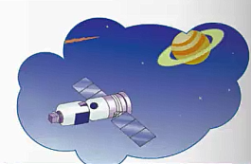
3. Listen and say.
In October 2003，my father flew into space in Shenzhou V.
He spent about twenty one hours in space.
He did a lot of work there.

Slide 15
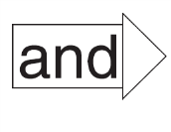
4. Practise.
Make sentences
Shenzhou V flew into space
Yang Liwei spent about twenty one hours in space
Yang Liwei made a video in space
Yang Liwei’s family met him at the airport
he did a lot of work there.
lots of people watched the video.
Yang Liwei was in it.
they were happy.

Slide 16
趣味活动：火眼金睛。
1. 小组合作，先准备所学过的不规则的动词原形和过去式的词卡，分别放在两个盒子里。
2. 选派一人从盒子中摸出一张词卡，并大声读出来，其他成员迅速地从另一个盒子里找到它的过去式或原形，并大声读出来，找得最快最正确的同学得一分。
3. 轮流进行该游戏，得分最高者获胜。

Slide 17
一、单项选择。
1. Last Sunday, we _____ to a zoo and _____ lots of animals.
A. go；see B. went；saw C. go；saw
2. The girl spends much money _____ clothes.
A. in B. on C. at
B
B

Slide 18
3. I finished my homework at _____ eight last night.
A. about
B. for
C. on
A
点拨：
根据句意：“昨天晚上我大约八点钟完成我的家庭作业。”可知，A项“大约”符合句意。

Slide 19
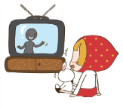
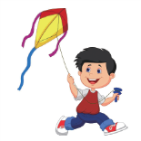
二、根据图片和首字母提示补全句子。
She s one hour（ in）watching TV every day.
2. I f a kite in the park last Sunday.
pends
lew

Slide 20
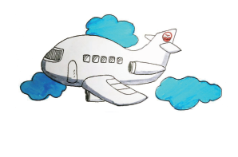
三、根据图片提示完成句子。
He _____ _____ Shanghai yesterday.
flew to

Slide 21
本节课我们学习了以下知识，请同学们一定加强巩固，以便能和同学们进行灵活交流哦！
重点词汇：about, flew, spent, video, proud, someday
重点短语：make a video, be proud of, a long time ago
重点句式：He spent about twenty one hours in space.

Slide 22
1 熟记本节课所学的句型、短语和单词，必须会听、说、读、写。
2 将Listen and read的内容朗读流利。
3 完成配套的课后作业。

Slide 23
Thank you!

