Slide 1
Unit 5 I Love Learning English!
Amazing English
WWW.PPT818.COM

Slide 2
Learning targets
1. Be able to use the words: letter, exactly, fact,
sentence, quick, fox, lazy, forwards, backwards,
therein, even, dig, in fact, move around, dig in
2. To learn something about English and know
some ways of learning English
3. To learn some key sentences:
(1)There are only 26 letters in English.
(2)Well, not exactly.

Slide 3
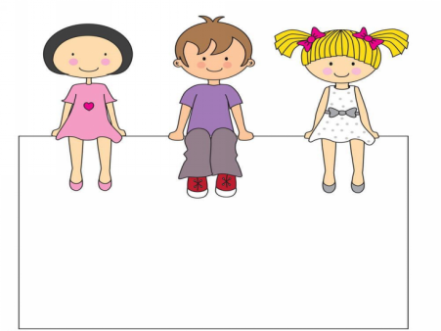
(3)In fact, there are about 800 000 words in the
English language.
(4)You can read it forwards or backwards—it's
the same word!
(5)Dig in and enjoy!

Slide 4
Lead in
Do you know something about English?
Do you think English is an easy language to learn?
How do you study it?

Slide 5
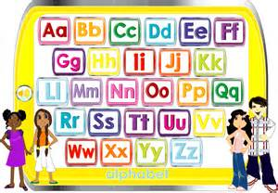
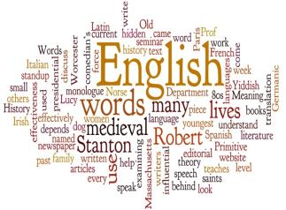
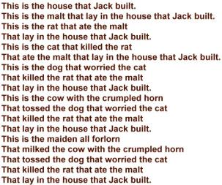
English letters
PPT模板：www.1ppt.com/moban/ PPT素材：www.1ppt.com/sucai/
PPT背景：www.1ppt.com/beijing/ PPT图表：www.1ppt.com/tubiao/
PPT下载：www.1ppt.com/xiazai/ PPT教程： www.1ppt.com/powerpoint/
资料下载：www.1ppt.com/ziliao/ 范文下载：www.1ppt.com/fanwen/
试卷下载：www.1ppt.com/shiti/ 教案下载：www.1ppt.com/jiaoan/
PPT论坛：www.1ppt.cn PPT课件：www.1ppt.com/kejian/
语文课件：www.1ppt.com/kejian/yuwen/ 数学课件：www.1ppt.com/kejian/shuxue/
英语课件：www.1ppt.com/kejian/yingyu/ 美术课件：www.1ppt.com/kejian/meishu/
科学课件：www.1ppt.com/kejian/kexue/ 物理课件：www.1ppt.com/kejian/wuli/
化学课件：www.1ppt.com/kejian/huaxue/ 生物课件：www.1ppt.com/kejian/shengwu/
地理课件：www.1ppt.com/kejian/dili/ 历史课件：www.1ppt.com/kejian/lishi/
English words
English sentences

Slide 6
Words and expression
letter
exactly
fact
sentence
quick
fox
lazy
forwards
n. 字母
adv. 确切地；精确地
n. 事实；真实的事物
n. 句子
adj. 快的；迅速的
n. 狐狸
adj. 懒惰的
adv. 向前

Slide 7
backwards
therein
even
dig
in fact
move sth. around
dig in
adv. 向后；倒
adv. 在那里；在其中
adv. 甚至；还；其实
v. (dug/dug)挖；掘
事实上，实际上
移动某物
开始认真工作，钻研

Slide 8
Presentation
There are only 26 letters in English. So English is an easy language to learn, right?
Well, not exactly.
Yes, English only has 26 letters, but those 26 letters can make a lot of words. In fact, there are about 800 000 words in the English language.

Slide 9
One letter like “a”, can be an English word. And just one word, like “Go” can be a sentence.
There is an English word with about
1 900 letters in it. Wow! That’s a long word.
This sentence uses all 26 letters: The quick brown fox jumps over the lazy dog.

Slide 10
Look at this word: level. You can read it forwards or backwards—it’s the same word!
The word “therein” has ten words in it. You don’t even need to move any letters around. How many words can you find?
Dig in and enjoy!

Slide 11
Read and answer the questions.
1. How many letters in English?
There are only 26 letters in English.
2. How many words in the English language?
There are about 800 000 words in the English language.
3. Which sentence uses all 26 letters in this passage?
The quick brown fox jumps over the lazy dog.

Slide 12
Let’s Do It!
1. Listen and write true (T) or false (F)．
1. English is an easy language to learn. ( )
2. The word “therein” has ten words in it. ( )
3. There are about 800 000 words in the English
language. ( )
4. One word can't be a sentence. ( )
5. There is an English word with 1 900 letters in it.
( )
F
T
T
F
T

Slide 13
2. Fill in the blanks with the words in the box.
fact lazy letter quick sentence
1. My name is Jack. The first ________ in my name
is “J”．
2. I love football. In ________, it's my favourite sport.
3. Can you make a ________ with the new word?
4. Don't be ________. Practice English every day.
5. You eat very fast. You are ________.
letter
fact
sentence
lazy
quick

Slide 14
3. Circle the correct words to complete the
sentences.
1．I can (hear/hears/heard) with my ears.
2．You can (meeting/meets/meet) us at the restaurant.
3．Your cousin can (stayed/stay/staying) at our house.
4．Can we (being/am/be) friends？
5．I can (find/found/finding) lots of books at the
bookstore.

Slide 15
4. Work in groups. Interview your classmates
and collect more interesting facts about
English. Then write them down.
Interesting English Facts

Slide 16
Language points
1. There are only 26 letters in English.
(1)这个句子使用的是there be句型。
【辨析】there be与have
①there be 强调的是某地存在某人或者某物，并非表示所属关系，不能与作实义动词的have同时使用在一个句子中。There be句型的主语是be动词后面的名词，所以be动词要跟其后的名词在人称和数上保持一致。如果其后跟的是单数可数名词或不可数名词，be用is；如果其后跟的是复数名词，则用are；如果其后跟的主语是并列的多个名词，就需要根据最靠近be动词的那个名词的单复数来确定。

Slide 17
there be句型的一般疑问句句式为：Is/Are there...？其肯定回答为：Yes，there is/are.否定回答为：No，there isn't/aren't.
例：There is a pen on the desk.书桌上有一支钢笔。(表示存在)
There are some apples and an egg in the basket.篮子里有一些苹果和一个鸡蛋。(最靠近be的是some apples)

Slide 18
②have 意为“有”，强调的是所属关系，其主语往往是人。作为实义动词时，不能用在there be句型中。其第三人称单数形式为has。例：I have a red pen.我有一支红色钢笔。(表示拥有)
(2)letter作可数名词，意为“字母”。例：The third letter in the word “language” is “n”.“language”这个单词里的第三个字母是“n”。

Slide 19
【学以致用】
1.—Is there any outdoor learning in your school?
—_______.We learn outdoors once or twice every
month. (广东中考)
A. Yes, there is B. No, there isn't
C. Yes, it is D. No, it isn't
2. 她正给她的父母写信。
She is _______________ to her parents.
A
writing a letter

Slide 20
2. Well, not exactly.
exactly作副词，意为“正确地，完全地，精确地”。该词是由形容词exact加上副词后缀­ly构成的，在句中常作状语。注意：not exactly意为“并没有，并非如此”。例：Who can answer this question exactly？谁能准确地回答这个问题？

Slide 21
3. In fact, there are about 800 000 words in the English
language.
in fact意为“事实上，实际上”，相当于“as a matter of fact”，多用于句首，后用逗号与其他部分隔开。例：In fact, we chose a wrong way.事实上，我们选择了一条错误的道路。

Slide 22
4. Dig in and enjoy!
dig作动词，意为“挖，掘”。其过去式和过去分词均为dug；现在分词为digging。常用短语：dig in开始认真工作，钻研。例：If you want to plant a tree, the first step is to dig a hole.你如果想种树，首先是要挖一个洞。Dinner is ready, so dig in! 晚餐准备好了，开始吃吧！

Slide 23
Exercises
Ⅰ. 单项选择。
1. —You are leaving, aren’t you?
—_______, I’m just going on holiday.
A. Exactly B. Not exactly
C. Exact D. Not exact
2. Someone thinks English is an easy language _______.
A. learn B. to learn C. learned D. learning
B
B

Slide 24
3. Jim is a _______ man; he never cooks food
himself.
A. lazy B. quick C. happy D. funny
4. Which sign means “Go forwards”? _______
5. “Need” is a word _______ double “e”.
A. have B. has C. in D. with
A
A
D

Slide 25
Ⅱ. 根据汉语意思完成句子。
1. 英语中，一个单词可以构成一个句子。
In English, one word ______ _________ a
.
2. 事实上，英语和汉语都很重要。
, English and Chinese are all very
important.
3. 你的答案不完全准确。
Your answer is not _______ ______.
can be/make
sentence
In fact
exactly right

Slide 26
4. 你甚至不需要转动方向盘。
You ______ ______ ______ to turn the wheel.
5. 如果你想成功，你必须开始认真工作。
If you want to succeed, you have to ______ ______.
6. 谁能倒着读这句话？
Who can ________ the sentence ___________?
don’t even need
dig in
read
backwards

Slide 27
Summary
1. Learned some useful words and phrases: letter, exactly,
fact, sentence, quick, fox, lazy, forwards, backwards,
therein, even, dig, in fact, move around, dig in
2. Learned the key sentences:
There are only 26 letters in English.
Well, not exactly.
In fact, there are about 800 000 words in the English
language.

Slide 28
Homework
1.What other interesting Egnlish facts
do you know? Collect and discuss
them with your classmates.
2. Finish the exercises of this lesson.

