Slide 1
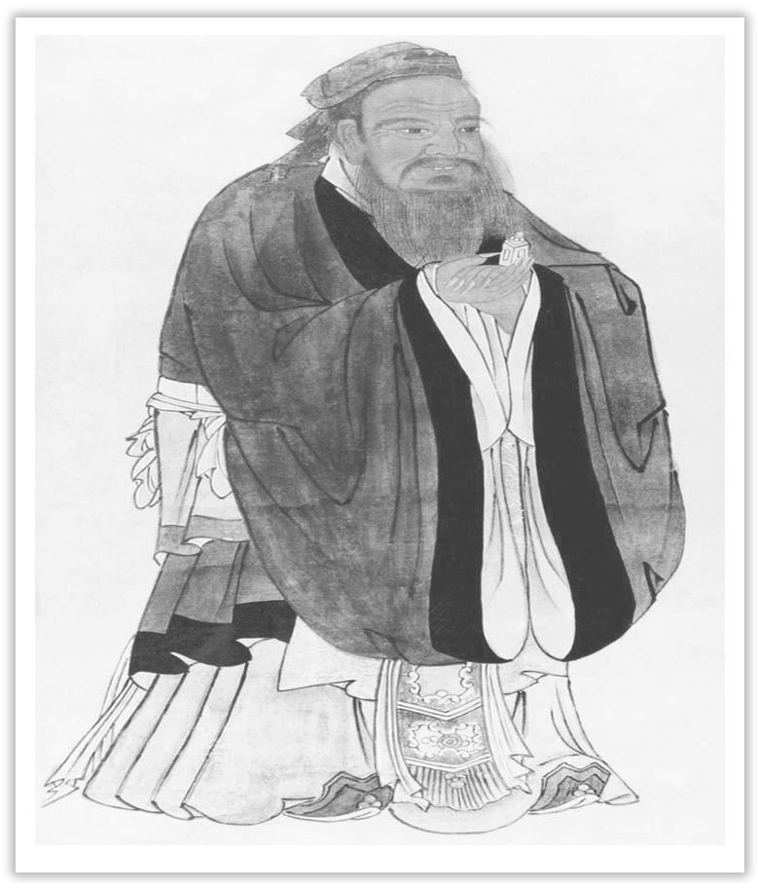
Unit 4 History and Traditions
Section Ⅰ Listening and Speaking
WWW.PPT818.COM

Slide 2
主题语境——人与社会之历史、社会与文化
【语境概说】
本单元的话题内容是“历史和传统”，它属于“人与社会”这一主题语境下的“历史、社会与文化”。该主题语境包括常见的中国和外国的历史知识、人物及事件等。通过本单元的学习，学生不仅能够从历史人物和历史事件中得到启发，还能够提高他们的历史底蕴和文化修养，有利于学生身心健康成长。

Slide 3
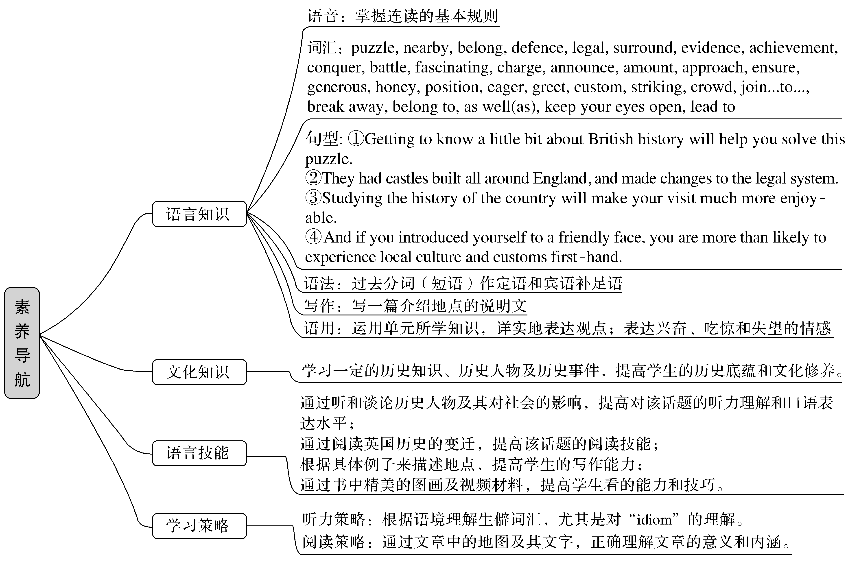

Slide 4
History is the teacher of life.历史是生活的教师。
History can teach us the wisdom and the relativity of value.历史可以教我们智慧和价值的相对性。
Society differs from nature in having a definite moral object.社会与自然的不同就在于它有一个明确的合乎道德的目标。
History is a mirror, which illuminates not only the reality but also the future.
历史是一面镜子，它照亮现实，也照亮未来。

Slide 5
1.Translate the following words and phrases.
①Confucius ____________ ②mansion n. ____________
③cemetery n. ____________ ④philosophy n. ____________
⑤descendant n. __________________
⑥individual adj.________________n.____________
孔子
公馆；宅第
墓地；公墓
哲学
后裔；后代；子孙
单独的；个别的
个人

Slide 6
⑦heel n. ____________________________________
⑧temple n. ____________
⑨confusion n. ____________ ⑩the family tree ____________
⑪Dacheng Hall ____________ ⑫be similar to ____________
⑬noticeable ____________
⑭Achilles’s heel ____________________________________
足跟；(脚、袜子、鞋等的)后跟
寺庙
困惑
家谱
大成殿
和……相似
显眼的
阿喀琉斯的脚跟，致命的弱点

Slide 7
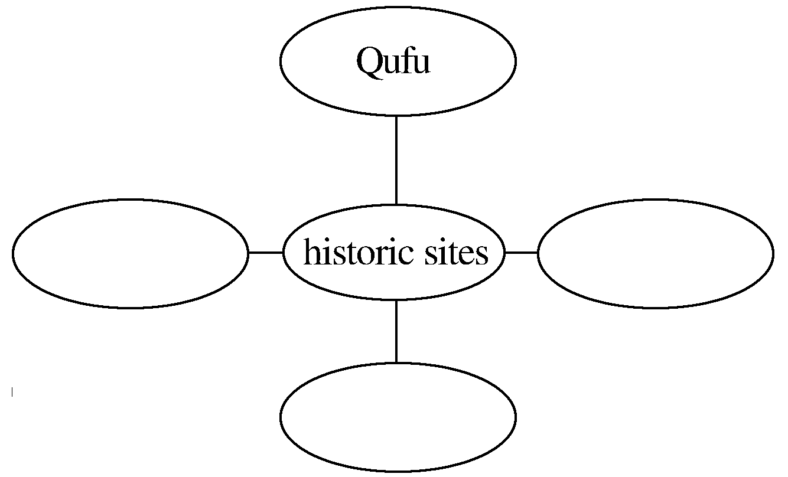
2.Brainstorming：How many historic sites have you visited and what are they?
The answer is open.

Slide 8
3.Look at the pictures on Page 38 and tell your classmates what these pictures stand for.
Temple of Confucius is in memory of Confucius; Kong Family Mansion is where Confucius and his descendants lived and he was buried in Cemetery of Confucius.
________________________________________________________________________
________________________________________________________________________

Slide 9
4.Finish Ex.1 on Page 38.
5.Try to translate the following sentences.
①它坐落在山东省。
________________________________________________________________________
②孔庙占地140 000平方米，大约有2 500年的历史。
________________________________________________________________________
________________________________________________________________________
③它已经成为最受欢迎的旅游景点之一。
________________________________________________________________________
④它们很值得参观。
________________________________________________________________________
It is located/lies in Shandong Province.
Temple of Confucius covers an area of 140，000 square meters, with a history of about 2，500 years.
It has become one of the most popular tourist attractions.
They are well worth visiting.

Slide 10
Finish Ex.2 & Ex.3 on Page 38 and Ex.4 on Page 39.

Slide 11
1.Speaking—Finish Ex.5 on Page 39 by following the example.
Confucius’ ideas on education have a great influence on the learning at present.One of his famous sayings“学而时习之，不亦说乎”indicates that repeating plays an important part in learning, while another example “学而不思则罔，思而不学则殆”stresses the importance of the relationship between thinking and learning.

Slide 12
2.Pronunciation—Listen to the following dialogue and pay attention to the linking sound.
W：Hi, David.I think you’re fat.
M：I’m too busy to take any exercise.
W：That is just an excuse.You can always find some time to exercise.
M：But I work hard all day for long hours.I often have no time for lunch.
W：I think not eating meals can’t help you lose weight.Instead, you will eat more in the evening.
M：I know you’re right, but what can I do?
W：How about going for a walk instead of watching TV on the sofa every evening?

Slide 13
M：But it’s too boring.
W：Why not take an MP4 with you? You can enjoy the music and get healthy at the same time.

Slide 14
语言知识积累
描述“地点”的常用表达
1.It is located/lies in..., with an area of...
2.It covers an area of..., with a history of...
3...., located in...and covering an area of..., is one of China’s most famous scenic spots.
4.The history of...dates back to...
5.It has become the most popular tourist attraction since...
6....is well worth visiting.

Slide 15
文化知识习得
三孔 (曲阜孔府、孔庙、孔林)
山东济宁曲阜的孔府、孔庙、孔林，统称曲阜“三孔”，是中国历代纪念孔子，推崇儒学的表征，以丰厚的文化积淀、悠久历史、宏大规模、丰富文物珍藏，以及科学艺术价值而著称。
山东济宁曲阜是孔子的故乡。孔夫子生前在此开坛授学，首创儒家文化，为此后2 000多年的中国历史深深地打上了儒学烙印。以孔子为代表的儒家文化，按照自己的理想塑造了整个中国的思想、政治和社会体系，成为整个中国文化的基石。1994年孔庙、孔林、孔府被联合国列入《世界遗产名录》。

Slide 16
孔庙，公元前478年始建，后不断扩建，至今成为一处占地14公顷(1公顷＝
10 000平方米)的古建筑群，包括三殿、一阁、一坛、三祠、两庑、两堂、两斋、十七亭与五十四门坊，气势宏伟、巨碑林立，堪称宫殿之城。
孔府，建于宋代，是孔子嫡系子孙居住之地，西与孔庙毗邻，占地约16公顷，共有九进院落，有厅、堂、楼、轩463间，旧称“衍圣公府”。
孔林，亦称“至圣林”，是孔子及其家族的专用墓地，也是世界上延续时间最长的家族墓地，林墙周长7千米，内有古树2万多株，是一处古老的人造园林。

Slide 17
发音技巧点拨
连读规律
1.辅音＋元音：第一个单词以辅音结尾，第二个单词以元音开头，则两个单词连读。如cut out；an old book等。
2.r或re结尾：若后面的单词以元音音素开头，两个单词连读。此时r或re不仅要发/r/音，还要和后面的元音一起连读。
3.元音＋元音：常见情况是he is和she is的连读，分别连成“his”“shis”的发音。
4.辅音＋半元音：若前一词是辅音结尾，后一词以半元音开头，尤其是以/j/开头，则两个单词要连读。如thank you; did you等。

