Slide 1
Unit 3
Could you please clean your room?
Section A
WWW.PPT818.COM

Slide 2
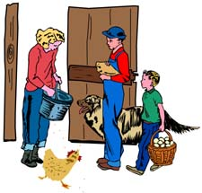

Who is the busiest in your family, your mother, your father or yourself?

Slide 3

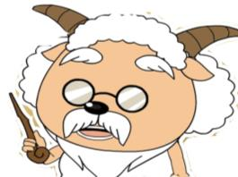
What chores do you do at home?
Who often does the chores?

Slide 4
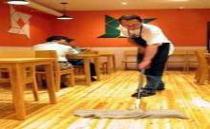
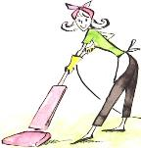
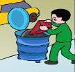
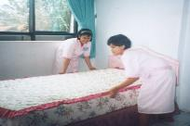
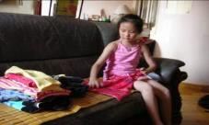
chores
sweep the floor
do the dishes
clean the living room
take out the rubbish
fold the clothes
make the bed

Slide 5

Guessing games!
What chore is she doing?

Slide 6
She’s sweeping the floor.

Slide 7
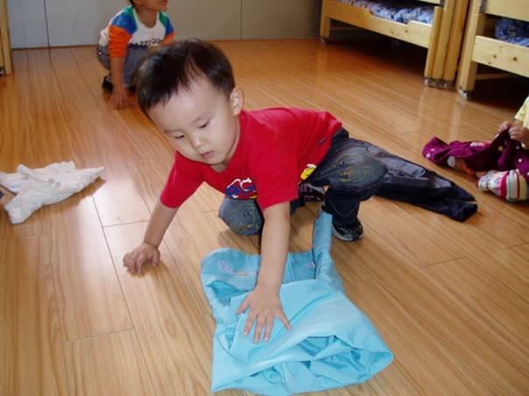
What chore is he doing?

Slide 8
He is folding the clothes.

Slide 9
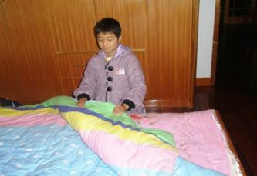
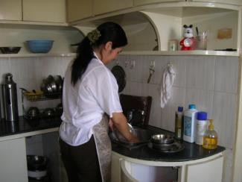

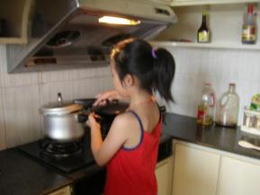
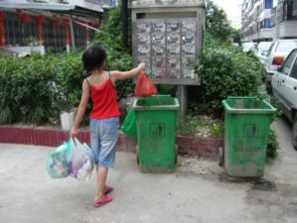


What chore is she doing?

Slide 10


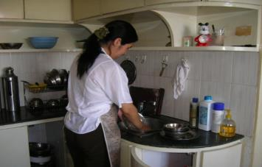


She is making the bed.
She’s doing the dishes.
She is cooking a meal.
She is taking out the trash.

Slide 11

Presentation
sweep the floor
Could you please sweep the floor?
Yes, sure.
Sorry, I can’t.

Slide 12
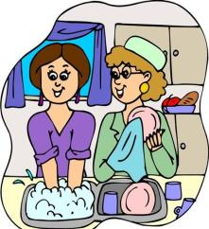

do the dishes
Could you please do the dishes?
Yes, sure.
Sorry, I can’t.

Slide 13
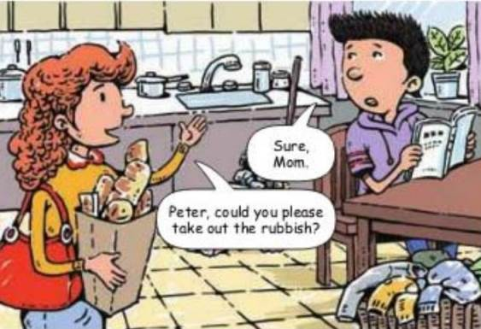

Slide 14
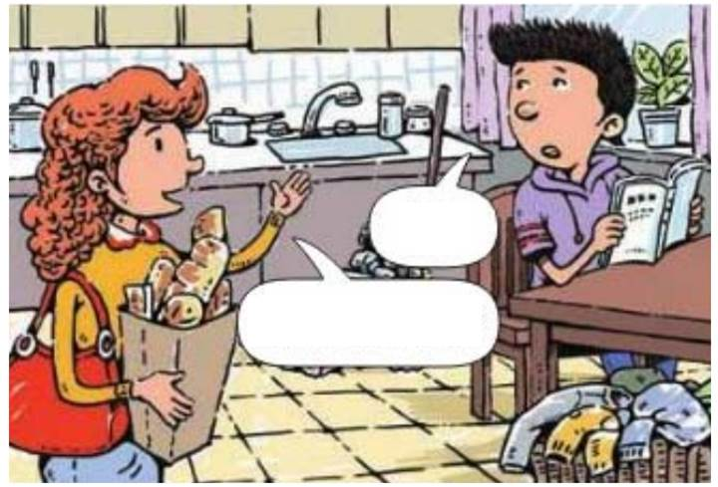
Yes, sure.
Could you please sweep the floor?

Slide 15
...
Could you please …?

Slide 16

1a Do you do these chores at home? Discuss them with your partner.
1.do the dishes 2. take out the rubbish
3. fold your clothes 4. sweep the floor
5. make your bed 6. clean the living room

Slide 17
1b Listen. Who will do these chores? Check (√ )
Peter’s mother or Peter.
Chores | Peter’s mother | Peter
do the dishes
sweep the floor
take out the rubbish
make the bed
fold the clothes
clean the living room
√
√
√
√
√
√

Slide 18
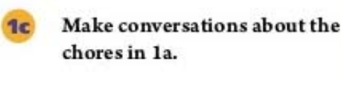
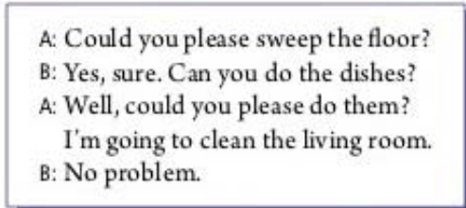
1.do the dishes
2. take out the rubbish
3. fold your clothes
4. sweep the floor
5. make your bed
6. clean the living room

Slide 19
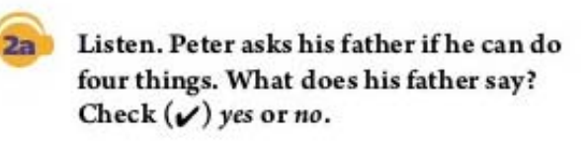
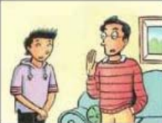
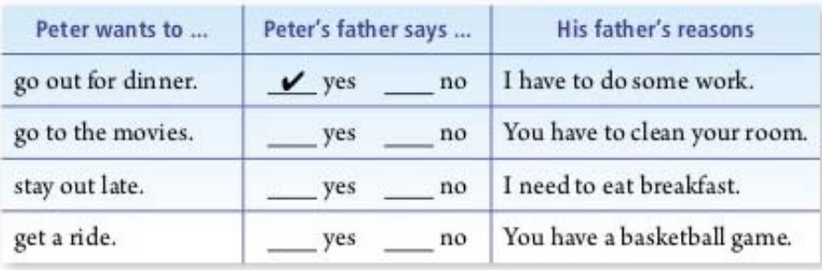

√
√
√

Slide 20

2b Listen again. Why does Peter’s father say “no”? Draw lines to the reasons in the chart in 2a.

Slide 21
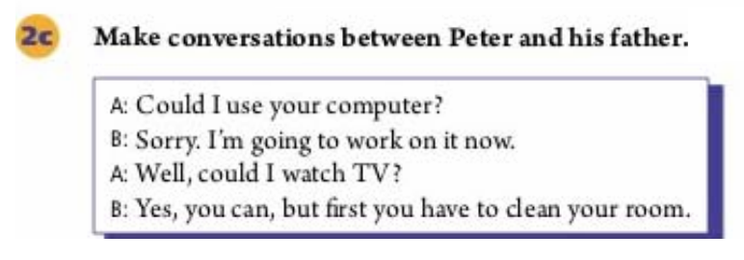

Slide 22
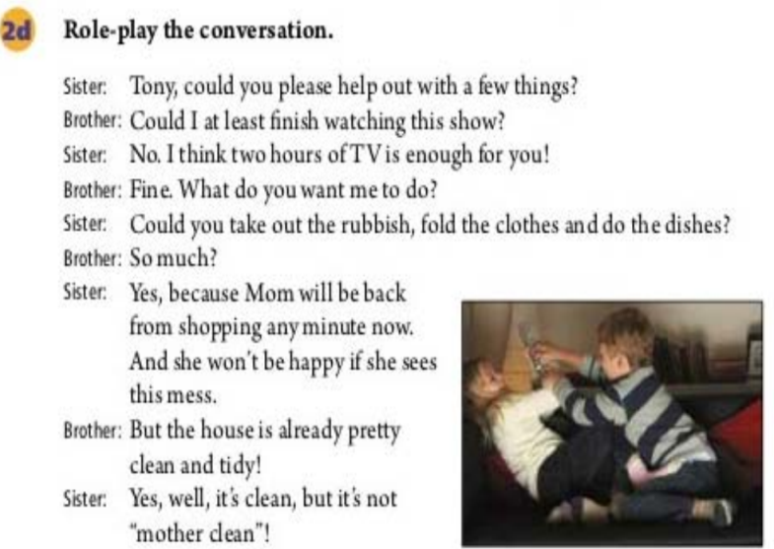

Slide 23

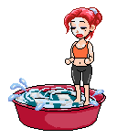





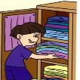



Practice Make conversations in pairs.
Could you please ___________ ?
Yes, sure. But I have to _________ first. /
Sorry, I can’t. I have to _________ first.
And I need to ________.
Could I ________ ?
Yes, you can. /
No, you can’t . Because ...

Slide 24
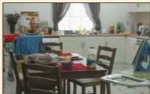

1.Why was Nancy’s mom angry with her?
_______________________________________________
2.Did they solve the problem? How?
_______________________________________________
Because she thought Nancy watched TV all the time and never helped out around the house.
Yes.Nancy said sorry to mom and she finally understood that they needed to share the housework to have a clean and comfortable home.

Slide 25
1.Neither of us did any housework for a week.
2.My mom came over as soon as I sat down in front of the TV.
3.You’re tired, but I’m tired, too!
For one week, she did not do any housework and neither did I.
The minute I sat down in front of the TV, my mom came over.
I’m just as tired as you are!

Slide 26
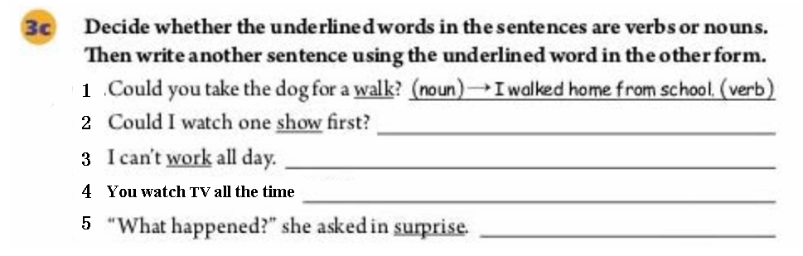

Slide 27

Could I go out for dinner with my friends?
Sure, that should be OK.
Could we get something to drink after the movie?
No, you can’t.You have a basketball game tomorrow.
Could you please take the dog for a walk?
OK, but I want to watch one show first.
Could you please take out the rubbish?
Yes, sure.

Slide 28
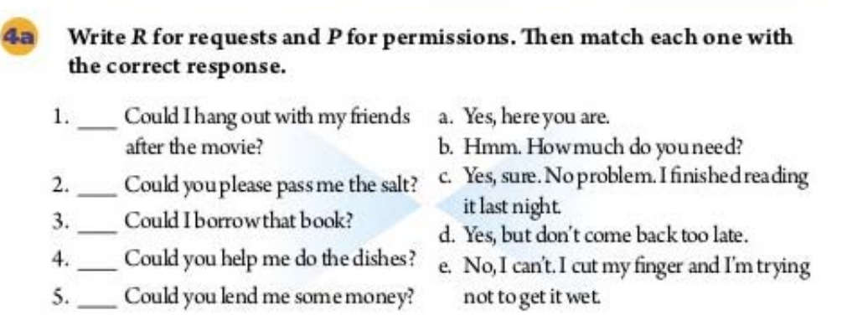
P
R
P
R
R

Slide 29
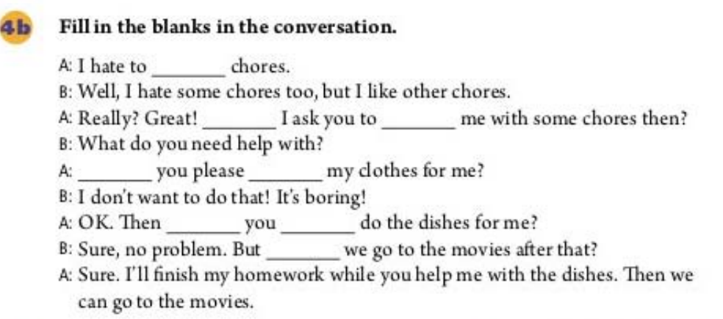
do
Could help
Could fold
could please
could

Slide 30
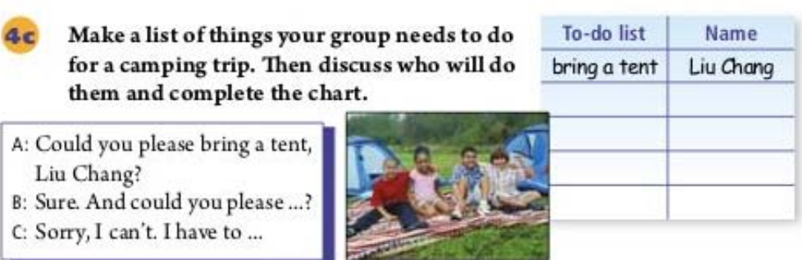

Slide 31
重点探究
1. You watch TV all the time and ...
all the time（在该段时间内）一直一向；时时刻刻；每时每刻
e.g. I do this all the time.
我一直是这么做的。
This happens all the time.
这种情况是时时发生的。

Slide 32

2. I’m just as tired as you are!
as ... as 意为 “和 ……一样” ，表示同级的比较。使用时要注意第一个as为副词，第二个as为连词。其基本结构为：as + adj./ adv. + as。

Slide 33

例如:
This film is as interesting as that one.
这部电影和那部电影一样有趣。
Your pen writes as smoothly as mine.
你的钢笔书写起来和我的一样流畅。

Slide 34
3. For one week, she did not do any housework and neither did I.
neither 用作副词，作“也不”解释，放在句首表示前面否定的内容也适用于另一个人或物，句子须采用部分倒装。此时也可用nor替换 neither。

Slide 35
例如:
— I don’t like this dress. 我不喜欢这件连衣裙。
— Neither / Nor do I. 我也不喜欢。
注意：neither 之后的主语要置于助动词或系动词之后。

Slide 36
neither… nor… | 意为“既不……也不……”，连接两个并列主语时，谓语动词的数要与邻近它的主语的数一致
both… and… | 意为“既……也……；两者都……”，连接并列成分，连接并列主语时，谓语动词用复数
either… or… | 意为“或者……或者……（二者任选其一）”

Slide 37
4. the minute =as soon as
一……就……, 引导时间状语从句。
这个短语比较常用，口语和书面语都可以。它的特点是，在句子中的位置比较灵活，而且可以用于各种时态。

Slide 38
例如：
I’ll write to you as soon as(the minute)I get there.
我一到那儿就给你来信。（一般现在时）
As soon as(the minute) I went in, Kate cried out with pleasure.
我一进门，Kate 就高兴的叫起来。（一般过去时）

Slide 39
语法探究
could 表示委婉语气的用法
Could you please +动词原形+...?
Could I +动词原形+...?
（1）在以上两个句型中，could表示委婉地请求或许可，而不是can 的过去式，否定句直接在动词原形前加not。例如： Could you please not tell him about it?
（2）在答语中表示允许某人做某事时,用can和may来表达,不能用could。例如：
—Could I borrow your dictionary?
—Yes, of course, you can.

Slide 40
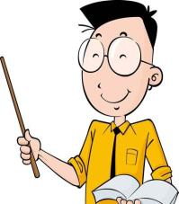
课堂小结
Could you please do... ?
Yes, sure. /No problem. /
Sorry, I can’t. I have to do ....
Could I do...?
Yes, you can. / No, you can’t.
Useful words & expressions:
do the dishes, sweep the floor, take out the rubbish,make your bed, fold your clothes, clean the living room,stay out late,get a ride，work on …

Slide 41
Ⅰ. 用所给词的适当形式填空
达标练习
1.Could I _____ (use) your dictionary ?
2. Could you please ______ (sweep) the floor?
3.I have _______ (clean) the room this afternoon.
4.He needs to ________ (study) English hard.
5. He is going to ______(work) on the computer.
use
sweep
to clean
study
work

Slide 42
Ⅱ. 翻译句子
1.我母亲很累，因为她每天得洗盘子、倒垃圾。
2.他讨厌叠衣服但喜欢打扫房间。
3.在家中我常帮妈妈做家务。
My mother is very tired because she has to do the dishes and take out the rubbish every day.
He hates to fold the clothes but he likes to clean the
room.
I often help Mom do chores at home.

Slide 43
Homework
Make a survey about what chores your classmates do at home and write a short passage.

