Slide 1
Module 4 Healthy Food
Unit 1 We've got lots of apples.
WWW.PPT818.COM

Slide 2
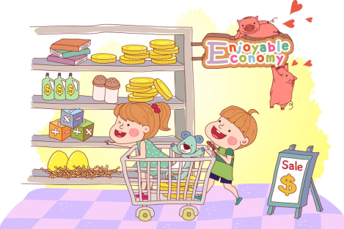
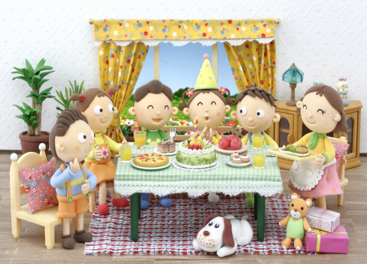
Let’s have a party.
food and drink

Slide 3
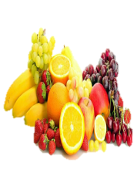
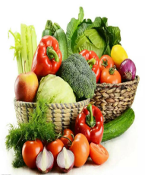
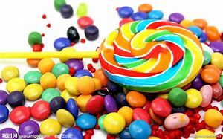
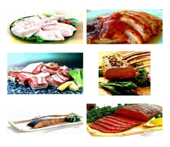
What's your favourite food?
fruit
/fru:t/
vegetables
/'vedʒtəblez/
candies
/'kændiz/
meat
/mi:t/

Slide 4
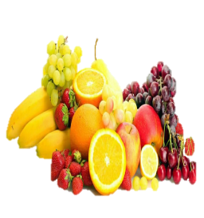
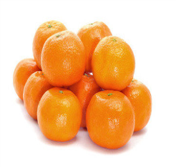
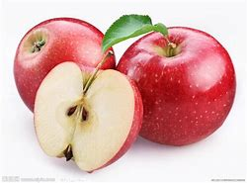
Let's get some…
fruit /fru:t/
oranges
apples

Slide 5
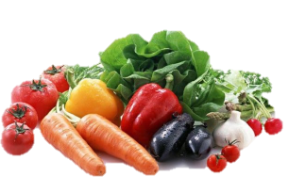
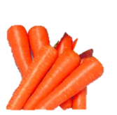
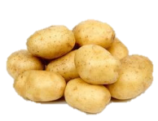
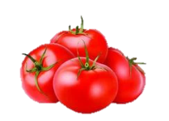
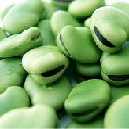
Let’s get some…
vegetables /´vedʒtəblez/
carrots
potatoes
tomatoes
beans

Slide 6
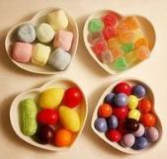
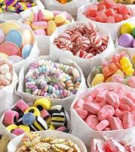
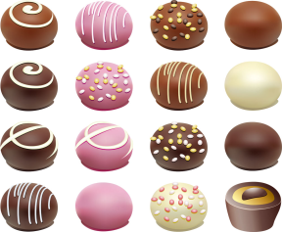
Let's get some …
candies
chocolate
Too much chocalate isn't good for us!
Too much chocalate is bad for us!

Slide 7
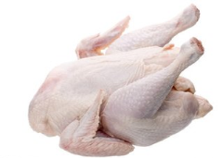
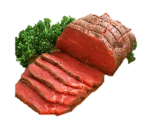
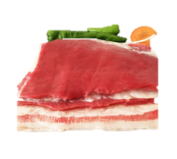
Let's get some…
meat
chicken
pork
beef

Slide 8
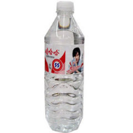
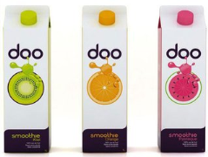
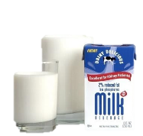
Let’s get some …
drinks
water
juice
milk

Slide 9
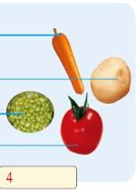
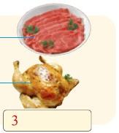
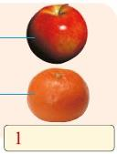
Label the food in the pictures with the words from the box.
fruit
candy
meat
vegetables
candy fruit meat vegetables

Slide 10
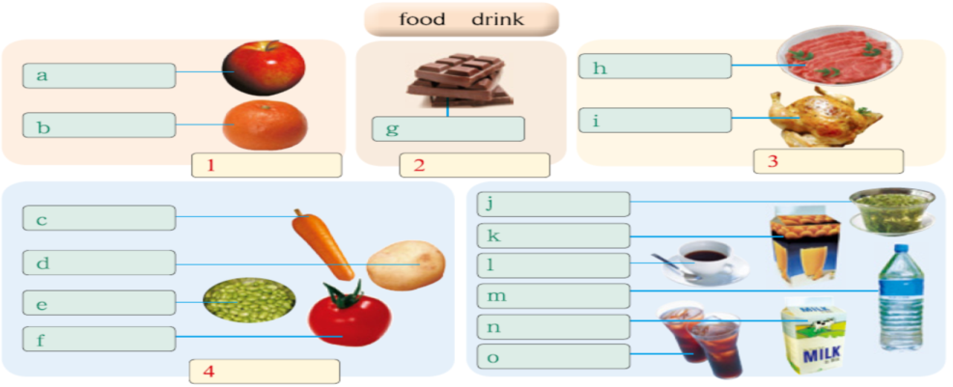
2
Label the food in the pictures with the words from the box.
apple beans beef carrot chicken chocolate coffee cola juice milk orange potato tea tomato water
apple
beef
orange
chocolate
chicken
fruit
candy
meat
tea
carrot
juice
potato
coffee
bean
water
milk
tomato
cola
vegetables

Slide 11
A4. Listen and check the food and drink that Betty and her mother have got.
√
apples □ juice □ beans □
milk □ beef □ oranges □
carrots □ potatoes □ chicken □
tea □ coffee □ tomatoes □
cola □ water □
√
√
√
√
√

Slide 12
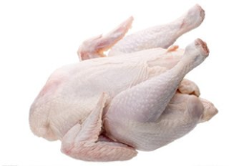
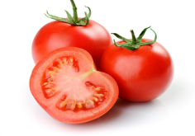
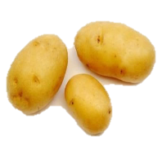
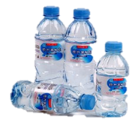
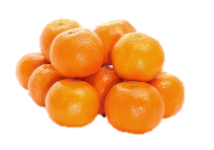
Let's say!
A: Has she got any …?
B:Yes, she has / No, she hasn’t
√
×
√
√
×
×
√

Slide 13
1. Listen to the tape and answer the questions.
How many speakers are there?
Two.
What are they talking about?
Food and drink.

Slide 14
Listen and decide true or false（T/F）.
1. They’ve got some apples.
2. They haven’t got any meat.
3. They haven’t got any coffee.
4. They have got some cola.
5. They haven’t got some tea.
T
T
T
F
T

Slide 15
3.Listen, read and complete the table.
Things Tony’s family has got at home
Things Tony’s family hasn’t got at home
Food
chocolate
meat
chicken
apple
oranges
Drink
orange juice
cola
coffee
tea

Slide 16
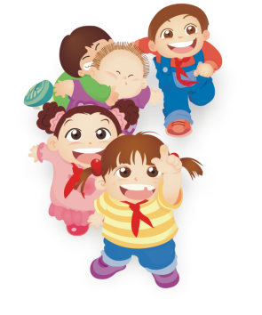
Summary
1.Let's get some...
2. how about+n.
3.have/has got
They/We have got... He has got....
—Have they/we got..? Has he got...?
—Yes, they have / No, they haven’t
4.“一些”：some肯，any否/疑。

Slide 17
Pair Work
Let's go shopping！
A: Have we got any...?
B: Yes, we have.

Slide 18
Pair Work
Let's go shopping
A: Have we got any...?
B: No, we haven't. Let's get some...

Slide 19
Sentence patterns
A: … is coming for dinner. Have we got any…?
B: Yes, we have got some…
A: Have we got any…
B: No, we haven’t. Let’s get some for…
… …
A: Thanks.

