Slide 1
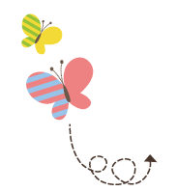
Unit 4 Li Ming Comes Home
六年级下册
Again,Please!
WWW.PPT818.COM

Slide 2
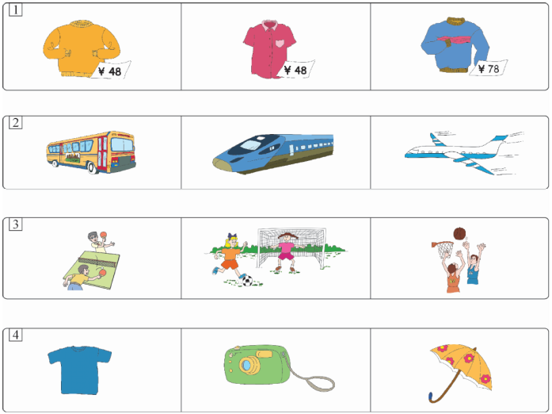
1. Listen and circle.

Slide 3
2. Listen and write.
1．—Will you come to my ________tomorrow? —Sure! 2．—What time does it________？ —At 9:00. 3．—Do you ________ it? —Sorry, I don't. 4．—Don't be_______. —Okay. I'll come here________． 5．They ________come here at 8:30.
party
begin
hear
late
early
all

Slide 4
3. Read and write.
light early difficult short close
1．The window is open. Please ________ it, Danny.
2．My pencil is long. Your pencil is________．
3．This ball is heavy. That one is________．
4．Please come here ________．Don't be late.
5．Flying a kite is easy for Jenny, but it is ________for Danny.
close
short
light
early
difficult

Slide 5
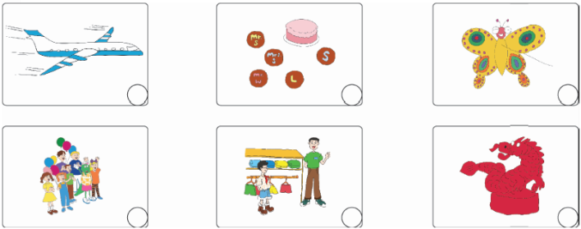
4. Read and match.
1
3
4
2
6
5
1．Li Ming will fly to China next week.
2．Danny and Jenny have a surprise party for Li Ming.
3．Danny and Jenny make a cake and some cookies.
4．Li Ming gives Danny a Chinese kite.
5．Li Ming gives Jenny a little red dragon.
6．Li Ming buys some gifts at the shop.

Slide 6
5. Read and write.
1．—____________ is the blue hat?
—Fifty yuan.
2．—___________ do you eat tomatoes?
—Once a week.
3．—___________ will you go to Beijing?
—We will go to Beijing by plane.
4．—___________ gifts do you need?
—I need four.
5．—___________ did he stay there?
—About a week.
6．—_________ is it from Beijing to Shi­jiazhuang?
—It's 278 kilometres.
How much
how much
how many
how long
how often
how far
how
How often
How
How many
How long
How far

Slide 7
6. Look and write.
are have sunny will play go fly
It was ________ yesterday. ________ to the park with my friends. We________ kites in the park. Then we ________ football . We ________very happy.
Tomorrow I ________get up at 6:30.Then I will ________ breakfast and walk to school.
sunny
went
flew
played
were
will
have

Slide 8
7. Complete the dialogue.
John：Hello?
Lucy：Hi, John. ________Would you come to a party for Mary?
John：________
Lucy：Tomorrow afternoon. It's a surprise for her.________
John：Okay.________
Lucy：At 3:00. Don't be late. We want to surprise Mary.
John：Okay.________
Lucy：Great! See you tomorrow.
C
A. Please don't tell her.
B. I will come before 3:00.
C. It's Lucy calling.
D. What time does it begin?
E. Sure！When is the party?
E
A
D
B

Slide 9
8. Read and answer.
One day，an ant walked by the river. He was thirsty. He went to drink the water, but fell into the river.“Help! Help！” cried the ant. A bird heard him and threw the ant a leaf. Then the wind blew the leaf to the bank.
Some days later, the ant saw a man opening his net to catch the bird. He ran fast to bite the man's arm.“Ouch！” cried the man and his net fell down. The bird flew away at once.
The ant was very happy because he helped his friend.

Slide 10
8. Read and answer.
1．Where did the ant drink the water?
______________________________________________
2．How did the bird save the ant?
______________________________________________
______________________________________________
3．Did the ant save the bird?
______________________________________________
4．Do you think friends should help each other?
______________________________________________
By the river.
He threw the ant a leaf. Then the wind blew the leaf to the bank.
Yes, he did.
Yes.

Slide 11
9. Look and say.
Today is... I'll have... I'll invite... I'll have...
We'll eat... We'll sing... We'll play... Will you come?

Slide 12
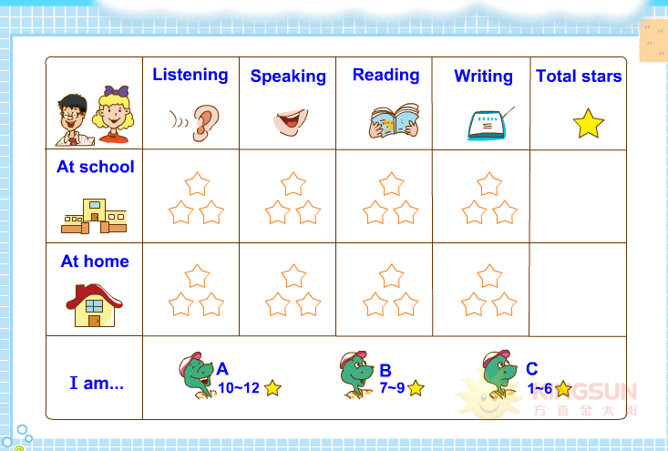
10. How am I doing?

