Slide 1
Unit 3
I'm more outgoing than my sister.
Section A ( 1a - 1c )
WWW.PPT818.COM

Slide 2
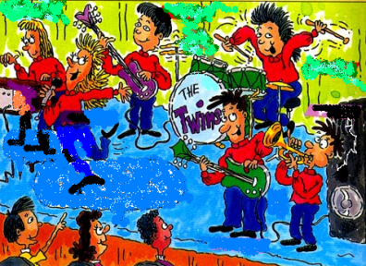
1a.Match each word with its opposite.
tall loudly
thin short hair
long hair heavy
quitely short

Slide 3
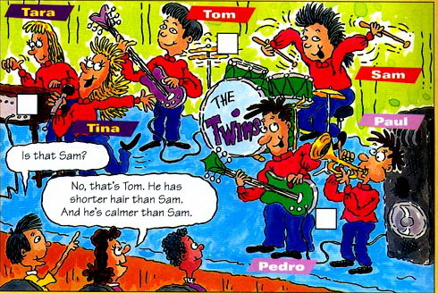
1b. Listen and number the pairs of twins 1-3 in the picture.
1
2
3

Slide 4
小结训练
写出下列单词的比较级。
high late tall
hungry thirsty fuuny
big hot wet
little good/weel
beautiful interesting
higher later taller
hungrier thirstier funnier
bigger hotter wetter
less better
more beautiful more interesting
用所给词的适当形式填空。
My father has _________ ( short ) hair than my mother. My mother has ________ ( long ) hair than my father. But my father is __________ ( heavy ) than my mother and _______________ ( outgoing ) than her.
shorter
longer
heavier
more outgoing

Slide 5
1C. Practice the conversations.
A: That's Tara, isn't it?
B: No, it isn't. It's Tina.Tina is taller than Tara.
And she also sings more loudly than Tara.

Slide 6
问题探究
1. 形容词和副词比较级的构成
1） hard — harder great — greater
2） late — later nice — nicer
3） big — bigger fat — fatter
4） easy — easier happy — happier
5） beautiful — more beautiful interesting — more interesting
6）good — better many — more
一般情况在词尾直接加 er；以字母 e 结尾的只加 r；
重读闭音节词尾只有一个辅音字母时，先双写该辅音字母，再加 er；
以辅音字母 + y 结尾的先变 y 为 i 再加 er；
在多音节和部分双音节词的前加 more（更多）或 less（较少）；
此外还有一些不规则变化的单词，需要我们特殊背诵。

Slide 7
2.比较级的用法
1）我比 Lily 瘦。 I am thinner than Lily.
2）我跑得比 Tom 快。 I run faster than Tom.
当两种物体之间相互比较时，我们要用形容词或副词的比较级，“ A + be + 形容词比较级 + than + B ” 意为 “ A 比 B 更... ...
( )3. Lily is a good student, ____ she?
A. is B. doesn't C. isn't D. does
答案选C。本题考查反义疑问句，本题前面部分是肯定陈述句，所以要用否定简略疑问，并且前面是 be 动词，前后要保持一致，因此选C.

