Slide 1
陕旅版四年级下册
Unit1 Our New House
第3课时
WWW.PPT818.COM

Slide 2
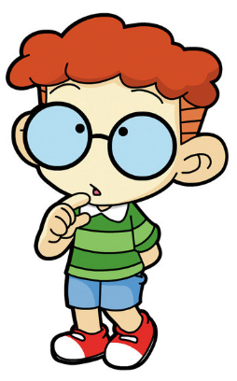
I can say
I have …
There is/are …

Slide 3
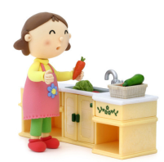
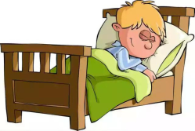
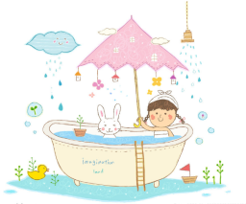
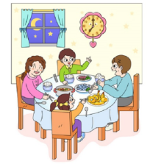
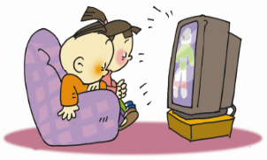
Do and say

Slide 4
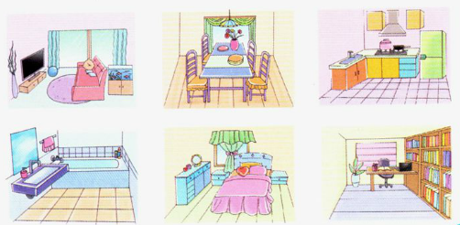
Look and circle
Where do you watch TV?

Slide 5
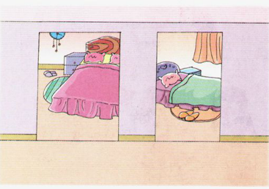
How many bedrooms are there in Picture 1?
There are two bedrooms.
Are they nice?
Yes, they are.

Slide 6
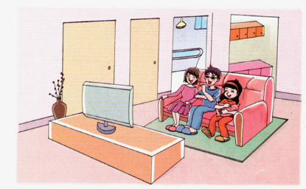
Is there a living room in Picture 2?
Yes, there is.
Is it beautiful?
Yes, it is.
Where do they watch TV?
They watch TV in the living room.

Slide 7
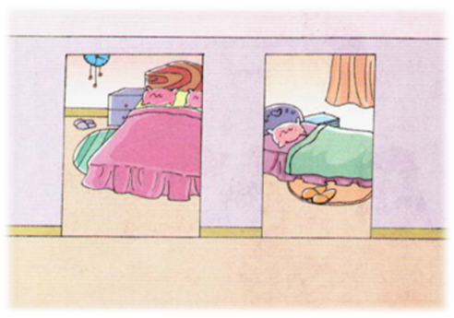
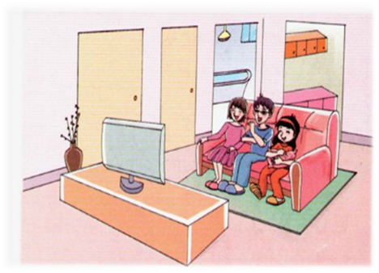
Let’s learn

Slide 8
This is our new house. There are two bedrooms.
The big one is for my mom and dad.
My bedroom is small. They are nice.

Slide 9
Our living room is not big, but it’s beautiful.
We often watch TV there.
There is a kitchen and a bathroom, too.
They are clean.

Slide 10
too的用法总结
1. too用于肯定句句末时，其前面加逗号(口语中可省略逗号)，表示“也、还”之意。
如：I like swimming, too.我也喜欢游泳。
2. too修饰形容词或副词，做程度副词时，表示“太，过分”之意。
如：He speaks too fast.他讲话太快。
3. too也可用在口语中，表示“真是、很、非常(=very)”之意。
如：I’m too happy. 我非常幸福。

Slide 11
Read it by yourselves for one minute .
自读课文一分钟。
一分钟倒计时
60
Learning tip :
50
10
当你自己朗读时，遇到不会读或不明白意思的单词或句子，可以把它圈起来，请教同学或老师！
20
40
30
开始

Slide 12
Read in groups
以小组为单位，选择一种喜欢的方式读一读课文。
Read together.
(齐读)
Read in pictures.
(分图读)
Read your favorite
animal.(自己选一幅读)

Slide 13
Look and say
Retell in groups

Slide 14
Read again. Then tick or cross.
√
( ) 1. Our bedrooms are nice.
×
( ) 2. The living room is big and beautiful.
√
( ) 3. There is a kitchen and bathroom in
our new house.
√
( ) 4. We often watch TV in the living room.

Slide 15
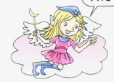
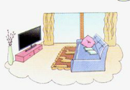
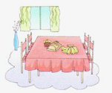
The living room is big.
living room/big
dining room/small but clean
The dining room is small
but clean.

Slide 16
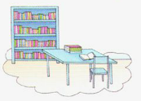
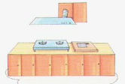
study / nice
The study is nice.
kitchen/clean
The kitchen is clean.

Slide 17
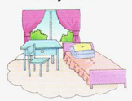
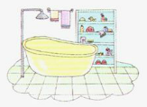
bedroom / beautiful
The bedroom is beautiful.
bathroom /not big but clean
The bathroom is not big but clean.

Slide 18
如何用形容词描述自己的家？
This is our new house.
The bedroom is small/beautiful...
The study is nice/big/clean...
The bedroom is small/beautiful...

Slide 19
1.听课文录音并跟读，按照正确的语音、语调朗读并表演课文对话。 2.回家向自己的父母描述自己的家，不少于3句话。
3.预习B Read a story。

