Slide 1
九年级英语上 新课标 [冀教]
Unit 6 Movies and Theatre
The Fisherman and the Goldfish(Ⅱ)
WWW.PPT818.COM

Slide 2
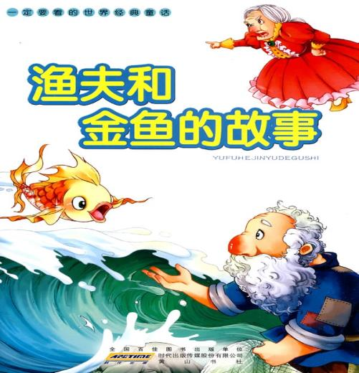

Slide 3
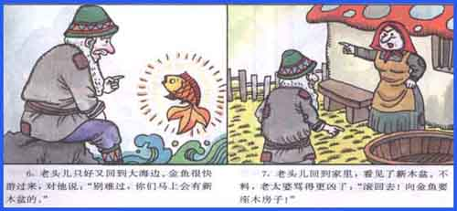

Slide 4
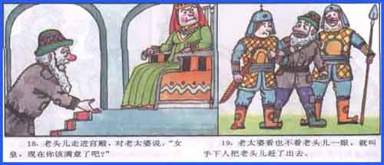

Slide 5
Think about it !
Which Characters in the play do you like? Which do you dislike?
What happened in the last lesson? Can you guess what will happen in this lesson?

Slide 6
New Words
coast
handbag
servant
serve
among
crash
guard
queen
mad

Slide 7
Read the lesson and tick the correct answers.
(1)What does the wife not ask for?
To be rich.
To be a queen.
To be a beautiful lady.
(2)What happens in the end when the wife keeps asking for more things?
She gets everything she wants.
The fisherman leaves her.
Everything is taken away.
(3)How many times does the fisherman go to see the goldfish?
Once.
Twice.
Three times.
√
√
√

Slide 8
Read the text and find out main phrases and sentences.
Main phrases:
·stand on the coast
·go off
·go on

Slide 9
Main sentences:
·No problem.
·How stupid you are!
·What else can I do for you,Mr. Fisherman?
·Could you please make my wife a rich lady?
·The wife is wearing beautiful new clothes and sitting among servants and guards.
·I want to be Queen of the Sea and all the fish should serve me!
·It’s too much.
·Go right now,or I will punish you!
·She also wants all the fish to serve her.
·The lights go on.

Slide 10
☆教材解读☆
1.The fisherman is standing on the coast,looking out towards the sea.
◆句中的looking out towards the sea是现在分词短语作状语,用在动词后表示伴随状况。
◆towards为介词,意为“向,往,朝着……的方向”。
2.No problem.
no problem表示同意、默许,意为“没问题”。
【拓展】 在日常用语中,当同意某人的观点或接受他人的请求时,可以用Of course./No problem./Certainly.等回答。在美式英语中,No problem.可用来回答感谢,意为“不用谢,别客气,没什么”,相当于You’re welcome.或Not at all.。

Slide 11
3.How stupid you are!
这是一个感叹句,英语中的感叹句通常由what或how来引导,结构为:
(1)How+形容词/副词+主语+谓语+其他!
(2)What(+a/an)+名词+主语+谓语+其他!
4.The lights go off.
go off在本文中意为“(灯)熄灭”,其反义词组为go on。
【拓展】 go off还可意为“(食物)变质,(质量)下降,(闹钟等)发出响声”。
5.What else can I do for you,Mr. Fisherman?
else常用在疑问代词、不定代词之后,意为“其他的,别的,另外的”。
【拓展】 else还可用在疑问副词之后。

Slide 12
6.Could you please make my wife a rich lady?
“Could you please+动词原形…?”意为“请你……好吗?”,表示委婉地提出请求或建议。
【拓展】 表示请求/建议的句型有:
(1)Will/Would/Could you please do sth.?
(2)Would you like to do sth.?
(3)Would you mind doing sth.?
(4)Why don’t you do sth.?/Why not do sth.?

Slide 13
7.The wife is wearing beautiful new clothes and sitting among servants and guards.
among意为“在……之间”,用于指在三者或三者以上的人或物之间。
8.It’s too much.
too much在这里意为“太过分,太糟糕,太不像话”。
【拓展】 too much还意为“太多”,修饰不可数名词。

Slide 14
9.Go right now,or I will punish you!
◆本句是“祈使句+and/or”结构,相当于“If…,…”结构。
◆right now意为“就在此刻,就在现在,马上,立即”。
◆punish为及物动词,意为“处罚,惩罚”,后接名词或代词作宾语。
10.She also wants all the fish to serve her.
◆句中的to serve her是动词不定式用在宾语all the fish后作宾语补足语。动词want,ask,tell,order,invite等都可接不定式作宾语补足语。
◆serve在本句中为及物动词,意为“服务”,接名词、代词作宾语,其名词形式为service。

Slide 15
Practice
Ⅰ.Fill in the blanks with correct prepositions or adverbs.
1.A man is running us! What’s happening?
2.All the lights in the building go after 11:00 p.m.
3.The lights came back when the actor went on stage.
4.A:Where is your grandfather?
B:Look!He’s working the trees.
5.A:What can you hear the background?
B:The sound waves.
towards/to/after
off
on
in front of/behind
in
of

Slide 16
Ⅱ.Complete the passage with the correct forms of the words in the box.
queen,among,mad,guard,enter,serve
all the types of movies,I like fantasies best.Recently I saw a movie called The Chronicles of Narnia,which is based on series of novels.There are four children in the movie.By chance,they a fantastic world called Narnia.There,they meet the White Witch,who has a lot of and servants.She tries to control Narnia and orders people to and obey her.She is at the children and wants to kill them.In the end,the four brave children beat the White Witch and succeed in protecting Narnia.They also become the kings and the of Narnia.
Among
enter
guards
serve
mad
queens

Slide 17
Ⅲ.根据汉语意思完成句子
1.所有的灯晚上十点后熄灭。
All the lights after 10:00 in the evening.
2.海岸上的这些信号灯是用来提醒和指引船舶的。
These beacons are used to warn and guide ships.
3.他是多么愚蠢的渔夫啊!
fisherman !
4.为什么不向金鱼要一座宽敞的房子?
the goldfish a wide house?
5.她给我端上了一杯咖啡。
She a cup of coffee.
go off
on the coast
What a stupid
he was
Why not ask
for
served me

Slide 18
Homework
1.Finish off the exercises in the activity book.
2.Preview Lesson 35.

