Slide 1
What does your mother do?
Unit3 Topic 2
Section B
WWW.PPT818.COM

Slide 2
A: What does she do?
B: She is a teacher.

Slide 3
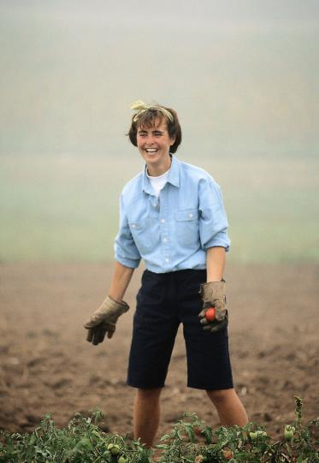
A: What does she do?
B: She is a farmer.

Slide 4
A: What does she do?
B: She is a driver.
PPT模板：www.1ppt.com/moban/ PPT素材：www.1ppt.com/sucai/
PPT背景：www.1ppt.com/beijing/ PPT图表：www.1ppt.com/tubiao/
PPT下载：www.1ppt.com/xiazai/ PPT教程： www.1ppt.com/powerpoint/
资料下载：www.1ppt.com/ziliao/ 范文下载：www.1ppt.com/fanwen/
试卷下载：www.1ppt.com/shiti/ 教案下载：www.1ppt.com/jiaoan/
PPT论坛：www.1ppt.cn PPT课件：www.1ppt.com/kejian/
语文课件：www.1ppt.com/kejian/yuwen/ 数学课件：www.1ppt.com/kejian/shuxue/
英语课件：www.1ppt.com/kejian/yingyu/ 美术课件：www.1ppt.com/kejian/meishu/
科学课件：www.1ppt.com/kejian/kexue/ 物理课件：www.1ppt.com/kejian/wuli/
化学课件：www.1ppt.com/kejian/huaxue/ 生物课件：www.1ppt.com/kejian/shengwu/
地理课件：www.1ppt.com/kejian/dili/ 历史课件：www.1ppt.com/kejian/lishi/

Slide 5
A: What does he do?
B: He is an office worker.

Slide 6
A: What does she do?
B: She is a doctor.

Slide 7
A: What does he do?
B: He is a student.

Slide 8
A: What does she do?
B: She is a nurse.

Slide 9
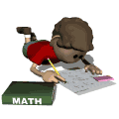
I am a teacher.
I work in a school.
What do you do?
Where do you study?
I am a student.
I study in a school.

Slide 10
1 a
Look, listen and say

Slide 11
Listen to 1a and match the picture with Maria’s parents’ jobs and workplaces.
doctor
office
nurse
restaurant
farm
cook
hospital
farmer

Slide 12
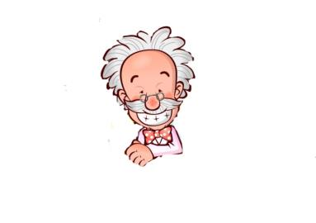
Work in pairs
What does he do?
Where does he work?
He is a doctor.
He works in a hospital.
doctor

Slide 13
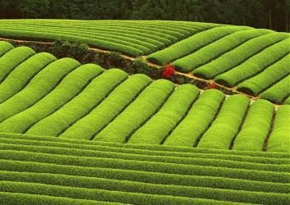
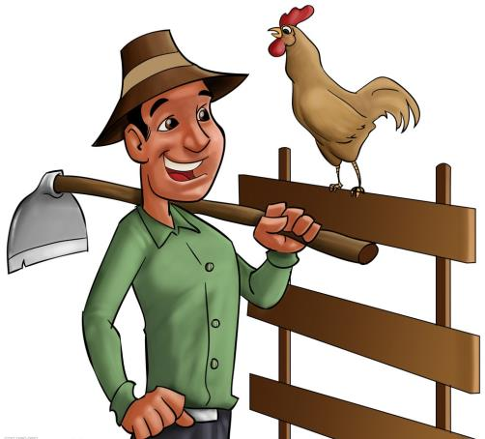
What does he do?
He is a farmer.
Where does he work?
He works on a farm.

Slide 14
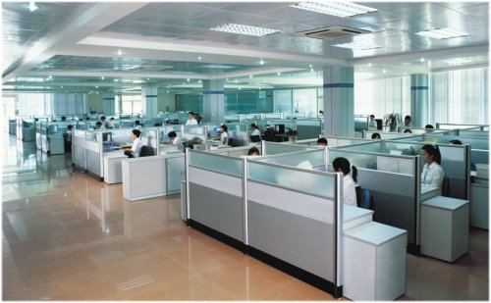
What does she do?
Where does she work?
She is an office worker.
She works in an office.

Slide 15
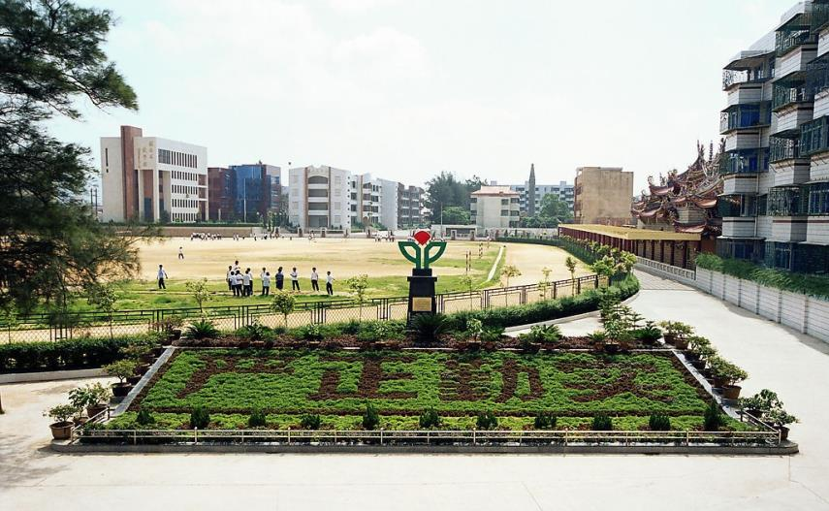
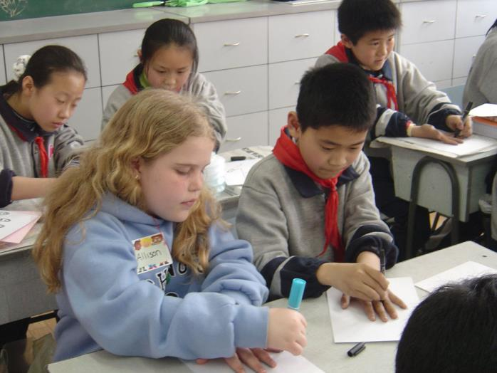
What do they do?
Where do they study?
They study in a school.
They are students.

Slide 16
用do/does填空。
1. What ________your brother do?
2. Where ________Maria study?
3. What ________Kangkang and Michael do?
4. Where________ they work?
5. What _______Jane’s classmate do?
6. What _______Jane’s classmates do?
does
does
do
do
does
do

Slide 17
v.＋-er/-or n.
If you understand word
formation, you will be able to
learn words more easily.

Slide 18
Have a try!
She works in a hospital. But she isn’t a doctor.
What does she do? She is ________.
2. She studies in a school. She is __________.
3. We works on a farm. We are __________.
4. He drives a bus. He is _________.
5. They work in an office. They are____________.
a nurse
a student
farmers
a driver
office workers

Slide 19
3
Work alone
Listen and match the people’s names with the cities. Then listen again and write down their jobs.
Fuzhou
Shenzhen
Nanjing
Beijing
David
Lisa
Paul
Danny
________
________
________
________
doctor
nurse
driver
teacher

Slide 20
Group work
Survey your classmates parents' jobs and workplaces.
Person | What does he/she do? | Where does he/she work?
Student A
Student B
Student C
Notes:
20

Slide 21
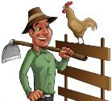
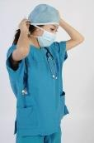
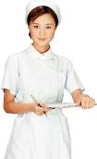
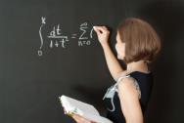
Game
学生动手做如图所示转盘，用笔当指针,转动转盘，当停住时，相互问答。
Student
Nurse
Office worker
Teacher
Doctor
Farmer
7

Slide 22
Summary
What does she do?
She is a nurse.
What do they do?
They are office workers.
Where does he do?
He works in a school.
Where do they work?
They work in a hospital.

Slide 23
Homework
1. Recite the dialogue in 1a.
2. Make a survey about what your friend’s parents do and where they work
3. Preview Section C.

