Slide 1
Unit 2 Topic 1
Pollution has caused too many problems .
Section D
WWW.PPT818.COM

Slide 2
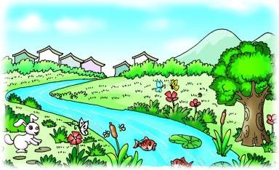
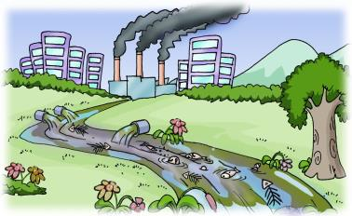
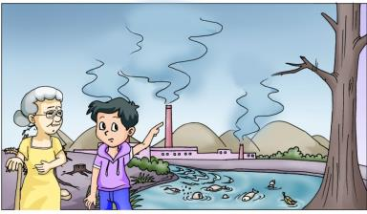
It _____ (be) beautiful in the past. Kangkang _______ (go) there two years ago.
was
went
Simple past 强调过去
The flowers and grass ___________ (go).
Everything _____________ (change).
have gone
has changed
They are caused
by pollution.
Present perfect 强调现在
Mrs. Zhou ____________ (be) like this since last week.
She ______________ (not see) a doctor yet.
has been
hasn’t seen

Slide 3
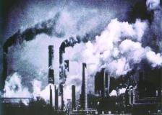
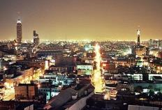
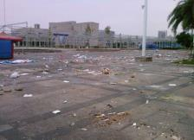
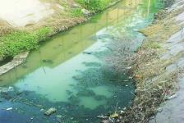
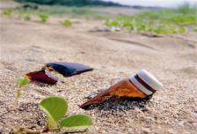
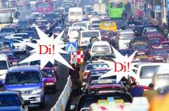
There are many kinds of pollution around us,
including
air pollution
light pollution
litter
water pollution
soil pollution
noise pollution

Slide 4
Read through Sections A-C and fill in the blanks with the correct words.
Grammar
Simple Past ＆Present Perfect
I _____ (go) there two years ago.
There ______ (be) lots of flowers and grass.
What _________________ (happen) here?
went
I have ______ (be) like this since last week.
The flowers and grass ____________ (go)!
been
were
have gone
has happened

Slide 5
Functions
Oh, what a _______!
There are several chemical factories _______ waste water into the stream.
What’s ______, the factory makes too much noise…
Noise is _________ to human’s health.
People who work and live in noisy conditions often ______ deaf.
…many teenagers in America can hear no ______ than 65-year-old people do, …
…does great _______ to people’s hearing.
shame
pouring
worse
harmful
go
better
harm

Slide 6
How well do you know Sections A-C? Now do the following tasks and check.
Read 1a and choose the best answer.
( ) 1. What is the passage mainly about?
A. Air pollution. B. Light pollution.
C. Litter. D. All sorts of pollution.
( ) 2. ________ destroy(s) the soil.
A. Chemicals B. Weather
C. Noise D. Industry
( ) 3. How do people feel after they work in strong light for
a long time?
A. Excited. B. Happy.
C. Terrible. D. Sad.
D
A
C

Slide 7
1a Read the passage and complete the table on Page 34.
Pollution | Cause | Effect
air pollution | burning_____, _____ and _____ | _____ eyes and _________ problems
soil pollution | _____ is everywhere, use too many __________ | ______ environment and _________ food
noise pollution | _______________ place for a long time | make people _____ and cause ____________ pressure
light pollution | _______ light | kinds of ________, bad for ________
gas
sore
oil
coal
breathing
litter
dirty
unhealthy
chemicals
work in a noisy
deaf
high blood
illnesses
strong
eyes

Slide 8
1b Read and understand the first sentence. Then complete the second one.
1. They are bad for our health in many ways.
They ____________to our health in different ways.
2. People may lose their hearing if they work in a noisy
place for a long time.
If people work in noisy conditions for a long time they
may have ______________.
3. Noise pollution can make people deaf.
People may ______ deaf _____________ noise pollution.
do harm
/ are harmful
hearing loss
go
because of

Slide 9
Complete the passage according to 1a.
There are many __________ of pollution around us. They are ______ for our health in many ways.
Air pollution causes _____ eyes and __________ problems. ______ makes our environment dirty. Soil pollution ________ the soil and _______ unhealthy food. Noise pollution makes people ______ and causes high blood pressure. Light pollution is bad for _____ and causes some kinds of __________.
With less pollution, our planet will become _______ and our health will be better. Let’s be greener people.
kinds/sorts
bad
sore
breathing
Litter
destroys
causes
deaf
eyes
illnesses
greener

Slide 10
Language points
1. Burning gas, oil, coal creates air pollution.燃烧气体、石油和煤都会造成空气污染。
create v. 造成，创造
creative adj. 创造性的
creation n. 创造；创造物
2. In the fields, farmers use too many
chemicals which destroy the soil.
在地里，农民使用了太多对土壤起破坏作用的化肥和农药。
定语从句

Slide 11
Language points
3. Too much noise can cause high blood pressure as well.噪声太大也可能导致高血压。
high blood pressure 高血压
as well 也, 还
e.g. We’re going to the party tonight.
Why don’t you come along as well?

Slide 12
Language points
4. With the increase in population and the development of industry, litter is everywhere.
随着人口的增加和工业的发展，垃圾到处都是。
5. With less pollution, our planet will become
greener and our health will be better.
随着污染的减少，我们的地球将变得更加环
保，我们也会更健康。

Slide 13
More tasks.
Phrase collection
pour… into…
把……倒入…… ___________________
have got a pain in… ___________________
throw around ___________________
对……有害 ___________________
not all people ___________________
go deaf ___________________
丧失听力 ___________________
和……（几乎）一样坏 ___________________
disturb others ___________________
各种各样样的 ___________________
在很多方面 ___________________
……疼
乱扔
be harmful to
= do harm to
不是所有人
变聋
lose one’s hearing
= have hearing loss
no better than
打扰别人
all sorts/kinds of
in many ways

Slide 14
More tasks.
Conversation
e
Mary: Excuse me. ______ I haven’t seen him for weeks.
Bill: Jim’s gone to England.
Mary: Really?______
Bill: He went there last week.
Mary: ______
Bill: For three times.
Mary: ______
Bill: He traveled with his friends.
Mary: ______
Bill: He will be away for about two weeks.
Mary: Oh, thank you. I’ll phone him this evening.
a
b
d
c
a. When did he go there?
b. How many times has he been there?
c. How long will he be away?
d. Who did he travel with?
e. Where’s Jim?

Slide 15
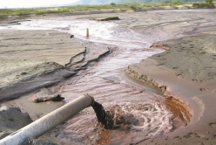
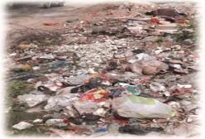
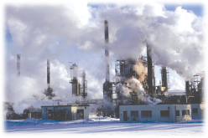
Project
Making a Wall Newspaper About Pollution
1. Collect some pictures about pollution.
2. What kind of pollution does each picture show? Work
in groups and discuss its bad effects.
3. Make a wall newspaper about different kinds of
pollution and the harm caused by them.

Slide 16
Exercises
根据汉语意思完成句子。
1. 如今，很多人患有高血压。
Nowadays, many people have _____ ______ ________.
2. 动物可以在很多方面帮助人们。
Animals can help people ____ ____ ______.
3. 迈克会打篮球，他跑步也很快。
Mike can play basketball. He runs fast ____ ______.
4. 随着工业的发展，污染越来越严重。
____ ____ ____________ ___ industry, pollution has
become _____ _____ _____ serious.
high blood pressure
in many ways
as well
With the development of
more and more

Slide 17
Exercises
单项选择
( ) 1. Linda has many hobbies, ________ listening to music, collecting coins, going cycling and so on.
A. for example B. including
C. about D. and
( ) 2. There is ______ pollution in the world. We must stop it.
A. much too B. too much
C. many D. too many
( ) 3. _______ the increase in population, food has become a serious problem.
A. And B. By
C. To D. With
( )4._____ the environment is important for human beings.
A. Take care of B. Took care of
C. Taking care of D. Take the care of
B
B
D
C

Slide 18
summary
We learn:
1. Some words:
coal, create, blood, planet
2. Some phrases:
in many ways, high blood pressure, as well
3. Some sentences:
With the increase in population and the
development of industry, litter is everywhere.
We can:
1. Make a wall newspaper in English.
2. Tell the differences between Simple Past
and Present perfect.
I went there two years ago.
I have been like this since last week.

Slide 19
Homework
1. Read 1a.
2. Make a wall newspaper about pollution.
3. Finish Section D in your workbook.
4. Preview Section A in Topic 2.

