Slide 1
Unit2 Be Helpful at Home！
第1课时
WWW.PPT818.COM

Slide 2
>>Warm-up
Let’s read.
1. What time do the rabbits eat breakfast?
It’s seven o’clock.
2. What time do the rabbits clean up?
It’s three o’clock.
（单击图片可播放动画）

Slide 3
>>Lead-in
Free talk.
Who make breakfast in your home?
Who clean the room in your home?

Slide 4
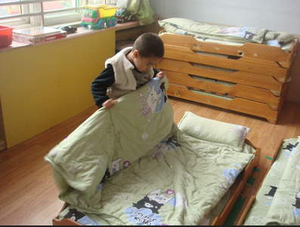
>>Presentation
Let’s learn.
make the bed

Slide 5
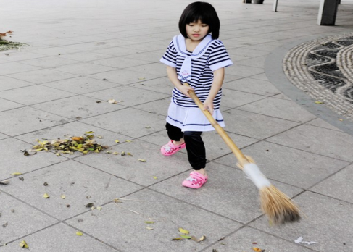
>>Presentation
Let’s learn.
sweep the floor

Slide 6
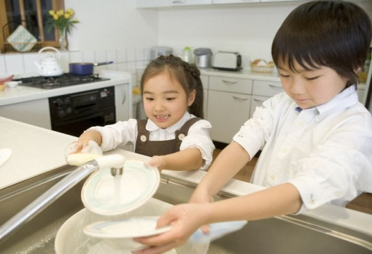
>>Presentation
Let’s learn.
do the dishes

Slide 7
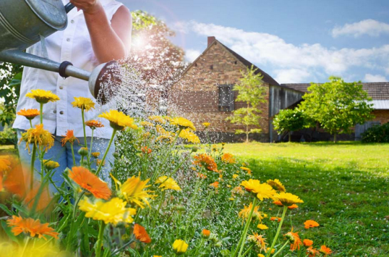
>>Presentation
Let’s learn.
water the flowers

Slide 8
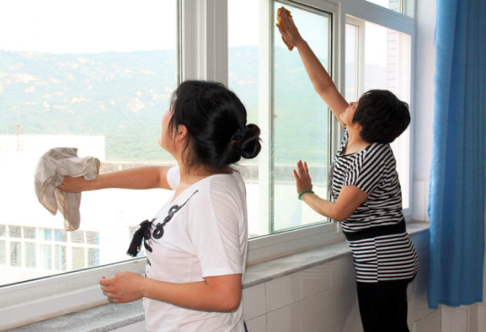
>>Presentation
Let’s learn.
clean the windows

Slide 9
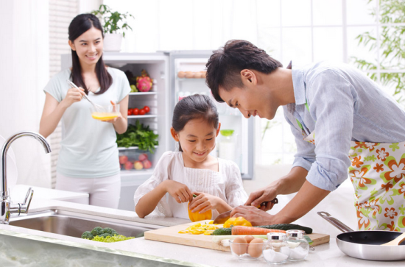
>>Presentation
Let’s learn.
cook the meal

Slide 10
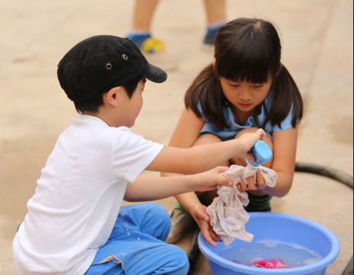
>>Presentation
Let’s learn.
wash the clothes

Slide 11
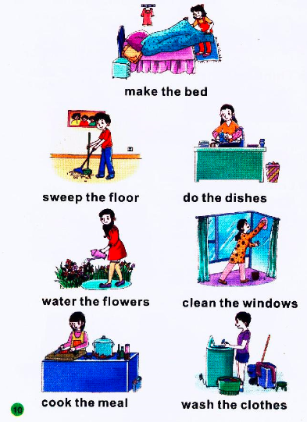
>>Practice
High-low voice.

Slide 12
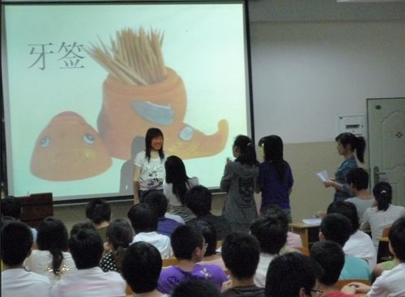
>>Practice
I do, you guess.

Slide 13
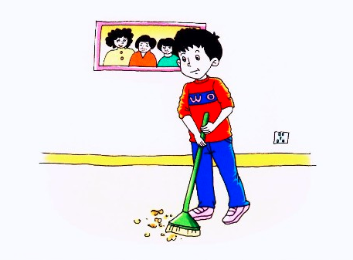
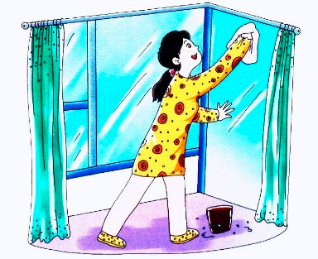
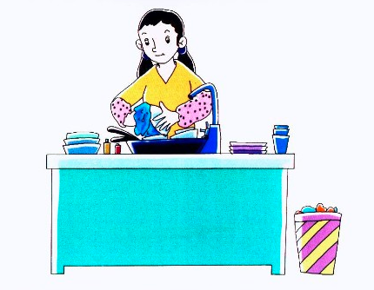
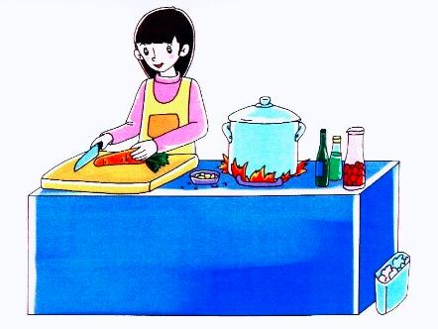
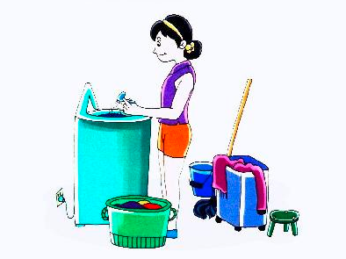
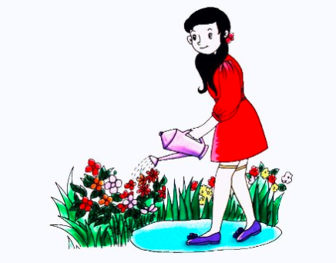
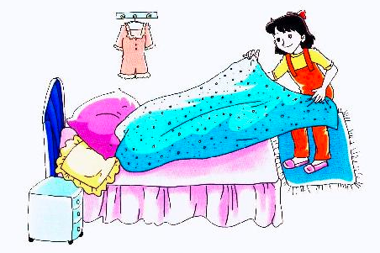
>>Practice
I do, you guess.

Slide 14
>>Practice
Flash cards.

Slide 15
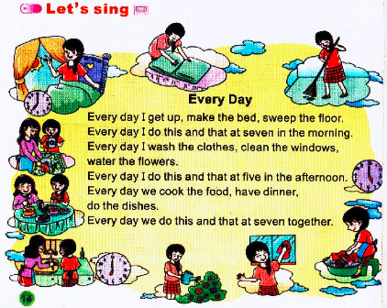
>>Consolidation
Let’s sing.
点击喇叭，播放录音

Slide 16
>>Summary
make the bed
sweep the floor
do the dishes
water the flowers
clean the windows
cook the meal
wash the clothes

Slide 17
>>Homework
1. 听课本第14页Let’s sing歌曲录音3遍。
2. 7个短语，每个短语抄写三遍。
close

