Slide 1
Module 3 Unit 1
I took some photos.
WWW.PPT818.COM

Slide 2
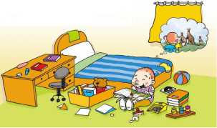
创设情境
Let’s chant
Last Sunday, I cleaned my room.
I found a book about the kangaroo,
the lion, tiger and monkey, too!
So I closed the book and went to the zoo.

Slide 3
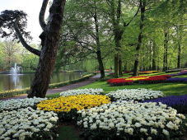
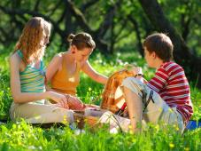
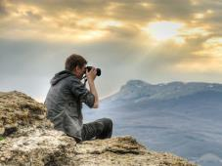
启发思考
What are you going to do on holidays?
go to park
have a picnic
take photos

Slide 4
What did you do last weekends?
went to park
had a picnic
took photos

Slide 5
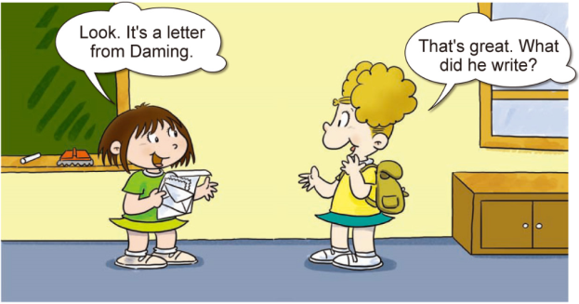
自主或小组探究
Lingling has got a letter from Daming. Now let’s learn this letter. Let’s look what Daming did.

Slide 6
Find the simple past tense!
Regular forms
wanted
started
rained
stopped
Irregular forms
had-have
went-go
brought-bring
took-take
left-leave
was/were-be

Slide 7
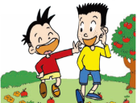
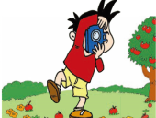
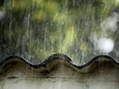
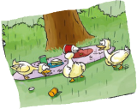
Find the plot!
We went to park.
I took some photos.
It started to rain.
Ducks had a picnic.

Slide 8
Ask and answer
1. When did Daming have a funny day?
He had a very funny day on Saturday.
2. When it started to rain, what did they do?
They ran quickly to hide and left their food.
3. What had a picnic?
The naughty ducks.

Slide 9
协作交流
Write about your last weekend and talk about it. You must use the following words.

Slide 10
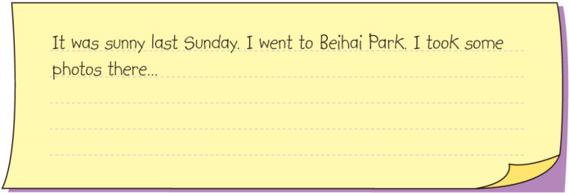

Slide 11
总结提高
1. 一般过去时主要表示过去某时发生的动作或情况。一般过去时由动词的过去式表示。
2. 动词be的过去式有：was/were
助动词do的过去式是：did
在构成否定句和疑问句时，一般都借助助动词did。

Slide 12
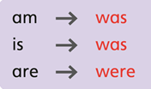

Slide 13
Homework
1.完成 配套练习。
2.记诵本课出现的生词，尤其是不规则动词。

