Slide 1
Unit 1
How can we become good learners?
Section B ( 第2课时)
WWW.PPT818.COM

Slide 2
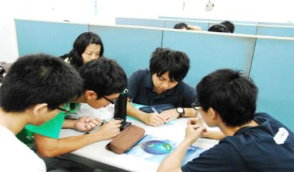
Revision
根据所给图示用适当的词汇完成句子。
working with friends
1.He learns English by _______ _________ ______.

Slide 3
listening to tapes
2.She learns English by _______ ______ _____.

Slide 4
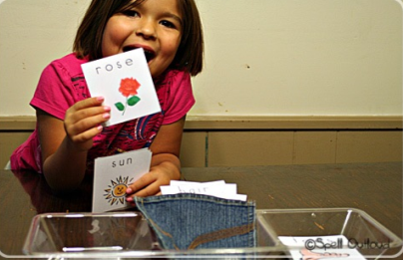
making word cards
3.She learns English by __________ _________ _________.

Slide 5
Your friend wants to improve his/her English and asks you for help.What are the three best ways to learn and why?Make some notes in the chart.
3a
Best ways to learn | Reasons | Examples
1.Being interested in what you do | If you are interested in something, your brain will be more active and... | If you like music, you can learn English by lisening to English songs.
2.
3.

Slide 6
Write a letter to your friend.Give him/her some advice about the best ways to learn English.Use your notes in 3a.
3b
Use the following expressions to help you:
There are three good ways to...
I think you should...
If you do this,you will...
It is also a good idea to...because...
You could try to improve your English by...
This will help you to...

Slide 7
Self Check
1 Fill in the blanks with the words in the box.
Are you stressed out each time you have a test?You don’t have to be if you________ smart study skills.Remember to ________ in class and review them on your own or with friends after class. Then _________ what you learned by doing exercises.Try to study and _______
information bit by bit instead of waiting ______ the last minute to study
_________ at once.If you _______ well for a test,then there’s nothing to ____________!
practice develop remember prepare
take notes until worry about everything
develop
take notes
remember
practice
until
everything
prepare
worry about

Slide 8
2 Number these sentences in order to make a
conversation.
_____What’s the matter?
_____Well,I practice my listening by listening to the tape over and over again until I can understand everything.
_____So you want to practice your listening?
_____Hi,Jake.I need your help.
_____Uh-huh.Do you have any advice?
_____OK,I’ll try that.
_____I have a listening test next week.
2
6
4
1
5
7
3

Slide 9
3 Give advice to these people.
1. Jane is a very slow reader.
She should improve her reading speed _________________.
2. Li Ming wants to improve his listening.
He could practice his listening _________________.
3. Meiping doesn’t know many English words.
She could learn more words __________________.
by reading word groups
by listening to tapes
by using dictionaries

Slide 10
Language Points
1. be born with
be born with意为“生而具有”。
e.g.:She was born with eyesight.
born in出生于……
e.g.:My little daughter was born in America.
2.But whether or not you can do this well depends on your learning
habits.但是你是否能把这做好取决于你的学习习惯。（教材第6页）
这句话中的主语是whether or not you can do this well,是由whether
引导的主语从句。
e.g.:Whether she is coming or not doesn't matter too much.

Slide 11
3. depend on
depend on取决于……
e.g.:You success depends on whether you work hard or not.
depend on还可译为“依赖；依靠”。
e.g.:Children depend on their parents for food and clothing.
4.Studies show that if you are interested in something,your brain is
more active and it is also easier for you to pay attention to it for a long
time.研究表明，如果你对某事感兴趣，你的大脑就会更活跃，你也更容易长时间关注它。（教材第6页）
(1)active adj.,活跃的，积极的，可作表语或定语。常用短语：take an
active part in积极参加

Slide 12
e.g.:Although he is over 80,he is still very active.
We all take active part in the sports meeting.
(2)pay attention to
pay attention to 意为“注意，关注”，其中to 是介词，后可接名词、代
词或动词-ing形式。
e.g.:You'd better pay attention to this word in the English exam last time.
5. Good learners often connect what they need to learn with something
they are interested in.好的学习者常常将他们需要学习的东西与之感兴趣的东西联系起来。（教材第6页）
connect…with…意为“ 把……和……联系起来”， 其名词形式为connection,意为“连接；关系”。
e.g.:Please don’t connect this person with that person.

Slide 13
6.Good learners think about what they are good at and what they need to practice more. 好的学习者考虑他们擅长什么和需要多练习什么。（教材第6页）
(1)think about意为“考虑”，其后接名词、代词、动词-ing形式或宾语从句。
e.g.:They are thinking about a serious problem.
(2) be good at擅长=do well in在某方面做得好
e.g.:He is good at English.=He does well in English.
7.Even if you learn something well,you will forget it unless you use it.即使
是你学得好的东西，如果有一天你不使用它，你就会忘记它。（教材第6页）
(1)even if意为“即使；尽管”，用于引导让步状语从句，有退一步设想的意味，等于even though。

Slide 14
e.g.:I'll help you,even if I must stay up the whole night.
(2)forget后直接跟名词、代词、动词不定式或动词的-ing形式，但两者
意义完全不同。
【辨析】forget to do sth.与forget doing sth.
forget to do sth.忘记去做某事（未做）
forget doing sth.忘记做过某事（已做）
e.g.:I forget to turn off the light.
I forget turning off the light。

Slide 15
8.They also look for ways to review what they have learned.他们也设法复习已经学过的知识。（教材第6页）
(1)look for 意为“寻找” 后跟名词或代词作宾语。
e.g.:They are looking for the missing child.他们在寻找失踪的孩子。
(2)辨析：look for, find与 find out
look for寻找，强调寻找的动作和过程，是有目的的寻找。
find找到，发现，通常指找到或发现具体的东西，强调结果。
find out弄清，查明，多指通过调查、询问后搞清楚、弄明白，含经过困难、曲折的意味。

Slide 16
Homework
How do you learn English,math or Chinese? What’re your problems? Write at least five ways and problems.

Slide 17
Thank you!

