Slide 1
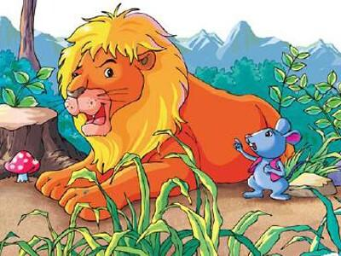
Unit 1
The lion and a mouse
第一课时
WWW.PPT818.COM

Slide 2
Introduce
A: Hello, boys and girls!
B: Hello, Miss Tang.
A: Nice to see you.
B: Nice to see you, too.

Slide 3
Words
lollipop [ˈlɒlipɒp]
作为名词，意为：“棒棒糖 ”。
eg：If you'll be making lollipops, remember to buy some lollipopsticks as well.
如果你要做棒棒糖，别忘了还要买些棒棒糖棍哟。
小练习：所给词的适当形式填空：
He wants to buy some _______ (lollipop).
拓展：sweets也表示糖果，而sweet表示甜的
eg：I love sweet sweets but Mum doesn‘t let me have them.
我爱吃非常甜的糖，可妈妈不让我常吃。
(2) I love sweet foot.我喜欢甜食。
lollipops

Slide 4
Words
buy [baɪ]
作动词，意为“买”。
eg：He buys a toy car.他买了一个玩具汽车。
固定搭配：买某物给某人：buy sb sth =buy sth for sb
eg： He buys a book for me. 他给我买了一本书。
He buys me a book. 他给我买了一本书。
小练习：根据中文提示完成句子：He _____(买) a pie every morning.
buys

Slide 5
Expressions
What will he say? 他将说什么？
作情态动词，意为“将要”，后面接动词的原形。
eg：He will buy a new car. 他将买一个新汽车。
小练习：单项选择：（ ）He will ____ (go) to playground.
A: go B: goes
拓展：be going to+动词原形”表示即将发生的或最近打算进行的事。
eg：He is going to play basketball.= He will play basketball. 他将要打篮球。
A

Slide 6
Expressions
What do you want to buy? 你想要买什么？
want to do sth. 表示想要干某事
eg：I want to play cards.我想打牌。
小练习：所给词的适当形式填空：Helen wants ____ (be) a doctor.
拓展：would like也表示想要干某事。
eg：He would like some apples. 他想要一些苹果。
He’d like to have a PE lesson. 他想上一节体育课。
to be

Slide 7
Dialogue
What are you going? To the sweet shop.
你将要去哪儿？去甜品店。
What do you want to buy? A lollipop.
你想要买什么？一个棒棒糖。
Who is it for? The boy over there.
它是给谁的？那儿的男孩。
What will he say? It doesn’t matter.
他将说什么？没关系。

Slide 8
Summary
lollipop
buy
What will he say?

Slide 9
Exercise
写出下列单词的适当形式
1.happy (副词) ________
2.sad （副词）________
3.quiet （副词）________
4. bite （过去式）________
5.say（过去式）________
6.let（过去式）________
7.wake （过去式）________
8.catch过去式）________
happily
sadly
quietly
bit
said
let
woke
caught

Slide 10
Exercise
改错
1. I and mum go to supermarket every day . ________
2. He brings some eggs yesterday. ________
3. He’d like play games after class. ________
4. Mr. Wu teaches us English last term. ________ 5. She don’t do her homework last Sunday. ________
Mum and I
brought
to play
taught
didn’t

Slide 11
Exercise
左右栏配对，连线
1. What are you doing ? Some apples.
2. Please don’t eat me. OK.
3. What did you do ？ I’m doing my homework.
4. What would you like? We played football.

Slide 12
Homework
Name the animals.

