Slide 1
Unit 4
Finding your way
WWW.PPT818.COM

Slide 2
Words review
follow
path
have to
north
west
south
east
trip
kilometre
vt. 跟随；仿效
n. 小路，小径
不得不，必须
n., adj. & adv. 北，北方
n., adj. & adv. 西，西方
n., adj. & adv. 南，南方
n., adj. & adv. 东，东方
n. 旅行，旅游
n. (=km) <英>千米，公里
= <美>kilometer

Slide 3
north-west
north
north-east
west
east
south-west
south
south-east

Slide 4
N
请
你
帮
它
找
食
物。
W
E
S
a horse
east
south
east
south
east
east
north
west
south
west
south
east
west
south
south
grass

Slide 5
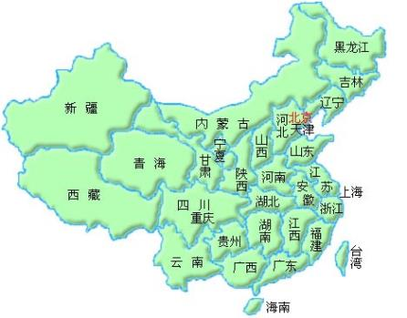
Hainan is in the of China.
Qinghai is in the of China.
Shanghai is in the of China.
Xinjiang is in the of China.
Taiwai is in of Fujian.
Heilongjiang is of Liaoning.
Yunnan is of Hunan.
south
west
east
north-west
south-east
north-east
south-west
north
east
west
south

Slide 6
Sum up
A is +方向 of B (A在B的什么方位)
上海在南京的东面
Shanghai is of Nanjing.
A is in the +方向 of B(A在B里面什么方位)
上海在中国的东面
Shanghai is of China.
east
in the east

Slide 7
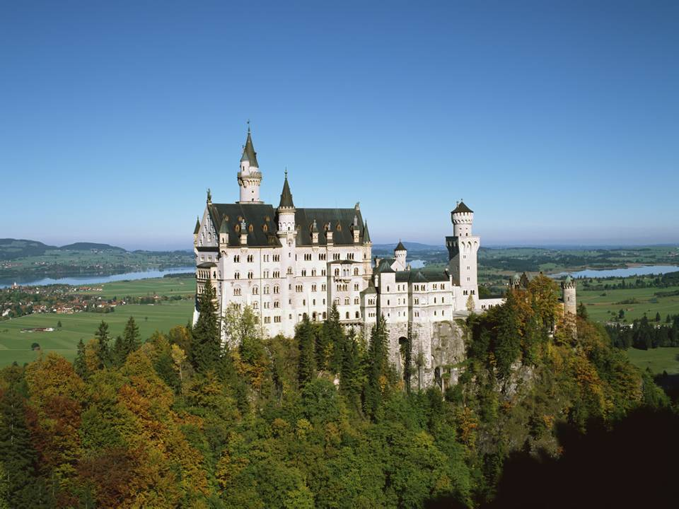
Do you like travelling?

Slide 8
Let’s go on a trip!

Slide 9
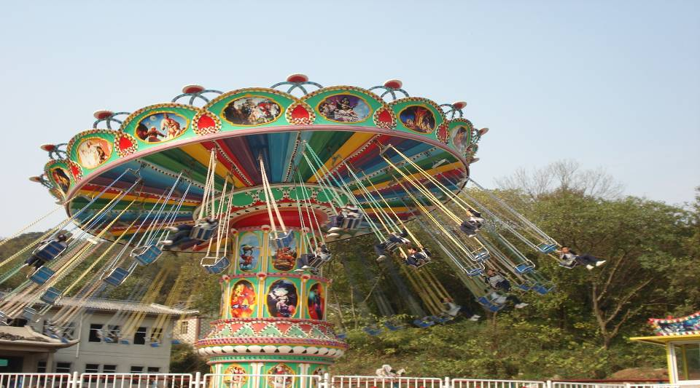
go on a trip
go on a picnic 去野餐
go on a visit 去参观
go on a trip 去旅行

Slide 11
The Jialefu is ______________ Xuzhou.
It is _________ Guohua Building.
The Jinying shopping mall is ________ Jialefu.
It is _________ Eye Hospital.
Pengcheng Square is ______________ Xuzhou .
It is_______________ Huaxia Bank.
in the north of
east of
south of
east of
in the centre of
north-west of

Slide 12
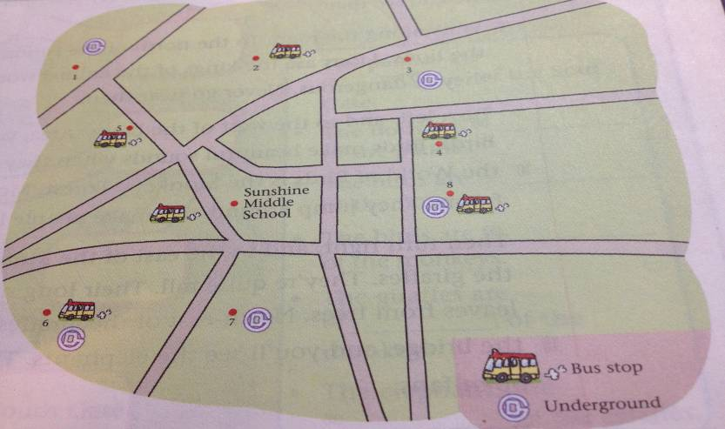
Sunshine Zoo
Sunny Garden
Sunshine Park
Lake Park
1、Sunshine Zoo is north of Sunshine Middle school. ( )
2
2、 Sunny Garden is west of the Zoo. ( )
1
3、 Lake Park is south of Sunny Garden.( )
6
4、 Sunshine Park is east of Lake Park.( )
7

Slide 13
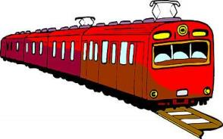
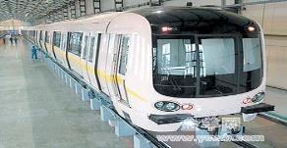
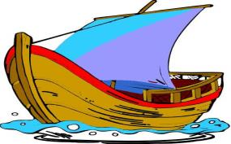
How do we get there?
by train
by plane
by car
by underground
by boat
by taxi
by bus

Slide 14
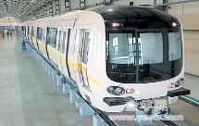
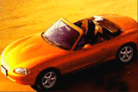
How do you usually go on a trip?
I usually go on a trip by bike.
by car.
by underground.
on foot.
by taxi.
by train.
by plane/air.
by ship/sea.
…

Slide 15
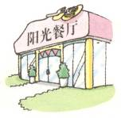
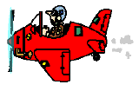
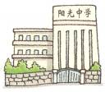
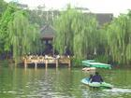
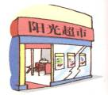
north-west
north
north-east
west
east
south-west
south
south-east

Slide 16
May Day is coming. Our class is going to organize a trip. Please make a plan trip with your partner.

Slide 17
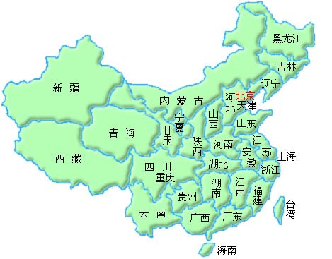
Make a dialogue
A: Let’s go to …
B: Good idea. But where is …?
A: It’s …of ….
B: How can we get there?
A: We can get there by….

Slide 18
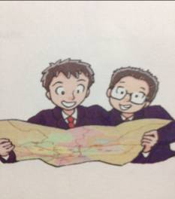
Daniel and Simon's trip
Where are they going?
2. Where is it?
3. How will they get there?
Sunshine Zoo.
It’s north of the school.
They will get there by bus.

Slide 19
Daniel: Where are we going for our class
____?
Simon: We’re going to Sunshine Zoo.
Daniel: Where’s the zoo? Is it ___ _____
from our school.
Simon: No. It’s ______ of the school, about
_____ kilometres away.
Daniel: How will we get there?
Simon: We’ll get there ___ ____.
trip
far away
north
three
by bus

Slide 20
Talk about a trip you want to go on
A: Where are we going for our trip?
B: We’re going to …
A: Where’s the …? Is it far away from … B: No. It’s north/south/east/west of …,
about … kilometres away.
A: How will we get there?
B: We’ll get there ...

Slide 21
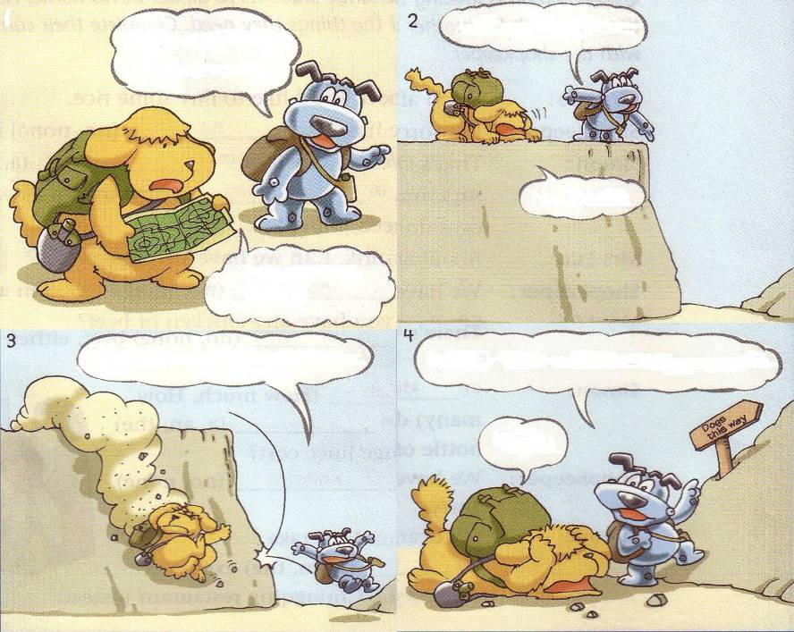
Video

Slide 22
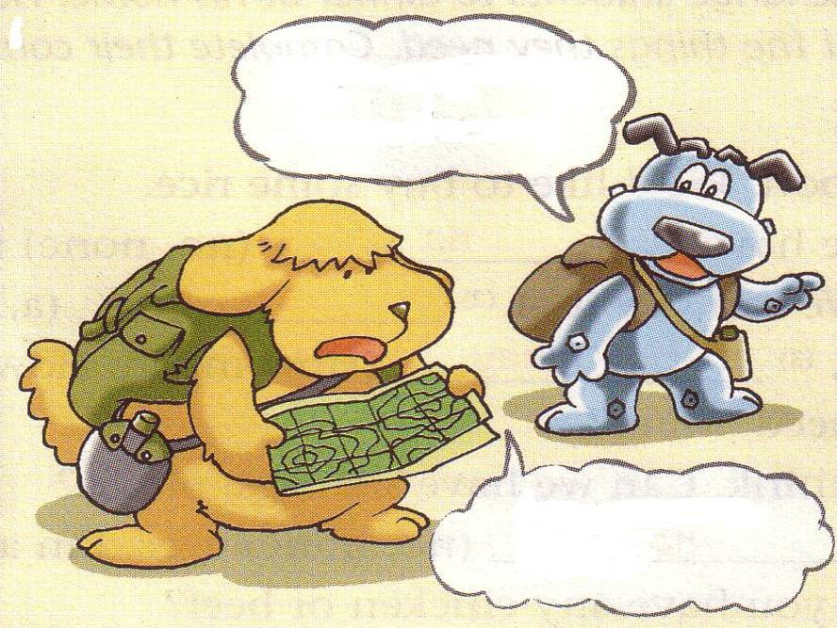
_________, Eddie.
Follow me
Are you sure
____________, Hobo?

Slide 23
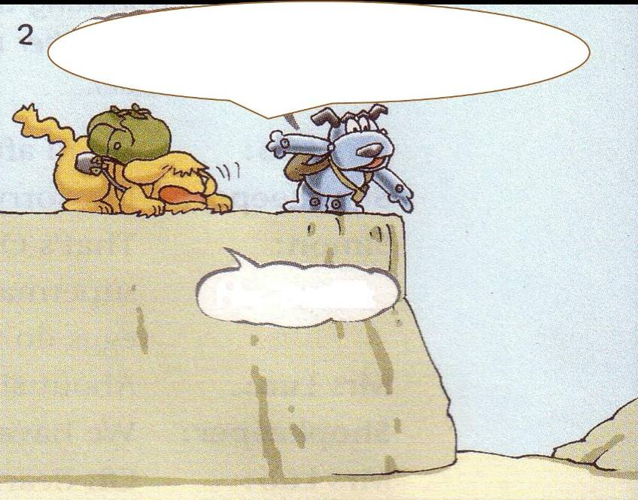
between
There’s a path _______ the hills. Let’s _______ here.
go down
No, I can’t.

Slide 24
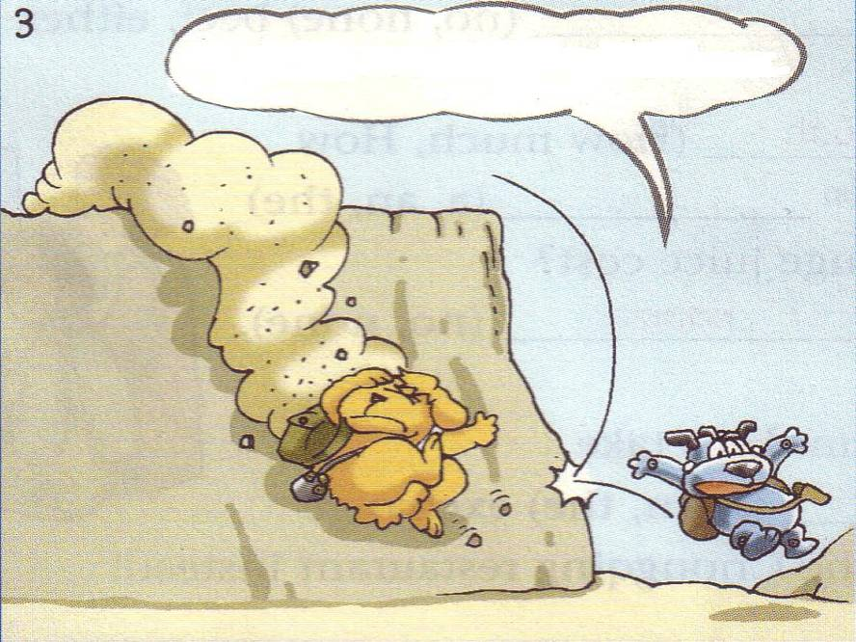
be afraid
Don’t ________. Come with me.

Slide 25
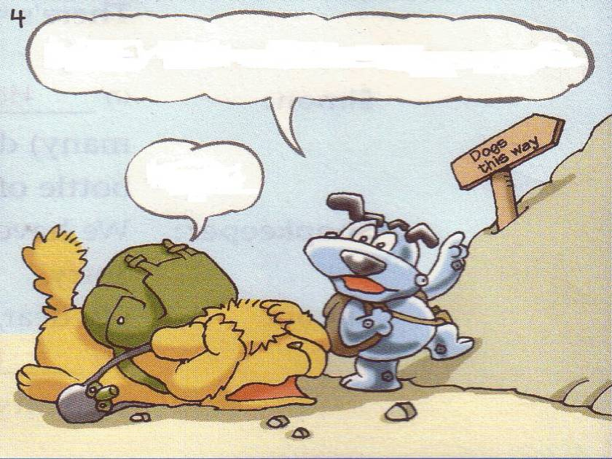
Eddie, I think we ______ go up again.
have to
Oh, no!

Slide 26
Comic strip
Read and answer the questions.
1. Where are Hobo and Eddie standing?
On top of a hill.
2. How does Hobo go down the hill?
Hobo jumps down.
3. What does the sign “Dogs this way” mean?
4. Do they have to go up the hill again?
Yes, they do.
Dogs should go along this way.

Slide 27
Fill in the blanks
Hobo and Eddie go on an outing.But Eddie doesn't know the ______ , so Hobo asks Eddie
to ________him. Hobo says he is______about the way .
First,he asks Eddie to go_______, but Eddie is very________.When they go down , Hobo finds the way wrong.So they _______to go up again.
How unlucky they are!
way
follow
sure
down
afraid
have

Slide 28
5. [知识点]
1.follow 跟随
请跟着我
夏天在春天后面
2. Are you sure, Hobo? be sure 确信，有把握
(1) be sure to do sth. 表示说话人推测“一定，必然会”。
天肯定会下雨。 It _____ ______ ______ rain.
(2) be sure + that从句，确信……
我确信我能比你跑得快。
I’m ________ ________ I can run faster than you .
Please follow me.
Summer follows Spring.
is sure to
sure that

Slide 29
5. [知识点]
Don’t be afraid.
①祈使句：e.g. (1) 上学不要迟到
(2) 不要再街上踢足球
②(1) be afraid of (doing) sth. 害怕（做）某事，表示“怕……”“担心……”
这个小孩怕狗。 The little boy ______ _______ ______ the dog .
(2) be afraid to do sth. 害怕做某事，着重指“因害怕而不敢做某事”。
夜间他不敢独自外出。 He ______ _______ _______ go out alone at night .
(3) be afraid ( that ) 从句表示“引出不好的消息或带有歉意的回绝：。
抱歉，我恐怕帮不了你。I ______ ______ ________ I can’t help you .
is afraid of
is afraid to
am afraid that

Slide 30
句型转换练习
1. Let’s enjoy Beijing opera here. (改为同义句)
____ ___ / _____ ___ enjoy Beijing opera here?
2. Be late for school. (改为否定句)
______ ___ late for school.
3. I think we can go there by underground. (改为否定句)
I _____ _____ we can go there by underground.
4. She goes to the zoo by bus. (对划线部分提问)
____ ____ she ___ to the zoo?
Why
not
Shall
we
Don’t
be
don’t
think
How
does
go

Slide 31
5. The Sunnyside Garden is north-west of the zoo.
(改为一般疑问句)
6. Simon walks to the supermarket. (改为同义句)
Simon ____ __ the supermarket ___ ____.
7. They go to the restaurant by bike. (改为同义句)
They ____ _____ to the restaurant.
Is the Sunnyside Garden north-west of the zoo?
goes to
on foot
ride bikes

Slide 32
把下列句子翻译成汉语：
1. Don’t be so sure. Let’s ask the teacher for help.
2. Don’t be afraid. We are all here to help you.
3. The zoo is north of Beijing Sunshine Secondary
School.
4. Tom is going up the hill.
5. Don’t do it like that.
6. Some people are afraid of dogs.

Slide 33
Homework
1.熟悉本课时所学内容。

Slide 34
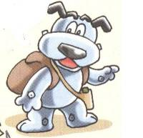
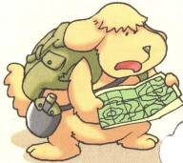
Answer
What are Eddie and Hobo doing ?
Do they have to go up the hill again?
Does Hobo really know the way?
They are finding their way.
Yes, they do.
No, he doesn’t.

