Slide 1
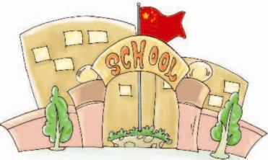
Unit3 How do you come to school?
陕旅版
三年级下册
第三课时
WWW.PPT818.COM

Slide 2
>>Review
Magic fingers
bus train ship
taxi foot school home

Slide 3
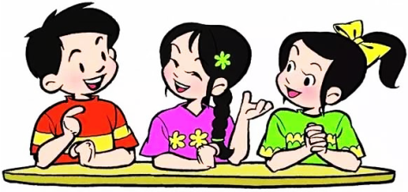
>>Review
Do you come to school on foot?
Yes, I do.
No, I don’t.
How do you come to …?
I come to …

Slide 4
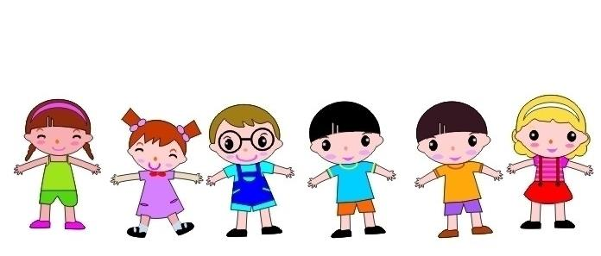
>>Warm-up
Act and say
Car, car, drive a car.
Bus, bus, take a bus.
Bike, bike, ride a bike.
Plane, plane, go by plane.
Train, train, take a train.
Ship, ship, go by ship.
Foot, foot, go on foot.

Slide 5
>>Presentation
Let’s learn
Lily: How do you go to …?
Tom: I go to school by car.
Lily: How does Tom go to school?
John: He goes to school by car.
1、主语是第三人称(男孩是he, 女孩是she).
答语要用对应的he或she, 其谓语动词+s或+es.
2、 主语若是第三人称(they)
答语要用对应的they，其谓语动词不变。

Slide 6
>>Practice
Let’s do it
They
He
goes
A: How do they come to school?
B: ______ come to school by car.
They
A: How does Lily go to school?
B: She ______ to school by car.
goes
A: How does Tom go to school?
B: ______ goes to school by car.
He

Slide 7
>>Presentation
Listen and answer
How does Li Shan go to the zoo?
She goes to the zoo by car.
Do her father and mother go to the zoo by car?
Yes, they do.
How do they go to the zoo?
They go to the zoo by car.

Slide 8
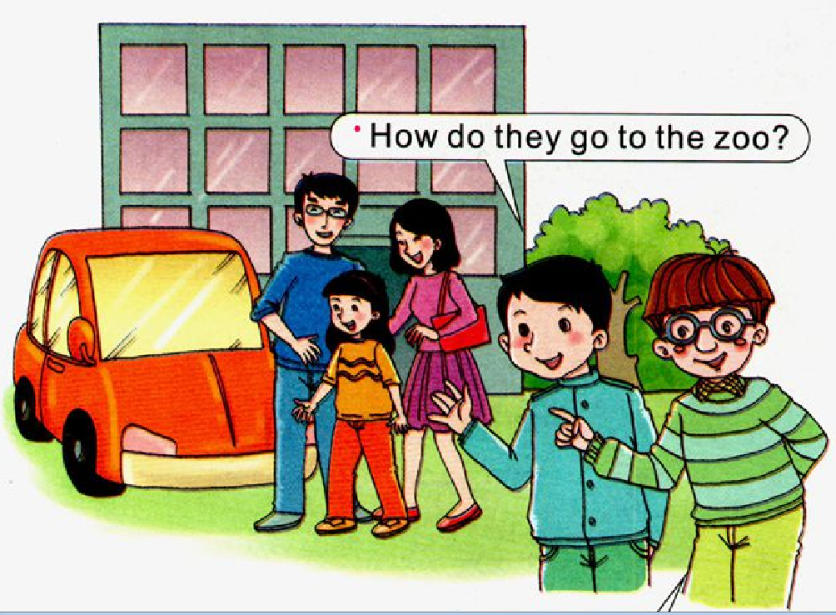
>>Presentation
Let’s learn more
They go to the zoo by car.

Slide 9
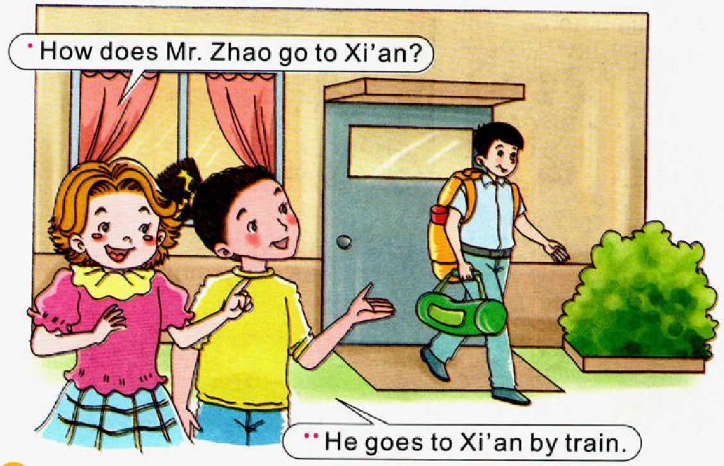
>>Presentation
Let’s learn more

Slide 10
>>Presentation
Let’s learn more
Read and imitate
Su Nan: How do they go to the zoo?
Kevin: They go to the zoo by car.
Alice: How does Mr. Zhao go to Xi’an?
Kitty: He goes to Xi’an by train.

Slide 11
>>Practice
Read it by yourselves for one minute .
自读课文一分钟。
一分钟倒计时
60
Learning tip :
10
50
当你自己朗读时，遇到不会读或不明白意思的单词或句子，可以把它圈起来，请教同学或老师！
20
40
30
开始

Slide 12
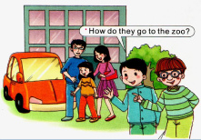
>>Practice
两人一组，先朗读再表演课文故事吧。
1
2
3
Read together.
(齐读)
Read in roles.
（分角色读）
Act in roles.
(分角色演）

Slide 13
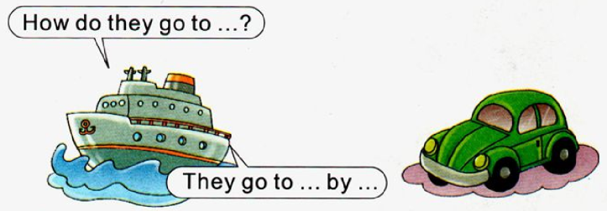
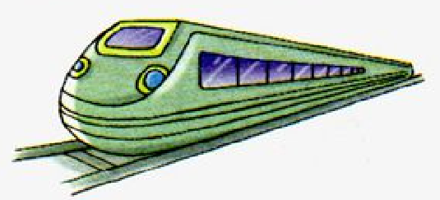
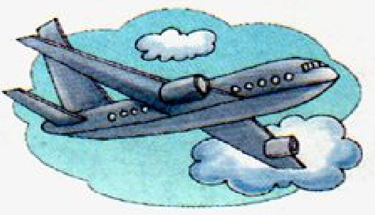
>>Practice
Ask and answer
Wu Chen and Mother /Hainan
my sister / school
my brother / Chengdu
Kitty and Father/ Hong Kong

Slide 14
>>Summary
本课的重点句型有哪些？
—How do they/does he go to …?
—They go/He goes to… by …
例如
—How do they go to school?
—They go to school by car.

Slide 15
>>Homework
1.听课文录音并跟读，按照正确的语音、语调朗读并表演课文对话。 2.熟读课文Let’s learn more并会背诵。
3.预习B Let’s sing。
close

