Slide 1
Module 5 Unit 2
It describes the changes in Chinese society.
WWW.PPT818.COM

Slide 2
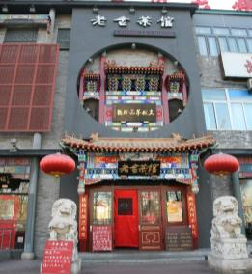
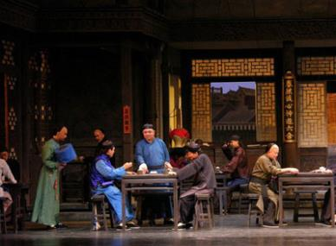
Lead-in
Enjoy some pictures.
Lao She’s Teahouse
customer

Slide 3
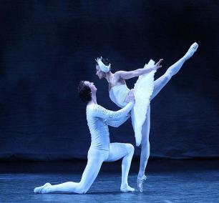
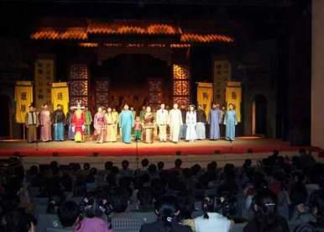
Presentation
act n. (戏剧、歌剧或芭蕾舞的)一幕

Slide 4
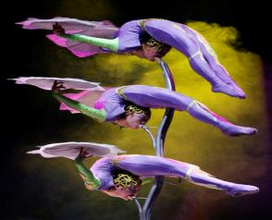
show v. 展示；显示 n. 演出；表演

Slide 5
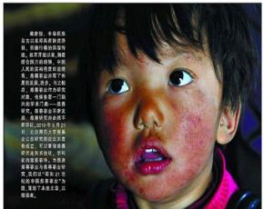
Chinese society

Slide 6
the Beijing Opera

Slide 7
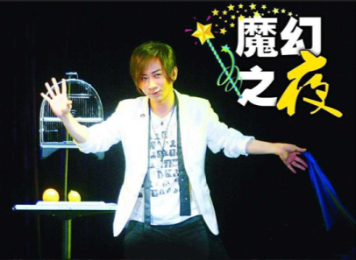
traditional music
magic shows

Slide 8
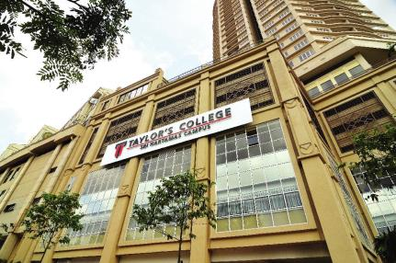
college
n. 大学；学院
novel
n. (长篇)小说

Slide 9
Words and expressions
act
show
common
twentieth
describe
society
n. (戏剧、歌剧或芭蕾舞的)一幕
v. 展示；显示
n. 演出；表演
adj. 普通的；一般的
num. 第二十
v. 描写；描述
n. 社会

Slide 10
head teacher
college
novel
name
if
magic
校长
n. 大学；学院
n. (长篇)小说
v. 给……取名；给……命名
conj. 如果；若
adj. 魔术的；戏法的

Slide 11
Language points
1. … and was named “the People’s Artist”. Lao She is one of the greatest Chinese writers of the twentieth century.
（他）被誉为“人民艺术家”。老舍是20世纪中国最伟大的作家之一。
name 在这里是动词，表示“命名”；name 还有“任命”的意思。

Slide 12
e.g. Lili was named as captain of our English studying team.
李丽被任命为我们英语学习小组的组长。
2. If you like the Beijing Opera, traditional music or magic shows, you can enjoy them at the teahouse.
如果你喜欢京剧、传统音乐或魔术表演，你可以在这家茶馆里欣赏到它们。

Slide 13
句中的them是代词，代指前半句中提到的 Beijing opera, traditional music or magic shows，因为这些是复数，故用them。
e.g. Has anyone seen his books? He can’t find them anywhere.
有人看见他的书了吗？他到处都找不到。（them指前句提到books）如果前面提到的是单数，后面的代词则用 it。

Slide 14
e.g. Have you seen my cat? I can’t find it. 你见到我的猫了吗？我找不到它了。
(it 指前句提到的cat，因为cat是单数， 故用it。)
3. Lao She Teahouse gives a warm welcome to everyone from all over the world.
老舍茶馆热情地欢迎来自世界各地的人们。

Slide 15
give (sb.) a … welcome 意为“对(某人)表示…… 欢迎”。
e.g.
Beijing gives a warm welcome to people from all over the world.
北京热情地欢迎来自世界各地的人们。
Jim gave her a cold welcome.
吉姆对她冷淡。

Slide 16
Practice
Work in pairs.
Ask and answer the questions about Lao She.
1. What do you know about Lao She?
2. What are his most famous books and plays?
3. What’s special about Lao She’s Teahouse?

Slide 17
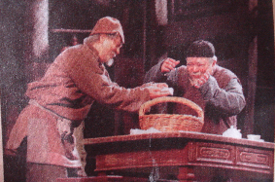
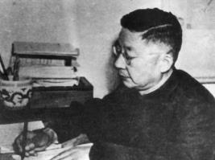
Lao She (1899-1966) was one of the most renowned contemporary Chinese writers, famous for his novels and plays. His works have been translated into over 20 foreign languages.

Slide 18
Listen and read

Slide 19
Read the passage and match the headings with the paragraphs.
a) Lao She Teahouse
b) The story of Teahouse
c) Lao She
1. ________________
2. ________________
3. ________________
b
c
a

Slide 20
Complete the timeline with information about Lao She.
1957 ______________________________
1924 ______________________________
1918 ______________________________
______________________________
______________________________
1913 ______________________________
1899 born in Beijing
Lao She
wrote Teahouse
left home and went to England
finished the teacher’s school and became a head teacher of a primary school
went to a teacher’s school

Slide 21
Blank filling
Complete the passage with the words in the box.
century common if magic society writers
Lao She’s play, Teahouse, has three acts. It describes the life of Wang Lifa and the changes of the lives of (1) ___________ people in Chinese
common

Slide 22
(2) ________ in the first half of the twentieth (3) ________.
Lao She went to a teacher’s school in Beijing, taught in London and later returned to China. He is one of China’s greatest (4) ________.
Come to Lao She Teahouse in Beijing (5) ______ you like the Beijing Opera, traditional music or (6) _______ shows.
Blank filling
society
century
writers
if
magic

Slide 23
Conclusion
Learning to learn
When you read a passage, remember to look at its title, the paragraph headings and the photos if there are any. They will help you understand the main ideas.

Slide 24
Writing
Complete the table.
 | Teahouse | Your favourite play or film
Where does the story take place?
In Beijing.

Slide 25
It starts at the end of the 19th century and finishes over 50 years later.
When does the story take place?
What is the story’s main idea?
Why is it good?
It tells the changes in Chinese society over 50 years.
It shows the lives of common people in China.

Slide 26
Write sentences about Teahouse with the information in Activity 5. Use the passage in Activity 2 to help you.
The story of Teahouse takes place in Beijing. ____________________________ ___________________________________ ___________________________________
Now join the sentences. Write a passage about Teahouse.
The story tells the changes in Chinese society over 50 years….

Slide 27
Practice
完成句子:
1. 他们决定星期天去老舍茶馆看魔术表 演。
They __________________ a magic show at Lao She’s Teahouse on Sunday.
2. 他们希望能再回到大自然。
They ______________ to the nature.
decided to watch
hope to return

Slide 28
3. 这个悲伤的故事发生在十年前。
This sad story __________ ten years ago.
4. 我们将热情欢迎来自世界各地的人们。
We’ll __________________________ everyone from all over the world.
5. 我们正努力提高我们的英语。
We _____________________ our English.
took place
give a warm welcome to
are trying to improve

