Slide 1
Unit 6 Topic 1
I have some exciting news to tell you.
Section B
WWW.PPT818.COM

Slide 2
Word competition
Review
Try to make sentences with these words.
field
proper
price
total
车辆，交通工具
航空公司
山，山峰
合适的，适宜的
田野
正确的，恰当的
价格
总的，全部的
vehicle
airline
mount
suitable

Slide 3
Sentences competition
Review
我们打算去泰山三日游。
太远了不能骑车去，我们可以选其它的交通工具。
我们查一下有关费用的信息吧。
我们要决定一个合适的出行方式。
We are going on a three-day visit to Mount Tai.
It’s too far to cycle. We can choose other vehicles.
Let’s find out some information about the cost.
We’ll decide on a proper way to travel.

Slide 4
Sentences competition
Review
我有振奋人心的消息要告诉你们。
骑车去那儿要花我们几天时间。
坐飞机去泰山要花多少钱？
去泰山的火车票价格是多少（price）？
I have some exciting news to tell you.
It will take us a few days to get there by bike.
How much does it cost to get to Mount Tai by plane?
What’s the price of a train ticket to Mount Tai?

Slide 5
Ask and answer
What’s the exciting news for the students?
What’s the best vehicle for their field trip?
What should they do before their trip?
What to take / What to do?

Slide 6
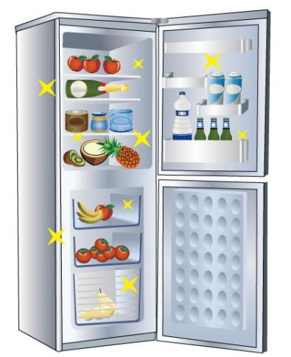
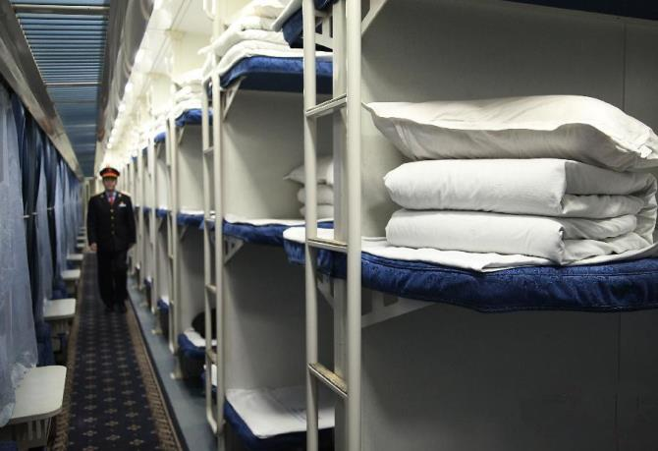
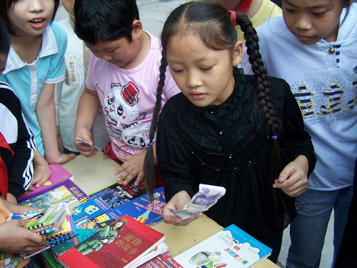
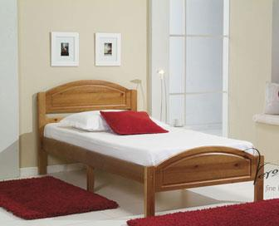
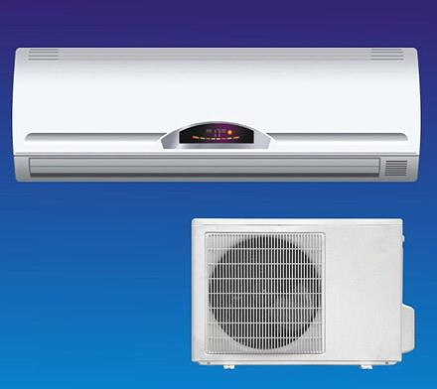
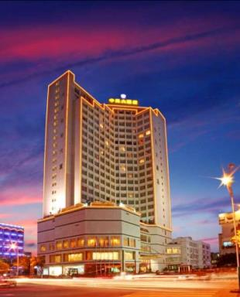
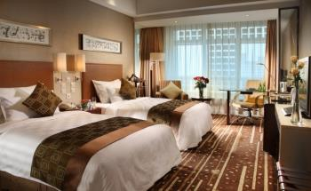
Learn the new words
hotel
sleeper
She is paying for the books.
pay
air conditioning
a single bed
fridge=refrigerator
a standard room

Slide 7
Listen to 1a and complete the table.
1b
Name |  | Departure time
Tel |  | Arrival time
From |  | Kind of tickets
To |  | Price (per ticket)
Total price |  | Number of tickets
Li Weikang
11:15 a.m.
8250-2448
6:17 p.m.
Beijing
hard sleeper
Mount Tai
¥ 145
¥ 3,045
21
Ask and answer in pairs based on the table.

Slide 8
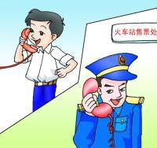
1c
Read 1a and fill in the blanks based on 1b.
Li Weikang is booking some tickets from ________ to ________ on the phone. He needs 21 ______ ______ tickets and they cost _______ yuan together. The train leaves at _______ a.m. and ______ _____ Taishan Railway Station at 6:17 p.m. Li Weikang’s _______ ________ is 8250-2448.
Beijing
Mount Tai
hard sleeper
3,045
11:15
arrives at
telephone number

Slide 9
Act out 1a in pairs.
Key words:
book some tickets to,
leaves, arrives
price, hard sleeper, soft sleeper,
21, pay for
Li Weikang,
8250-2448

Slide 10
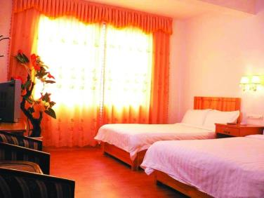
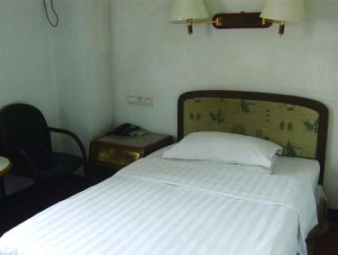
2
Read the conversation and write down the price of the rooms under each picture. Then complete it with the sentences in the box and practice in pairs.
A standard room with two single beds
A standard room with one single bed
A standard room with one single bed
80
Price: ¥ _____
Price: ¥ _____
100

Slide 11
Read the conversation and write down the price of the rooms under each picture. Then complete it with the sentences in the box and practice in pairs.
How much does a standard room cost?
When do you want them?
What can I do for you?
We are sure that conditions here will make you feel comfortable.
2
条件，状况
舒服的
C
Clerk: Good morning, Lantian Hotel. ______
Maria: Good morning, I want to book some rooms.
Clerk: OK. We have rooms with a bathroom, TV, fridge and air conditioning. _____ Also, from the windows you can see the mountains.
Maria: ______
Clerk: A standard room with two single beds costs ¥100 and a room with one single bed costs ¥80.
Maria: OK. I want to book 10 standard room with two single beds and one room with one single bed.
Clerk: ______ And how long do you plan to stay?
Maria: From April 13th to 15th, two nights.
Practice and act out the conversation.
D
A
B

Slide 12
3
A. Listen to the conversation and check what kinds of rooms the hotel has.
Standard room for one person
Standard room for two people
Room for three people with a bathroom and air conditioning.
Room for three people without a bathroom or air conditioning
60
100
90
¥ ______
√
¥ ______
√
¥ ______
¥ ______
√
Date: From ________to 6th．
April 2nd
Telephone number:____________
13176204240
B. Listen again and complete the information above.

Slide 13
Text for Listening
Clerk: Hello! Xingsheng Hotel. Can I help you?
Xu Xia: Yes. I want to book some rooms. What kinds of rooms do you have?
Clerk: We have two kinds of standard rooms. A standard room with one single bed costs ¥60 and a standard room with two single beds costs ¥100. We also have a kind of room with three single beds without a bathroom or air conditioning. It costs ¥ 90. Which would you like?
Xu Xia: I only want standard rooms. Two rooms with one single bed and three rooms with two single beds.
Clerk: When do you want them and how long will you stay here?
Xu Xia: From April 2nd to 6th, four nights.
Clerk: All right. May I have your name and telephone number, please?
Xu Xia: Sure. My name is Xu Xia and my telephone number is 13176204240. Thank you.
Clerk: It’s a pleasure.

Slide 14
Exercise : choose the right answer.
( ) 1. The students felt very ____ at the _____news .
exciting, excited B. excited, exciting C. exciting, exciting
( ) 2. We have nice T-shirts ____the price of ¥15 each.
in B. at C. for
( ) 3. I’d like _____a train ticket to Dalian.
to book B. book C. booking
( ) 4. - ______ do you plan to stay in the hotel? – For three days.
How much B. When C. How long
( ) 5. They decided to _______ ¥108 for a standard room with air conditioning because its condition is better.
A. cost B. spend C. pay
★
★
★
★
★

Slide 15
Read the sentences and pay attention to the liaison. Then listen and imitate.
4
May I have your name, please?
I want to go on a trip to Mount Tai.
I’d like to visit my aunt on Sunday.
Why don’t we go out for the day?
One vowel can be linked with another by adding a slight /j/ or /w/.

Slide 16
Summary
We learn:
New words and phrases:
pay, pay for, hotel, fridge, standard, single, condition, comfortable
To book train tickets and rooms.
Useful expressions:
We have tickets at 145 for the hard sleeper…
Please pay for the tickets before 5:30 p.m.
…

Slide 17
Summary
We can:
Book tickets or rooms over the phone.
Plan our own trip.
Offer help:
Can I help you?
What can I do for you?

Slide 18
Project
Do you know about other ways to book tickets or rooms?
Can you have a try and use the Internet to book tickets or rooms and then write down the steps?

Slide 19
Homework
Review the key points in Section B and try to recite the conversations of booking tickets and room.
Make your own conversations to book (movie) tickets or rooms over the phone.
Preview Section B.

