Slide 1
Unit 2 Hobbies
What's your hobby?
WWW.PPT818.COM

Slide 2
教学目标：
1. 能听懂、会说并认读单词：hobby, paper cutting, uncle, aunt, cook.
2. 能够听懂、会说、认读并理解句型： “ What’s your hobby？” “My hobby is dancing.” “I like reading.”

Slide 3
Review
do
doing
play
playing
run
running
dance
dancing
skip
skipping

Slide 4
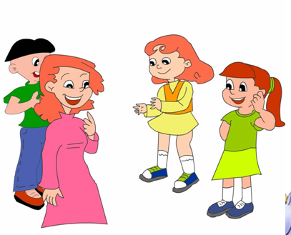
I like skipping. Do you like skipping？
小朋友，你的爱好是什么呢？

Slide 5
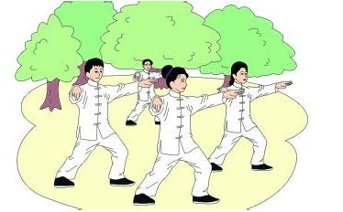
What’s your hobby？
你的爱好是什么？

Slide 6
My hobby is reading.
我的爱好是读书
我们也可以这样说：
I like reading.

Slide 7
比比看谁说得好
Hobby, hobby,
What’s your hobby?
Reading, reading,
My hobby is reading.

Slide 8
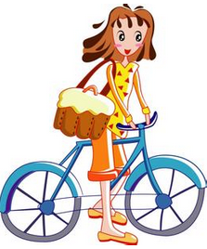
aunt
婶；姑；姨

Slide 9
uncle
叔；伯；舅；
姑父；姨夫

Slide 10
paper cutting
剪纸

Slide 11
回答问题：
Grandpa’s hobby is_______________.
Grandmas hobby is__________________.
Uncle’s hobby is____________________.
Aunt’s hobby is_____________________.
doing Taijiquan
paper cutting （剪纸）
reading
cooking

Slide 12
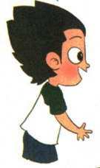
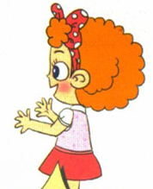
Let’s talk
What’s your hobby?
My hobby is dancing.
Do you like running?

Slide 13
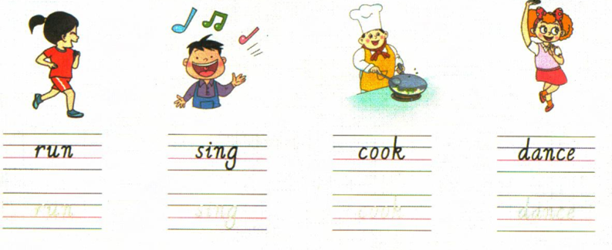
Let’s copy

Slide 14
Homework
模仿跟读课文录音。
2. 用所学的英语，调查一下朋友的业余爱好。

Slide 15
Thank You

