Slide 1
Unit 5 I like those shoes.
WWW.PPT818.COM

Slide 2
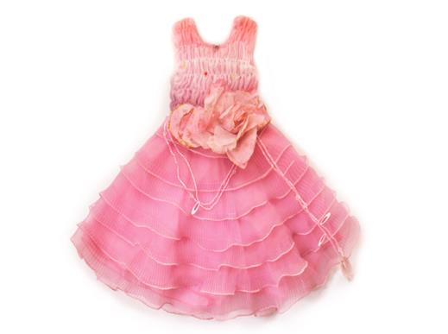
dress

Slide 3
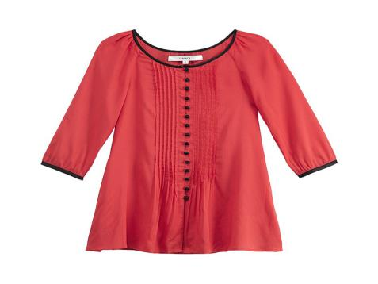
blouse

Slide 4
Lisa, this is for you.
For me? What's in the box?
Open it and see.

Slide 5
And a hat, happy birthday.
Wow, it's pretty.

Slide 6
What is in the box?
It's a T-shirt.

Slide 7
重点单词
dress 裙子
blouse 女士套装
box 盒子

Slide 8
重点句型
What's in the box?
什么在盒子里？
Open it and see.
打开并且看看它。
猜猜看

Slide 9
大家一起分享
想一想，你们生日的时候都收到了什么礼物？

Slide 10
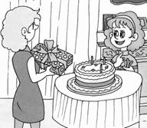
我给句子排排队。
A．Open it and see. B．This is for you.
C．Wow，a dress! D．For me? What's in it?
E．Thank you.
正确的顺序是_______________________________________________________

Slide 11
连词成句。
1．see，it，and，Open(.)
________________________________________________________________________
2．in，What，box，the，is(？)
________________________________________________________________________
3．hat，a，Is，this(？)
________________________________________________________________________

