Slide 1
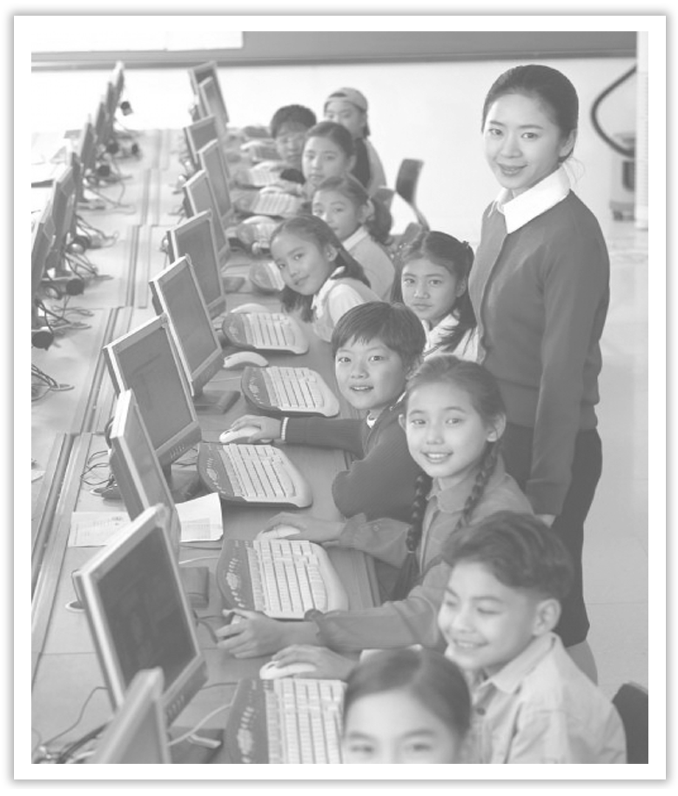
Unit 3 The Internet
Section Ⅷ Assessing Your Progress
WWW.PPT818.COM

Slide 2
Ⅰ.单词拼写
1.He is my favorite blogger, because he ____________(更新) his blogs every day.
2.He had lost his ____________ (身份) card and was being questioned by the police.
3.Most students find it convenient to ____________ (浏览) the Internet for accurate answers.
4.The teacher did not explain its grammatical ____________(功能).
5.They found that 95% of Wechat users ____________ (进入) their account daily.
6.The ____________ (居住的) population of the city is more than one million.
updates
identity
surf
function
accessed
resident

Slide 3
7.I gave a detailed ____________ (描述) of what had happened that night.
8.The village lies beside a main road, making it an easy ____________ (目标) for robbers.
9.There is no way that you cannot have any ____________ (令人尴尬的) moments.
10.Born in a family of English teachers, she always had a ____________(特别的) interest in English.
account
target
embarrassing
particular

Slide 4
Ⅱ.单句语法填空
1.Another student ____________ (blog) admitted that he often worked late into the night.
2.There is no denying the fact that private cars do bring ____________ (convenient) to our life.
3.Help others in need and you will be helped when you ____________ (stick) in difficulties!
4.I have been eager to do something ____________ (benefit) to the world.
5.I like to watch movies, especially when I see the ____________ (inspire) stories, I will feel touched.
blogger
convenience
are stuck
beneficial
inspiring

Slide 5
6.I am writing to you to apply to reopen the access ____________ the Internet in the classroom.
7.X-rays ______________ (confirm) that he has not broken any bones.
8.The goods on this counter are sold ____________ a discount of 25%.
9.These ____________ (tip) will be helpful for you to keep your children safe in heavy traffic.
10.The town is situated at a ____________ (distant) of twenty miles from Oxford.
to
have confirmed
at
tips
distance

Slide 6
Ⅲ.选词填空
keep sb company, now that, go through, in shape, keep track of, make fun of, keep...in mind, in case
1.Jogging is a great way to have fun and stay ________________.
2.Our task was to ________ the old people ________ today.
3.This is an app for ________________ the money in your wallet.
4.________________ you understand my meaning, I don’t need to explain again.
5.We consider it rude for the disabled to be ________________ by others.
6.We are supposed to learn English well ________________ we would fail in the exams.
in shape
keep
company
keeping track of
Now that
made fun of
in case

Slide 7
7.It is located at the foot of a hill and a small river ________________ our schoolyard.
8.Always ________________ that your own determination to succeed is more than anything.
goes through
keep in mind

Slide 8
Ⅳ.用现在完成时的被动语态补全句子
1.Till now, three films __________________________________ (已被放映) in that small village this month.
2.Great changes have taken place in my hometown and a lot of factories ________________________________________(已被建立).
3.We _______________________________________ (已被教了许多) about social studies by Mrs.Brown since September.
have been shown
have been set up
have been taught a lot

Slide 9
4.Despite the previous rounds of talks, no agreement ________________ (已达成) so far by the two sides.
5.A rescue worker risked his life to save two tourists who _________________________________ (已被困在山里) for two days.
has been reached
have been trapped in the mountain

