Slide 1
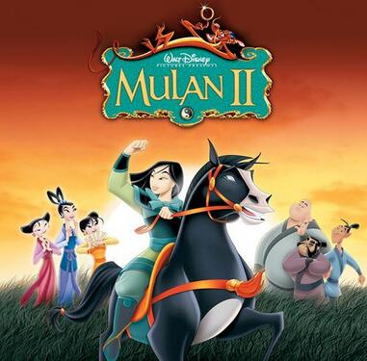
人教版八年级上册
Unit5
Do you want to watch a game show?
Section B（第3课时）
WWW.PPT818.COM
0

Slide 2
1. 能熟练掌握本单元重点词汇、短语及句型。 2.通过分析范文，总结出有关写影评的文章结构。 3.能独立完成一篇影评的文章。
学习目标

Slide 3
自学互研
新词自查
根据句意及汉语提示完成句子
1. My brother wants to join the army (军队) when he finishes
the high school.
2. The girl dressed up (乔装打扮) herself with beautiful skirt
when she went to the party.
3. Tom is ill, so we have to ask John to take his place (代替他).
4. We helped the farmers on the farm last weekend and the t-
eacher said we all did a good job (干得好).
5. It often makes me think of (想起) my childhood when I saw
this movie.
6. I like to watch the talk show because I can get some intere-
sting information (有趣的信息) form it.

Slide 4
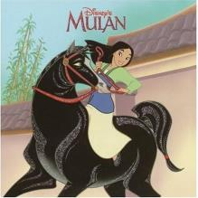
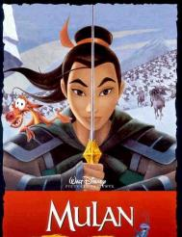
情景导入
Free talk
Do you like cartoons?
Do you know Mulan? Can you say anything about her?

Slide 5
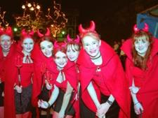
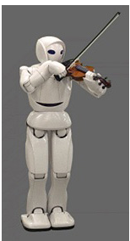
New words
1. dress up 装扮; 乔装打扮
e.g. The girls dressed up to take part in the party. 女孩子们打扮起来去参加舞会。
2. take one’s place 代替; 替换
e.g. A robot will take his place.
一名机器人将代替他的位置。

Slide 6
3a Fill in the blanks in the movie review. Use the words in the box to help you.
fantastic shows action want comes from
played about like exciting plan
Mulan is an ________ ______ movie. It_____________ an old Chinese story. The movie is ______ a village girl, Mulan. She dresses up like a boy and takes her father’s place to fight in the army. I think the actress _______ Mulan’s role well. The other actors are also _________ and they did a good job in the movie. I _____ Mulan very much. The movie _______ her love for her family, friends and country. If you ______ to watch a movie this weekend and you ______ to see something enjoyable, choose Mulan!

Slide 7
阅读指导
首先，阅读短文，整体把握短文大意。
其次，分析有空格的每个句子，判断空格处的意思，联系所给单词，确定空格处应填的单词。
最后，再通读一遍短文，看是否通顺合理。

Slide 8
Check your answers
Mulan is an ________ ______ movie. It_____________ an old Chinese story. The movie is ______ a village girl, Mulan. She dresses up like a boy and takes her father’s place to fight in the army. I think the actress _______ Mulan’s role well. The other actors are also _________ and they did a good job in the movie. I _____ Mulan very much. The movie _______ her love for her family, friends and country. If you ______ to watch a movie this weekend and you ______ to see something enjoyable, choose Mulan!
exciting action
comes from
about
played
fantastic
like
shows
plan
want

Slide 9
3b Write notes for your own movie review.
The name of the movie:___________
The kind of movie:___________
What the movie is about:___________
What you think of the movie / stars:___________

Slide 10
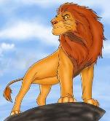
Sample
The Lion King
The name of the movie: ______________
The kind of the movie: _______________
What the movie is about:______________
___________________________________
___________________________________
___________________________________
What you think of the movie/star:
____________________
Cartoon
Simba’s father
was the king. But his uncle, Scar killed his father.
When Simba grew up, he came back to the
forest and became the true king.
It was fantastic.

Slide 11
3c Write your movie review using the notes in 3b.
写作指导
本文为写自己所喜欢的电影的剧情回顾，因此，时态应用一般现在时态与一般过去时态；
首先，可介绍影片的类型，及主人公等;
然后，介绍故事的梗概;
最后，表达你对该影片的看法。

Slide 12
Sample
The Lion King is a cartoon movie. It’s the most popular English movie in the world. The movie is about a young lion, Simba. He was the prince of the forest. But his uncle Scar wanted to be the king. So he killed Simba’s father. When Simba grew up, he came back to the forest and had a big fight with his uncle. At last, Simba won and became the true king.

Slide 13
4 What do you and your partner think of these TV shows or movies? Write description words for each one.
 | Me | My partner
Soap operas
Talent shows
News
Sports shows
Game shows
Talk shows
Comedies
Scary movies
Action movies
Cartoons
What do you think of soap operas?
I think they’re boring.

Slide 14
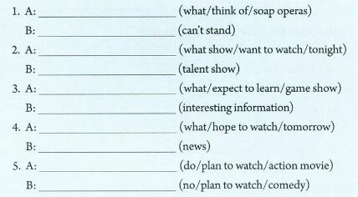
1 Write questions and answers using the words in brackets.

Slide 15
Check the answers
1) —What do you think of soap operas?
—I can’t mind them.
2) —What show do you want to watch tonight?
— I want to watch a talent show.
3) ─ What does she expect to learn from game shows?
─ She expects to learn some interesting information.
4) ─ What does your grandpa hope to watch tomorrow?
─ He hopes to watch the news.
5) ─ Do you plan to watch an action movie?
─ No, I don’t. I plan to watch a comedy.

Slide 16
2 Which of these statements do you agree with ( √ ) or disagree with (×)? Give at least one reason by yourself.
I think game shows are meaningless. ( )
2) I can’t stand soap operas. ( )
3) I think sitcoms and talent shows are
relaxing. ( )
4) I love talk shows. ( )
5) I think comedies are fantastic. ( )
I think game shows are relaxing.
I think we can learn something from soap operas.

Slide 17
Phrases:
dress up, take one’s place, do a good job
Sentences:
Mulan is an exciting action movie.
She dresses up like a boy and takes her father’s place to fight in the army.
The other actors are also fantastic and they did a good job in the movie.

Slide 18
Homework
Continue to improve your own passages.
Review the whole unit.

