Slide 1
初中英语仁爱版七年级下
Unit5 Topic3
My school life is very interesting
Section C
WWW.PPT818.COM

Slide 2
Warm-up
1
Presentation
2
Summary
3

Slide 3
Read the chant, paying attention to the rhythm.
Warm-up
'Where is the 'bear?
He's 'there in a 'chair!
'Please don't go 'near.
You'd 'better stay 'here.

Slide 4
Ask and answer in pairs
What day is it today?
Which subject do you like best?
Why do you like it?
I think it’s too difficult.
What time does the class begin?
It's ...
I like ... best.
Because it's ...
What do you think of it?
At 8:00.

Slide 5
Answer the questions:
Presentation
What subjects do you study in the school?
What activities do you have at school?
Do you love your school life?
Is it interesting?
activity (pl.) activities
outdoor activity
户外活动

Slide 6
1a.Read the following sentences and circle True or False.
1. Hu Bin likes his school life a lot.
2. Hu Bin likes math best.
3. Hu Bin has six classes every weekday.
4. Swimming is his favorite outdoor activity.
True False
True False
True False
True False

Slide 7
Read 1a again and fill in the blanks.
Hu Bin is a student of Class 1, Grade 7. His school life is very _________. Classes _______ at 8:00 a.m. He _______ Chinese, English, politics and some other subjects. He ______ English best. But he ________ _____ math very much. He ______ it’s a little difficult and boring. After school, he often _____ basketball with his classmates. It’s his favorite outdoor activity.
interesting
begin
studies
likes
doesn’t
like
thinks
plays

Slide 8
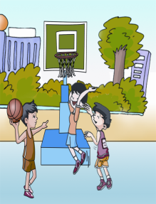
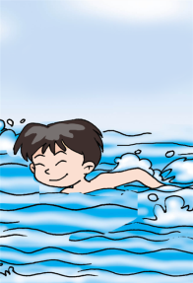
Retell the passage with the key words:
kind, interesting, classes begin, study, favourite, difficult and boring, after school, play basketball, in the swimming pool, draw pictures, school library
P21 1a 5幅图

Slide 9
stamp
Stamp Show

Slide 10
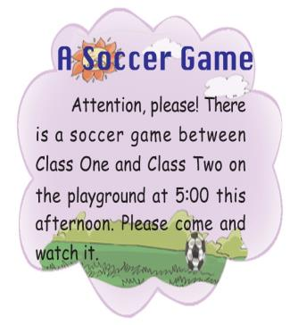
2. Read the news and posters and pay attention to the formats of news and posters.
P22 2 三幅图

Slide 11
Read the news and posters to learn about Hu Bin’s interesting school life. Then answer the following questions.
1) When does the soccer game begin?
2) Where can we see the Stamp Show?
3) What movies can we watch?
At 5:00 this afternoon.
In the school hall.
King Kong and the Sound of Music.

Slide 12
Read the news and posters again, and then fill in the blanks.
A soccer game
on the playground
Place:
Time:
Program: a soccer game
between Class 1
and Class 2
at 5:00 p.m.

Slide 13
Read the news and posters again, and then fill in the blanks.
Stamp Show
Place:
Day: every Saturday
Time: 9:00 a.m.-5:00 p.m.
Program:
in the school hall
Stamp Show

Slide 14
Suppose there will be a concert in the school hall from 7:00 p.m. to 9:00 p.m. on Friday evening. Please write a piece of news, and then make a poster.

Slide 15
Example: search bright
here chair clear wear early cheer
bought caught cough light sight learn

Slide 16
Summary
Review subjects and school activities.
2. Learn some new words and phrases.
study, outdoor activity,attention, between, stamp, from...to..., Saturday, night, sound
3. Learn how to write news and posters.
4. Learn to talk about the school life.
My teachers and classmates are very kind to me.
My school life is very interesting.
I often speak English with my classmates. ...

Slide 17
Homework:
Please write a letter to Hu Bin to tell him about your school life.
You may begin like this:
Dear Hu Bin,
I'm ..., a student of ...

