Slide 1
Unit 7 How much are these socks?
单元同步作文导练
WWW.PPT818.COM

Slide 2
本单元的话题是shopping，这是学生们所熟悉的，并且很容易激发我们的学习兴趣。要求我们能结合生活实际，用所学的语言创设购物的环境，并能对所购买的物品提出评论。那么本单元写作任务是利用本单元所学句型写一篇广告。
教材中出现的相关句型：
①Do you like…？你喜欢……？
②Do you want…？你想要……？
③Come and buy…at our great sale！快来买……，我们的……特价销售！
④We sell… at very good prices.我们以很低的价格出售我们……

Slide 3
⑤For girls，we have…对于女孩子，我们有……
⑥For boys，we have black trousers for only $22.对于男孩子，我们有黑色的裤子，仅售22美元。
⑦Socks are only $2 for three pairs.短袜仅售两美元三双。
⑧Come to Mr.Cool's Clothes Store now！现在快来酷先生的服装店吧！
拓展常用相关句型：
①Our…are very cheap.我们的……很便宜。
②You can buy…for only＋价钱．你只需花费多少钱就能买到……

Slide 7
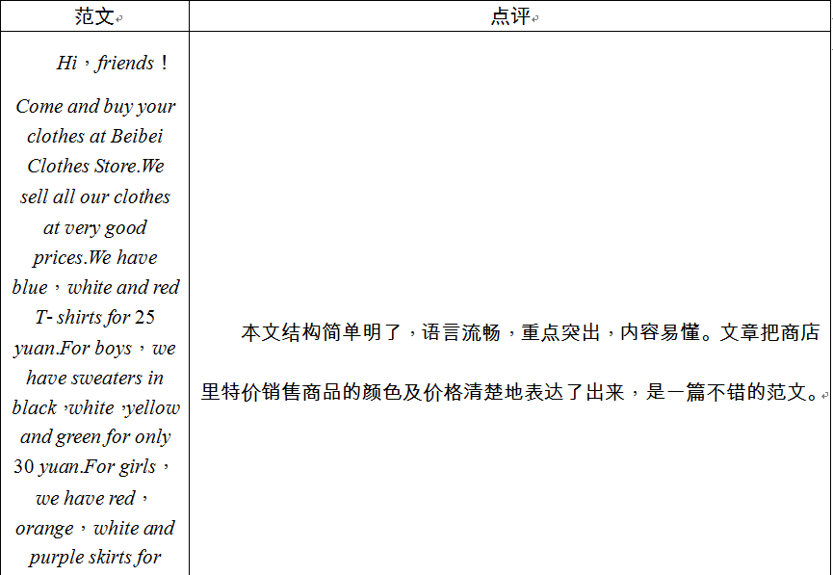

Slide 9
Come and buy your clothes at Liangli's great sale！We sell all our clothes at very good prices.Do you like trousers？Only 10 dollars.Do you like sweaters？We have green sweaters for only 18 dollars.Do you need shoes for sports？We have great shoes for only 5 dollars！For boys，you can buy T­shirt for only 14 dollars each！For girls，we have beautiful skirts in all colors for only 18 dollars.Come to Liangli's Clothes Store now!

