Slide 1
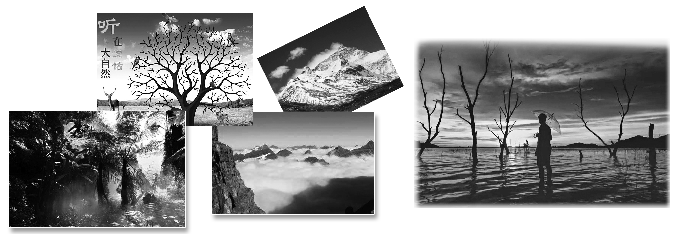
Section Ⅰ Starting out & Understanding ideas
WWW.PPT818.COM

Slide 8
教材原句
Imagine mountains wrapped in silver water, shining in the spring sun.想象一下，群山披着银色的水带，在春日阳光下闪闪发光。
句式解构
过去分词wrapped作后置定语，修饰mountains; shining是现在分词作伴随状语。
佳句背诵
He wrote an article involved in pollution, warning us to protect the environment.他写了一篇有关污染的文章，警告我们要保护环境。

Slide 9
教材原句
Summer sees the mountains turn bright green with growing rice.
随着水稻的种植，群山在夏季变成明亮的绿色。
句式解构
see是拟人用法，表示“见证”，这一用法使句式更加生动。
佳句背诵
The twenty century saw many changes.
二十世纪发生了很多变化。
教材原句
Reaching as far as the eye can see, these terraces cover tall mountains, often from the bottom to the very top.放眼望去，这些梯田从山底到山顶覆盖着高高的山脉。
句式解构
as far as在此表示“远至……”，后跟状语从句。
佳句背诵
The desert continued as far as the eye could see.沙漠一直延伸到视线的尽头。

Slide 10
教材原句
During the rainy season, it is along these waterways that rainwater moves down the mountains and into the terraces.在雨季，正是沿着这些水道，雨水从山上流下进入了梯田。
句式解构
It is ... that是强调句型，本句强调了地点状语。
佳句背诵
It was at the railway station that I met Li Ming yesterday.我昨天是在火车站遇到的李明。

Slide 13
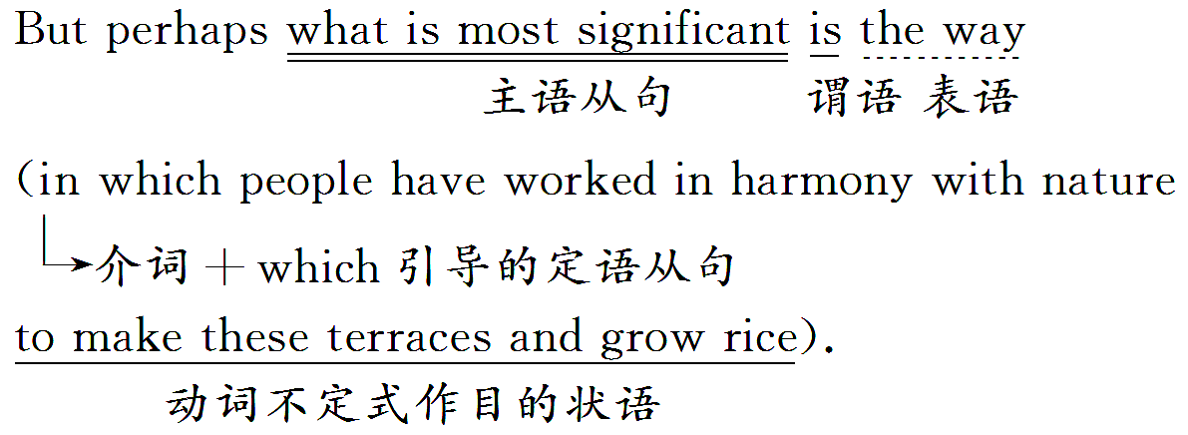

Slide 14
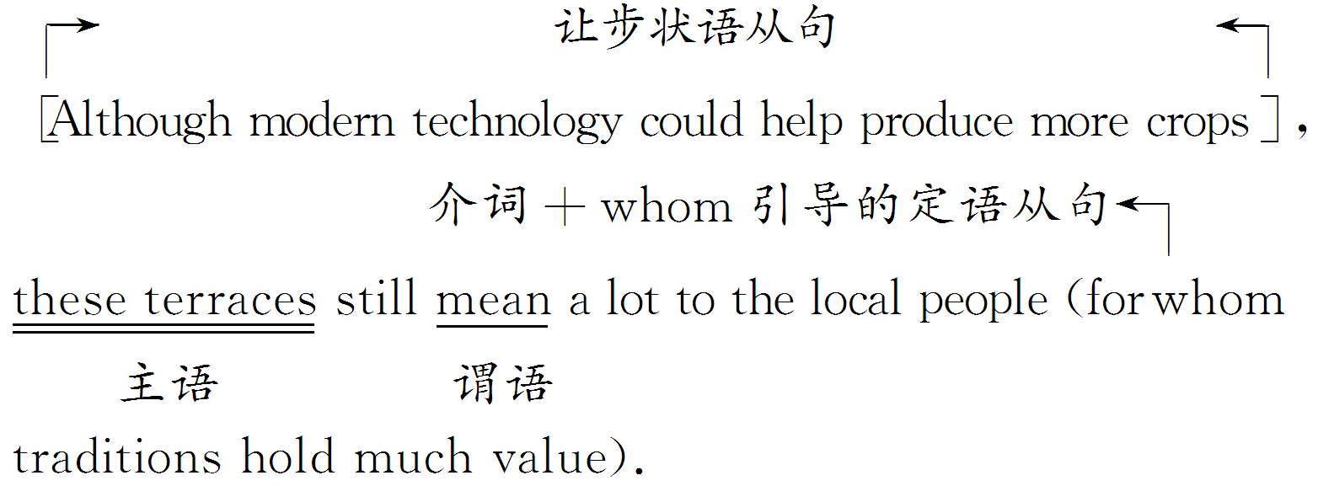

Slide 15
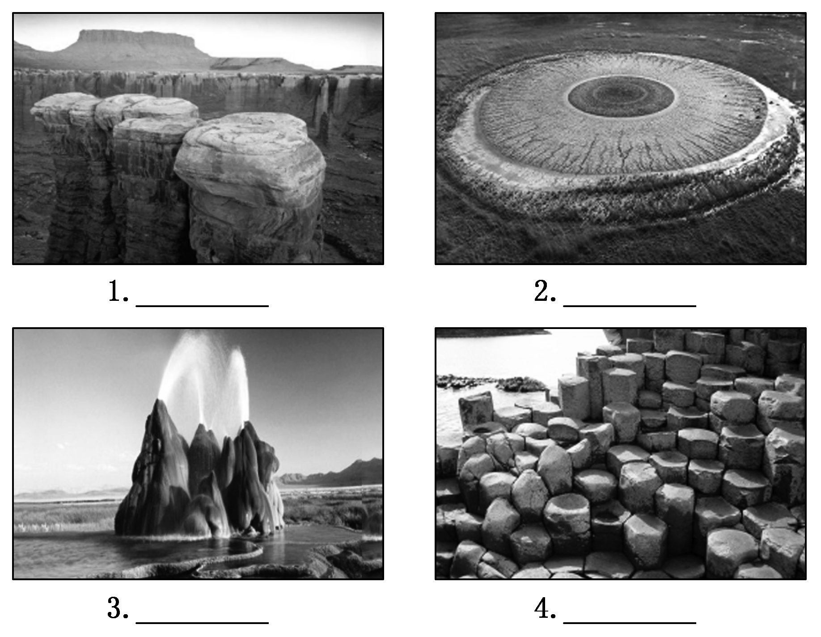

Slide 24
Longji Rice Terraces
The scenery | •Mountains 1.___________ in silver water in spring. •Mountains turn bright green in summer. •Mountains are flash gold in autumn. •Mountains are covered in sheets of white 2._____ in winter.
The history | •Longji Rice Terraces started 3.__________ _______. •Longji Rice Terraces 4.______________ in the early Qing Dynasty.
are wrapped
frost
in the Yuan
Dynasty
were completed

Slide 25
The reasons | •There are 5.___ large, flat areas of land. Building the terraces meant people could grow more rice. •The steep mountains and the shallow soil 6.__________ the rainwater.
The significance | People have worked in 7.________ with nature to make these terraces and grow rice, which is most 8._________.
The present situation | •New generations continue to use 9._______ methods of agriculture to maintain the terraces. •Longji Rice Terraces 10.______ thousands of people in the world.
few
can't catch
harmony
significant
ancient
attract

Slide 67
谢 谢 观 看

