Slide 1
Unit 6 Topic 3
Bicycle riding is good exercise.
Section C
WWW.PPT818.COM

Slide 2
Review: complete the sentences.
doesn’t rain
will go
If it __________ (not rain) tomorrow, we _________ (go) hiking.
He ________ (pass) the exam if he ______ (work) harder at it.
If everyone _________ (obey) the traffic rules, the roads _________ (be) safer.
It’s important for us ________ (know) about traffic rules.
It’s good exercise ________ (ride) a bike to school.
will pass
works
obeys
will be
to know
“主将从现”原则
to ride

Slide 3
Competition
Task 1
Speak out as many traffic rules as you can.
Task 2
Talk about the results of breaking the traffic rules using “if” clause.

Slide 4
Discuss
How to be safe on the roads?
Should do | Should not do

Slide 5
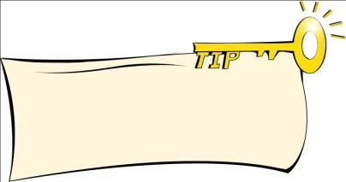
1a
Read and understand.
Tick the rules that bicycle riders should know. Then read the passage to learn more.
When you read a passage, your knowledge of the topic will help you understand it better.
The bicycle riders must pay attention to the traffic around them. The bicycle riders must know traffic signals. The bicycle riders must know and obey the safety rules. The bicycle riders must wear helmets to protect their heads.
care for，注意

Slide 6
1b
Read 1a and match the topic sentence with each paragraph. Then write a title for the passage in the box above.
Bicycle riding is good for health and the environment.
Bicycle riders must obey the safety rules.
Bicycles are very popular.
Paragraph 1
Paragraph 2
Paragraph 3

Slide 7
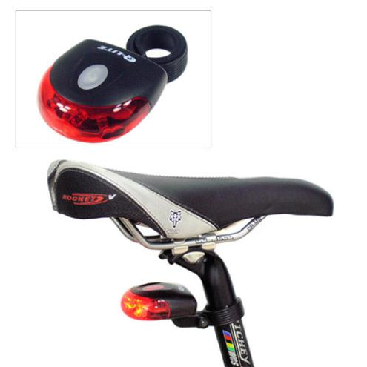
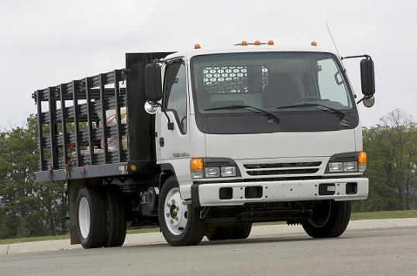
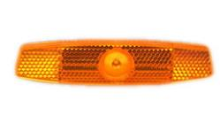
Find out and learn the new words in 1a.
truck n.
reflector n.

Slide 8
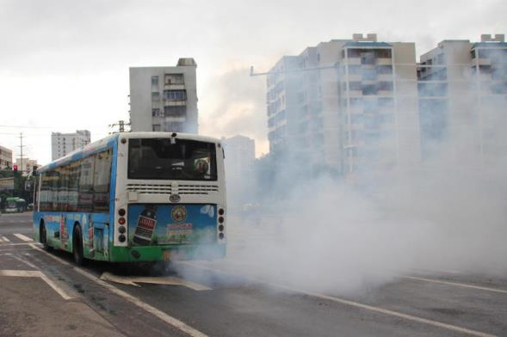
injury n. (对躯体的)伤害，损伤
signal n.信号，暗号
notice n. 注意，理会；v.看到，注意到
safety n.安全，平安
in case of 如果，假使
look out 小心(be careful)
in a word 总之

Slide 9
1c
Read again and answer the following questions.
1. What do people use bicycles for?
2. Why is bicycle riding good exercise?
3. How do bicycle riders protect their heads?
4. What must bicycle riders do when riding at night?
5. If a bicycle rider is badly hurt in a traffic accident, what should he / she do?
2. It helps people become fit and it can make the riders’ hearts and lungs strong.
4. They must wear light-colored clothes, and have lights in the front and reflectors on the back of the bicycles.
1. People use bicycles for work, for sport or just for fun.
5. They must call 120 for help.
3. They must wear helmets to protect their heads.

Slide 10
Listen to 1a and find out
Safety rules for bike riders:
Be careful and pay attention to other vehicles.
Wear helmets.
Wear light-colored clothes.
Use bicycle lights and reflectors.
Know how to give first aid.

Slide 11
Retell 1a according to the key words.
one of, use … for…
exercise, fit, strong, pollution
share… with…, notice, pay attention to, signals, safety rules, helmets, light-colored, reflectors, in case of, first aid, call 120

Slide 12
2
Complete the sentences with the correct forms of the words in the box.
ride give if because care safe
Bicycle riding is good exercise.
It is good for the environment _______ it doesn’t cause pollution.
Cycling can make bicycle _______ hearts and lungs strong.
You must know how to _______ first aid.
Call 120 ______ an accident happens.
Look out and always be __________.
Everyone should know and obey the ______ rules.
because
riders’
give
if
careful
safety

Slide 13
Exercise: Translation.
引起污染
cause pollution
4. 急救
first aid
2. 交通信号
traffic signals
5. 总之
in a word
3. 安全守则
safety rules
6. 骑自行车是很好的运动。
Bicycle riding is good exercise.
7. 人们用自行车来工作、运动或者只是娱乐。
People use bicycles for work, for sport or just for fun.
8. 骑车者必须要注意周围的车辆。
Bicycle riders must pay attention to the traffic around them.

Slide 14
Choose the words to fill in the blanks with the proper forms.
In China, traffic goes on the right. Cars, trucks, buses _____ bikes must all keep to the right side of the _____. In most other countries, traffic _____ to the left.
How can you ________ the roads safer?
______ you cross the road, stop and look each side. ______ left, then right, and then look left again. Don’t cross the road if you are not ______ whether the road is clear or not. It may be ________. If you see young children, old people, or blind people walking ______ the road, help them cross the road in _______. Helping others is a kind of virtue (美德).
and
roads
1
keeps
2
make
3
Before
4
Look
5
6
sure
dangerous
7
8
across
safety
9
10
keep and road safe danger
cross before sure look make

Slide 15
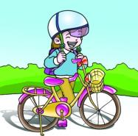
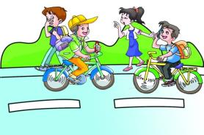
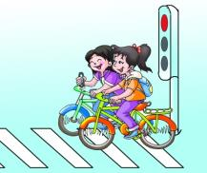
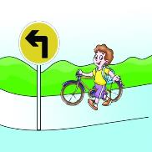
3
Talk about the pictures. Tick (√) the ones that bicycle riders should do and cross (×) the ones they shouldn’t do. Then write a passage.
wear a helmet
make a call
play on the street
follow the sign
You may begin like this:
Bicycle riding is good exercise. It helps people become fit… ______________________________________________

Slide 16
3
wear a helmet
make a call
play on the street
follow the sign
Example:
Bicycle riding is good exercise. It helps people become fit. But when you are riding a bicycle, you should wear a helmet to protect your head. You should also follow the sign. However, you shouldn’t make a call or play on the street while you are riding bicycles.

Slide 17
Project
How can we be safe on the road? Write a passage according to the information in 3, add your own ideas. The following words may help you.
should (not)/must (not)/had better (not)
play on the road; listen to music;
look left/right; pay attention to;
obey traffic rules; first aid;
…

Slide 18
Summary
We learn
New words and phrases:
truck, notice, safety，in a word, look out, pay attention to
Useful expressions:
Bicycle riding is good exercise.
In a word, the best way to be safe is to be careful.
: Safety rules for bike riders:
They must wear helmets to protect their heads.
…, bicycle riders should know how to give first aid.

Slide 19
Summary
We can
Tell about what we should do and what we should not do to be safe.
Share safety rules on the roads with others.

Slide 20
Homework
Review the key point in Section C.
2. Complete the passage of Project.
3. Preview Section D. Collect information about bicycle races.

Slide 21
The end.
Thank you!

