Slide 1
Unit 6 Topic 1
There is a study next to my bedroom.
Section B
WWW.PPT818.COM

Slide 2
There is a guitar behind the sofa.
There is a lamp near the sofa.
lamp
guitar

Slide 3
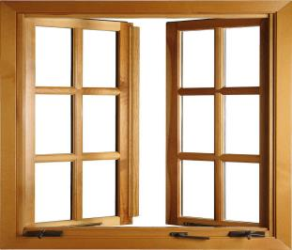
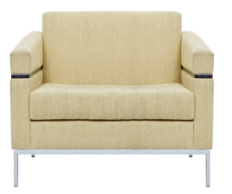
clock
window
There is a clock on the wall.
(在墙的表面）
There is a window in the wall.
（在墙的内部）

Slide 4
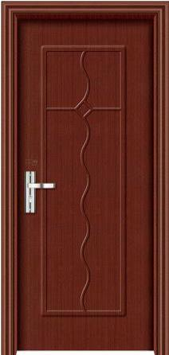
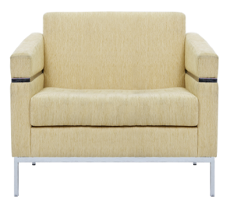
door
There is a chair in front of the door.
chair

Slide 5
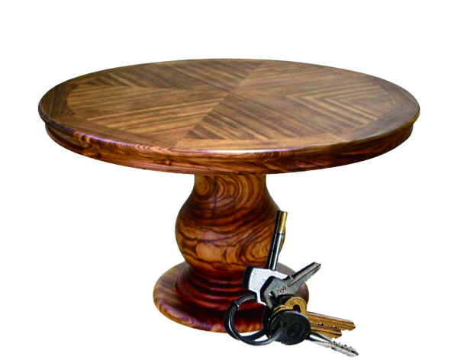
table
keys
There are some keys under the table.

Slide 6
Describe the picture.
There is/are...

Slide 7
Ask and answer.
P30 2 图1
a tree/in front of the classroom
A: What’s in front of the classroom?
B: There's a tree in front of it.
A: Is there a student in front of the
classroom?
B: No, there isn't.

Slide 8
Ask and answer.
P30 2 图2
two students/in the front of the classroom
A: Are there two students in the front of the classroom?
B: Yes, there are.
A: Is there a teacher in the front of the classroom?
B: No, there isn't.

Slide 9
You can learn a sentence pattern by changing a few words in it.
Tip
a guitar/ near the window
A: What's ...?
B: There's ...
A: Is there...?
B: ...

Slide 10
books/on the shelves
A: Are there...?
B: ...
A: ...
B: ...

Slide 11
Key Point
What's in front of the classroom?
in front of 表示在某人或某物的前面，指自身以外的前面；而in the front of 表示在某物的内部的前面。如：
There is a tree in front of my house.
There is a blackboard in the front of the classroom.

Slide 12
Listen to 1a and mark T (True) or F (False).
1. The sofa is near the desk. （ ）
2. There is a clock on the desk. ( )
3. The football is under the desk. ( )
4. Jane's study is nice. ( )
T
F
F
T
P29 1a 图

Slide 13
Read 1a and answer the questions.
1. What’s on the desk?
2. Where is the clock?
3. Where’s the football?
There is a computer, a lamp and some books on it.
It’s next to Jane’s family photo on the wall.
It’s under the chair.

Slide 14
Pair Work
Talk about your study/ bedroom/ living room or other rooms in your home with your partner, using the following structures.
A: Where is your ...?
B: It's ...
A: Is/ Are there …?
B: Yes, there is/are.
No, there isn't/aren't.
A: What’s in/ on/ behind/ under …?
B: There is/are ...

Slide 15
Look at the pictures and complete the conversations. Then listen and check.
on
Mom: What’s ____ the table?
Bob: ____ ___ some keys.
I think they’re Judy’s.
Judy: Oh, yes, they are my ____.
Mom: Don’t put them there.
Put them away, please.
Judy: OK, Mom.
There are
keys

Slide 16
Look at the pictures and complete the conversations. Then listen and check.
behind
Dad: What’s _____ the door?
Jeff: ________ a football behind it.
I think it’s Alan’s.
Alan: Oh, yes, it’s mine. My dog is playing
with it.
Dad: Put it _____, please. You must look
after your things.
Alan: OK, Dad.
There’s
away
put+n.+away=put+away+n.
put+pron.+away

Slide 17
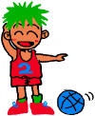
play + 球类
e.g. play basketball
play + 西洋乐器
e.g. play the guitar
play + games
e.g. play computer games
play with + sth.
e.g. play with a pen

Slide 18
Exercises
Choose the best answer.
A
1.Why not ______ home and watch TV?
A. go B. to go C. going
2. Is there a clock next to the photo? __________
A. Yes, it is. B. Yes, there is. C. Yes, there isn’t.
3.There is a bedroom _______ the second floor.
A. on B. at C. in
4. You must _______ your things.
A. look like B. look at C. look after
B
A
C

Slide 19
Summary
1.What’s + 表方位的介词短语?
There is/are ...
2. Is/Are there...?
Yes, there is/are.
No, there isn't/aren't.
3. Some phrases:
talk about, play with, in front of, in the
front of, put … away
4. Don't put them there.
Put them away, please.
You must look after your things.

Slide 20
Homework
Ask your partner what his/her study or bedroom is like. Then draw a picture about the room he/she describes.
A: Where is your ...?
B: It's ...
A: Is/ Are there …?
B: Yes, there is/are.
No, there isn't/aren't.
A: What’s in/ on/ behind/ under …?
B: There is/are ...
Preview Section B.

Slide 21
Thank you

