Slide 1
What colour is it?
第4课时
WWW.PPT818.COM

Slide 2
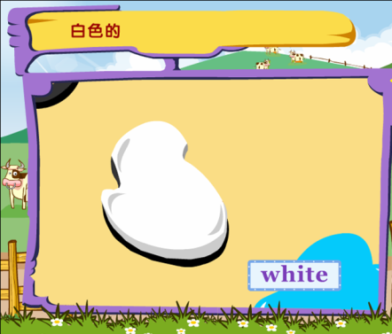
white

Slide 3
It’s white.

Slide 4
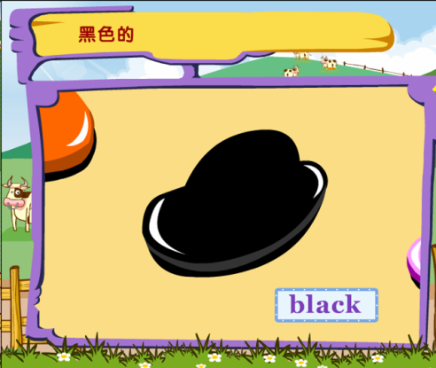
black

Slide 5
What colour is it?
It’s black.
B

Slide 6
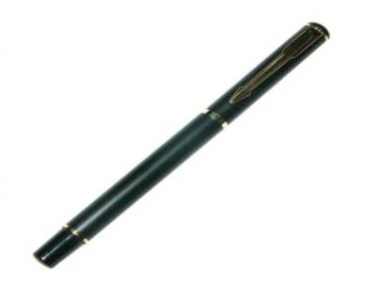
black
Black, black,
a black pen, a black pen.
It’s a black pen.

Slide 7
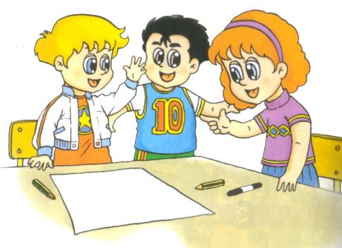
Hi, Lisa. Let’s draw a panda.
Great!

Slide 8
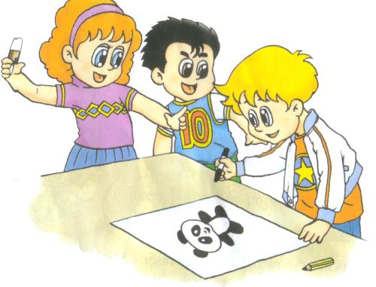
Colour it black and white.
OK!

Slide 9
Let’s colour

Slide 10
Homework
1、背诵课文。
2、完成练习册。
3、把所学的单词、字母、句型教给父母。

Slide 11
Thank You.

