Slide 1

精通版三年级下册
WWW.PPT818.COM

Slide 2
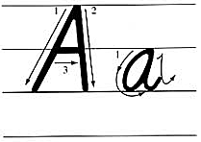


a
pple
a
m ngo
cat rabbit cake hamburger

Slide 3

an apple
apples
I like apples，yummy,yummy,yummy

Slide 4





Let`s learn
man
go
mangoes
I like mangoes.
yummy,yummy,yummy

Slide 5

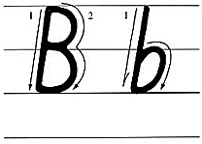

b
anana
b
read
big rabbit bird brother bus

Slide 6

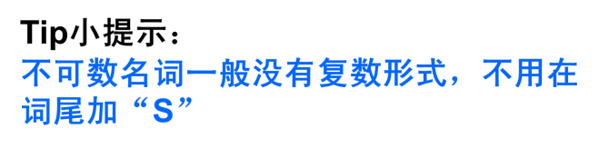
Let`s learn
bread
bread
I don’t like bread

Slide 7
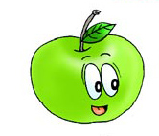
Pairwork
I like apples.
What about you?
I don't like apples.

Slide 8
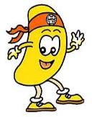
Pairwork
I like mangoes.
What about you?
I don't like mangoes

Slide 9

Pairwork
I like bananas
What about you?
I don't like bananas

Slide 10
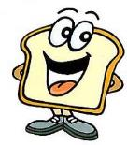
Pairwork
I like bread.
What about you?
I don't like bread

Slide 11
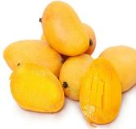
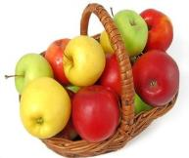
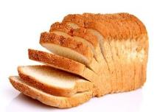
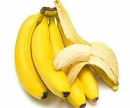
Let’s chant
I like apples . What about you?
I like mangoes . What about you?
I don’t like mangoes. What about you?
I don’t like bread,bread,bread.

Slide 12
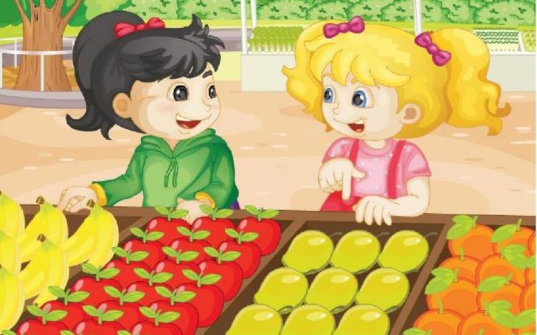
I like bananas.What about you ,Kate?
I don't like bananas. I like mangoes.

Slide 13




Practice
Let’s read
1
2
3
Read together.
(齐读)
Read in groups.
(分组读）
Read in roles.
（分角色读）

Slide 14
Practice
Show time
二人一组试着来表演，其他同学评价。
 | 模仿录音中的语音语调，有感情地朗读。
 | 可以脱离课本，适当改动其中部分。
 | 适当添加内容，意思完整，有创新，表演生动。
Good
Great
Excellent

Slide 15









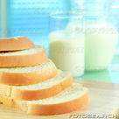
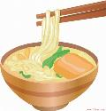
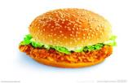
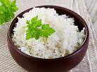


Make a new dialogue
I like _____.
What about you , _____ ?
I don’t like ______.
I like ______.

Slide 16



Summary
今天你学会了么？
mango
bread
I like ___.
I don’t like___.
What about you ?

Slide 17
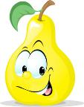


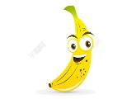

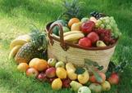
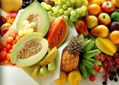
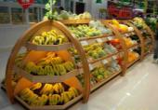
Fruit is good for our health.

Slide 18




Homework
1. 用I like...What about you?
I don't like...创编对话。
2. Do a survey.
father
mother
sister

Slide 19




Goodbye

