Slide 1
Unit 5
July is the seventh month.
WWW.PPT818.COM

Slide 2
Ask and answer
What day is (it)today?
It’s Monday/Tuesday/…
What’s the date today?
It’s October 5th./…

Slide 3
Can you say the months?
the fifth month-----------
the sixth month----------
the seventh month------
the eighth month--------
the ninth month----------
the tenth month----------
May
June
July
August
September
October

Slide 4
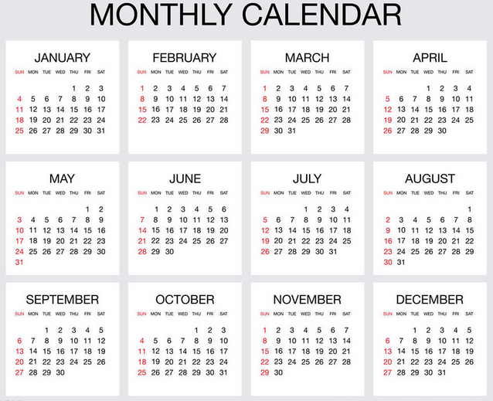

Slide 5
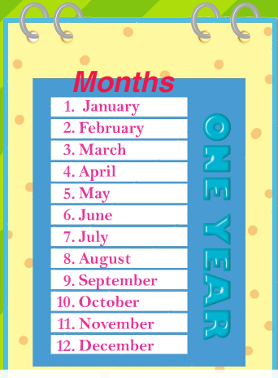
November is the eleventh month of the year.

Slide 6
Thanksgiving Day is on the fourth Thursday of November.

Slide 7
感恩节是美国人民独创的一个古老节日，也是美国人合家欢聚的节日。
1941年，美国国会正式将每年11月第四个星期四定为“感恩节”。感恩节假期一般会从星期四持续到星期天。

Slide 8
感恩节的晚宴是美国人一年中很重视的一餐。这一餐的食物非常之丰富。在餐桌上，火鸡和南瓜饼都是必备的。

Slide 9
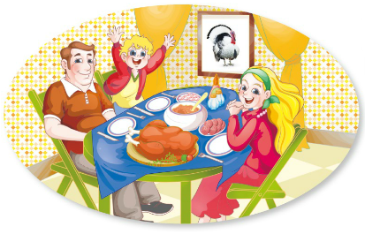
The family is celebrating Thanksgiving.

Slide 11
December is the twelfth and last month of the year.

Slide 12
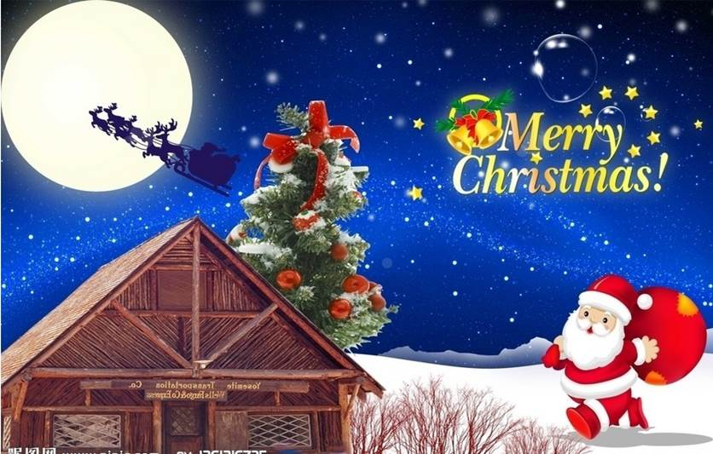
Christmas is on December 25th.

Slide 13
The children have presents from Santa Claus.

Slide 14
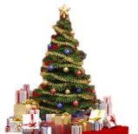
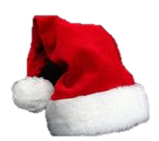
圣诞节（Christmas）又称耶诞节，西方传统宗教节日，在每年12月25日。大部分的天主教教堂都会在24日的平安夜举行子夜弥撒，然后在次日庆祝圣诞节。

Slide 15
THANKS

