Slide 1
Unit 5
What day is it today?
WWW.PPT818.COM

Slide 2
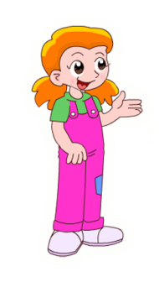
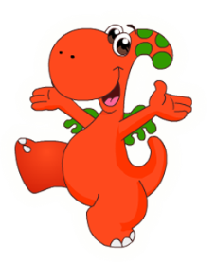
What day is it today?
It’s Sunday.

Slide 3
What day is it today?
It’s…
Sunday星期日
Monday星期一
Tuesday星期二
Wednesday星期三
This is a week.
Thursday星期四
week
周、星期
Friday星期五
Saturday星期六

Slide 4
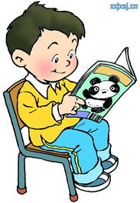
Sun
Sunday
星期日
My favourite day is Sunday.
On Sunday I read some books .
I like reading.

Slide 5
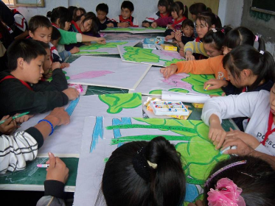
Mon
Monday
星期一
My favourite day is Monday.
We have an art lesson on Monday .
I like art.

Slide 6
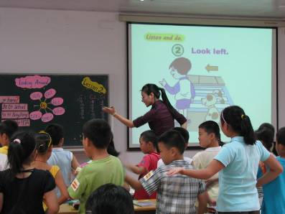
Tue
Tuesday
星期二
My favourite day is Tuesday.
We have an English lesson on Tuesday.
I like English.

Slide 7
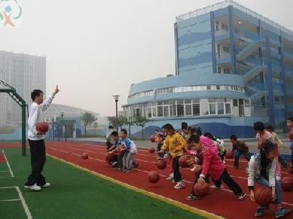
Wed
星期三
Wednesday
My favourite day is Wednesday.
Why do you like Wednesday?
We have a PE lesson on Wednesday. I like sports.

Slide 8
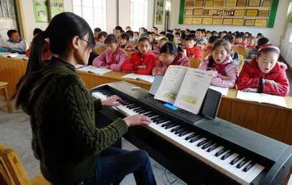
Thur
Thursday
星期四
My favourite day is Thursday.
We have a music lesson on Thursday.
I like music.

Slide 9
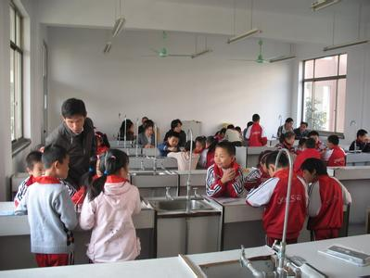
Fri
Friday
星期五
My favourite day is Friday.
On Friday we have a science lesson.
I like science.

Slide 10
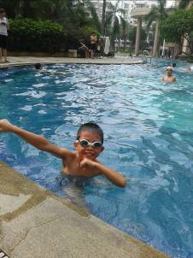
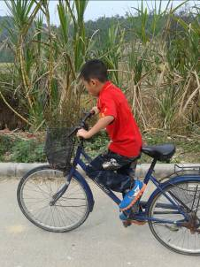
Sat
Saturday
星期六
My favourite day is Satday.
I go swimming or ride a bike
on Saturday.
I like swimming.

Slide 11
知识点
在Sunday, Monday, Tuesday….
这些 表示星期几的单词前要
加介词on.

Slide 12
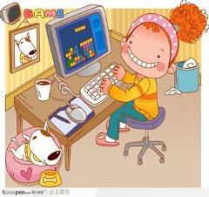
Let’s do.
看图填空。
Fri
is
it
What day ____ ____ today?
It’s _______.
2.______ do you like Friday?
I like playing ____________
games _______ Friday evening.
Friday
Why
computer
on

Slide 13
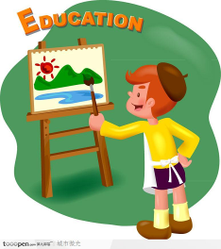
Let’s talk.
A: Hello.
B: Hi.
A: What day is it today?
B: It’s …
A: What's your favourite day?
B: My favourite is ...
A: Why do you like …?
B: On. . . we …
I like….
Monday
Monday
Monday
an art lesson
Monday
drawing
Monday
have an art lesson.
drawing

Slide 14
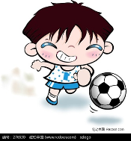
Let’s talk.
看图仿照例子说话。
Friay
a PE lesson
swimming
Thursday
Wednesday
a Chinese lesson
a PE lesson
playing football
reading books

Slide 15
我会填空
S__nday M__nday T_ _sday
( ) ( ) ( )
W_dn_sday Th_ _sday Fr_day
( ) ( ) ( )
S_t_ _day w_ _k
( ) ( )

Slide 16
如实回答。
What day is it today?
_____________________________
2. What’s your favourite day?
_____________________________

Slide 17
Goodbye!

