Slide 1
Unit 8 Birthdays
五年级
第2课时
WWW.PPT818.COM

Slide 2
Rules:
Collect five pieces,you’ll get the invitation card.
(集齐五个碎片，你将会得到米奇的生日请柬.)

Slide 3
Piece 1:
Talk about your birthday with your partners.
(和你的伙伴们谈谈你的生日。)

Slide 4
Talk about your birthday
My birthday is in…
Good!
I always/usually/often/sometimes…
eat a birthday cake eat noodles
play games have a party
buy new clothes sing and dance
have a big dinner go to the cinema
play with friends make a wish
…

Slide 5
Piece 2:
Talk about Su Hai’s and Mike’s birthdays.
( 谈谈苏海和迈克的生日。 )

Slide 6
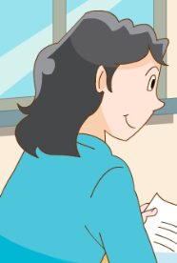
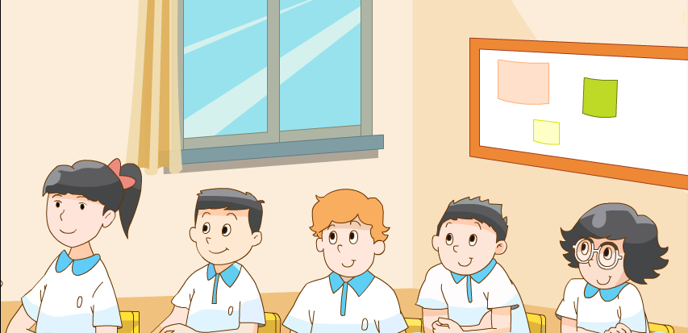
Miss Li and the students are talking about their birthdays .

Slide 7
I can say
When is Su Hai’s/Mike’s birthday?
Her/His birthday is on …
What does Su Hai/Mike usually do on the birthday?
She/He usually …
Good job!
Name
Birthday
Activities 活动
the eleventh of May
the eighth of April

Slide 8
Piece 3:
Learn the ordinal numbers. (学习序数词。)

Slide 9
I can say
小组内读一读句子，你能发现如何表达生日日期吗？
A. 基数词
B. 序数词
one
first
two
second
three
third
fourth
My birthday is on the of October.
His birthday is on the of April.
eighth
eleventh
Her birthday is on the of May.

Slide 10
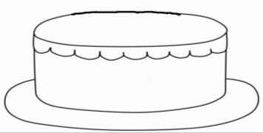
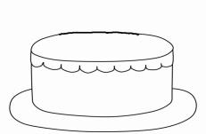
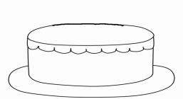
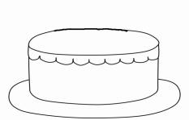
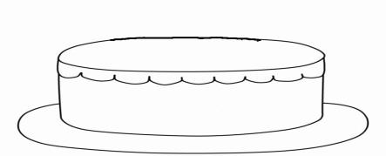
I can find
你能发现什么规律吗？同桌说一说！
直接加th，变成序数词。
six sixth
ten tenth
8去t，加th
four fourth
seven seventh
eight eighth
A
B
9去e，加th
ve变f，加th
nine ninth
five fifth
twelve
twelfth
C
D
整十去y变ie，加th
几十几，只把个位变为序数词
twenty twentieth
thirty
thirtieth
twenty-one
twenty-first
thirty-four
thirty-fourth
E
F

Slide 11
序数词变化口诀
一二三特殊记，词尾各是tdd；
th四加起，八去t，九去e，y结尾改ie；
ve结尾变f，five、twelve是两兄弟；
若是遇到几十几，只变个位就可以。

Slide 12
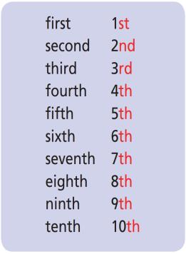
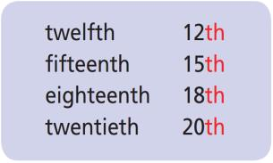
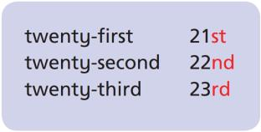
I can know
Tips:有时候，为了方便，会把序数词写成缩写形式！

Slide 13
Play a game
When’s your brithday?
the eleventh of May
twenty-second
twentieth
twelfth
third
fifth
ninth
third
fifth
Well done!

Slide 14
Piece 4:
Can say “When is your birthday? It’s on … .” (会说When is your birthday?句型及回答。)

Slide 15
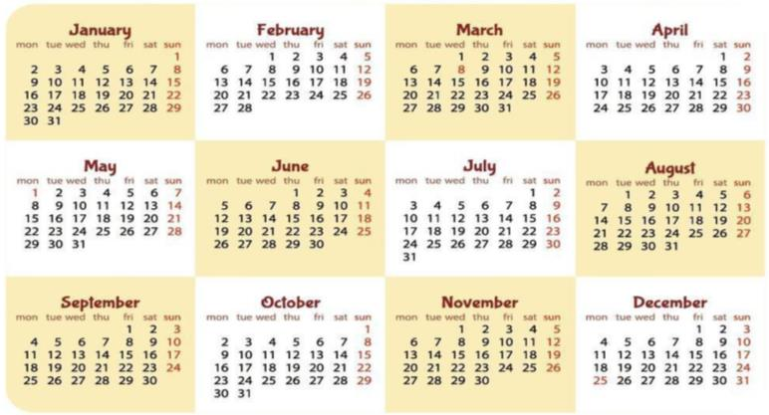
Let's guess

Slide 16
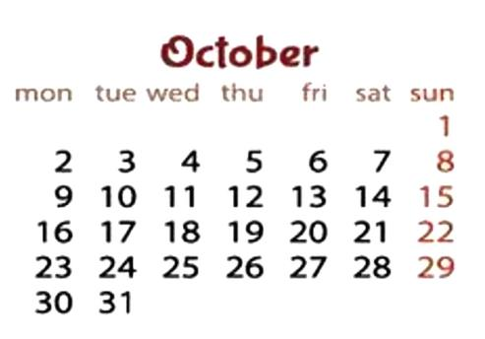

Slide 17
When is your birthday? It's on the ...

Slide 18
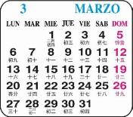
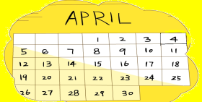
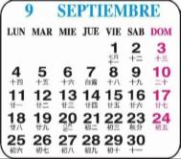
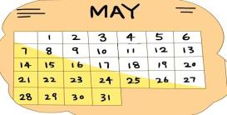
Work in pairs:
A：When is your birthday ?
B: It’s on…
①
MARCH
②
Great!
③
④

Slide 19
Piece 5:
Do a survey and report. (完成问卷调查表并汇报。)

Slide 20
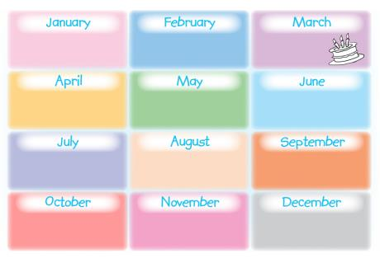
Fun time
四人一组调查组员的生日及做的事情！
When is your birthday?
Excellent!
What do you usually do on your birthday?
It’s on the …
I usually …

Slide 21
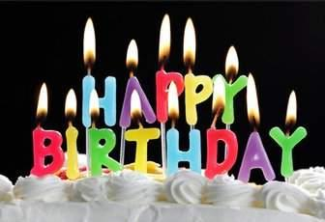
We all have our birthdays. But in different countries, they have different customs.
我们每个人都有我们的生日。但是在不同的国家，有着不同的习俗。

Slide 22
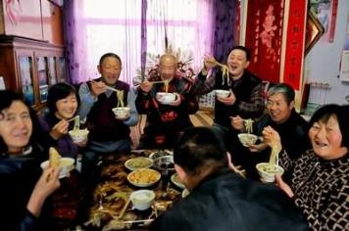
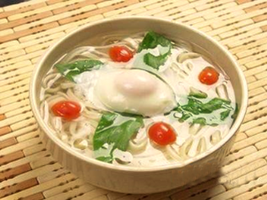
In China, people eat noodles to wish for longevity.
在中国，人们吃面条希望能长寿。

Slide 23
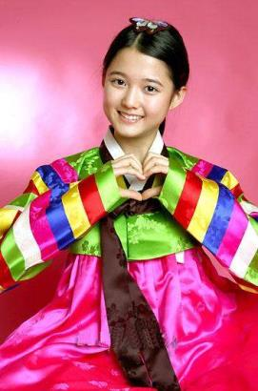
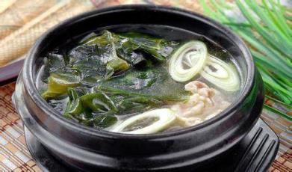
In Korea, people eat seaweed
soup on their birthdays.
在韩国，人们在生日那天
要喝海带汤。

Slide 24
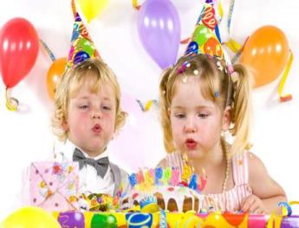
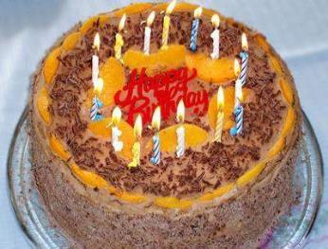
Lots of western people eat birthday cakes on their birthdays, and they put the candles on cakes. The number of the candles is the person’s age.
大多数西方人在生日那天会吃生日蛋糕，并且在蛋糕上插上蜡烛。蜡烛的支数就是那个人的年龄。

Slide 25
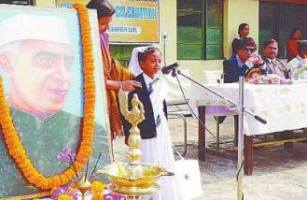
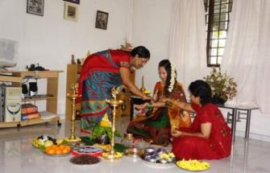
In India, the children kneel before parents, touch their feet to show respect and gratitude.
在印度，孩子们跪在父母面前，摸他们的脚以表示对他们的尊敬和感激。

Slide 26
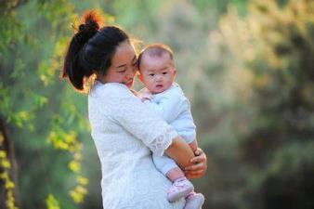
Remember
Our parents bring us to the world.
父母把我们带到这个世界。

Slide 27
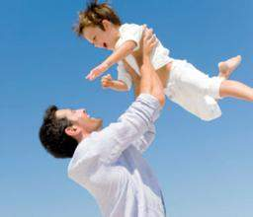
Remember
They grow with us.
他们陪伴我们成长。

Slide 28
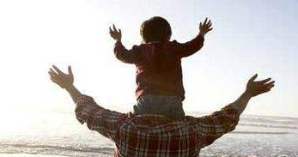
We are the everything in their lives.
我们就是他们生命中的一切！

Slide 29
Remember our parents’ birthdays,
learn to be grateful!
记住父母的生日，学会感恩！

Slide 30
Homework
1.Finish “Write and say”.
2.Do a survey in your family.

