Slide 1
Unit 7 Seasons
Welcome to the unit
WWW.PPT818.COM

Slide 2
Free talk
How many seasons do you know?
What are they?
What’s the weather like today?

Slide 3
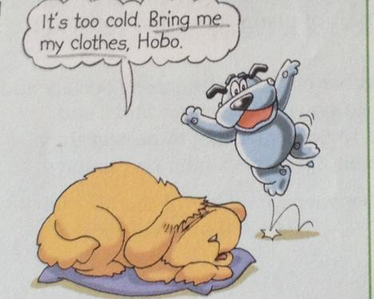
Listen and answer
How does Eddie feel?
He feels cool.

Slide 4
Read and act

Slide 5
Different kinds of weather
snowy
rainy
cloudy
stormy
windy and rainy
sunny

Slide 6
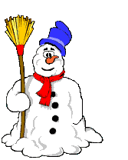
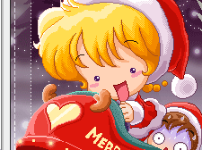
What’s the weather like?
snowy
The earth is covered with thick _________. It _______heavily.
The weather is ________. It’s _______.
snow
snowed
snowy
snowy

Slide 7
What’s the weather like?
It is a _______day.The wind is blowing strongly and the rain is too heavy.
stormy

Slide 8
What’s the weather like?
It is _______too heavily. It’s a _____ day.The world is all wet.You should take a raincoat or an umbrella with you.
raining
rainy

Slide 9
How is the weather?
The _______is too strong .What a _________day!
wind
windy

Slide 10
How is the weather ?
Look!There are a lot of _______.How _____it is!It is going to rain.
clouds
cloudy

Slide 11
How is the weather ?
The ______is shining brightly.It is a ________day.We can enjoy ourselves outside.
sun
sunny

Slide 12
How is the weather ?
There’s too much _______.We can’t see anything clearly.It’s so ________.We must drive carefully
fog
foggy

Slide 13
What’s the weather like?
The window is covered with much_______. It’s ______weather.
frost
frosty

Slide 14
Learn more about kinds of weather
Nouns Adjectives
Nouns Adjectives
cloud
fog
frost
storm
cloudy
sun
wind
rain
snow
sunny
foggy
windy
frosty
rainy
stormy
snowy
表 天气的名词 + y /双写 + y 形容词

Slide 15
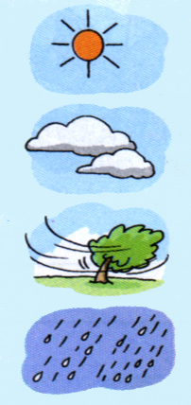
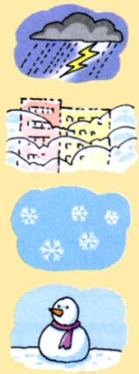
Talk about the weather
A: What’s the weather like?
B: It’s…

Slide 16
Talk about favourite seasons
What’s Simon’s favourtie season?
Why does Amy like summer?
Simon likes autumn best.
Because she can go swimming and enjoy ice cream.

Slide 17
Make up your dialogues
Make up a dialogue with your partner to talk about the favourite seasons.

Slide 18
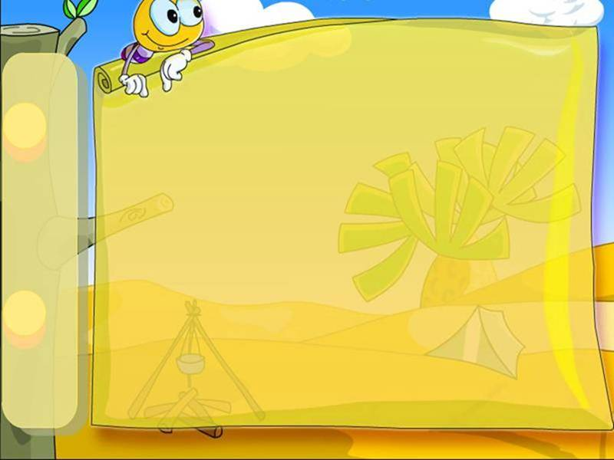
Homework
Talk about weather and seasons.
Pre-read ‘A poem about the seasons’.

