Slide 1
Unit 3 Would you like to come to my birthday party
WWW.PPT818.COM

Slide 2
Just resd and talk
Kate,Gao Wei&Peter:Happy birthday!Lisa!
Lisa:Thank you ! Welcom to my birthday party.
Kate:Here is a teddy bear for you!
Gao Wei:I have a new storybook for you!
Peter:Look!Here are some chocolates for you！
Lisa:Thank you very much!

Slide 3
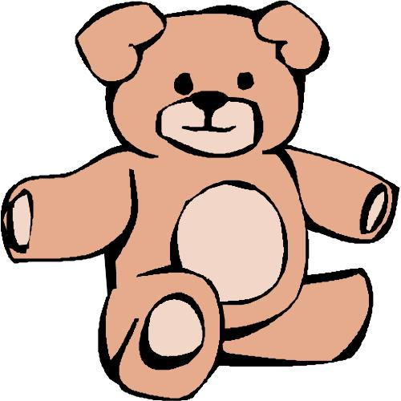
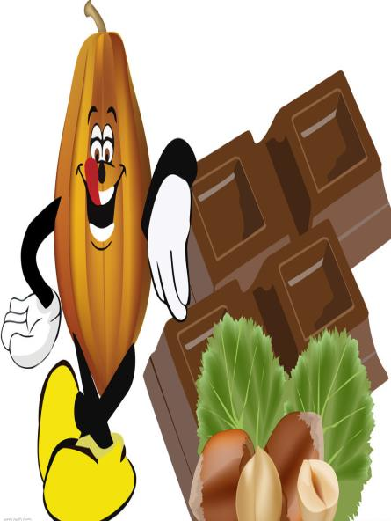
Just resd and talk

Slide 4
Just resd and talk
Mum:Shall we begin the party?
All:Yeah!
Mum:Let's light the candles and sing birthday song.
All:Ok!

Slide 5
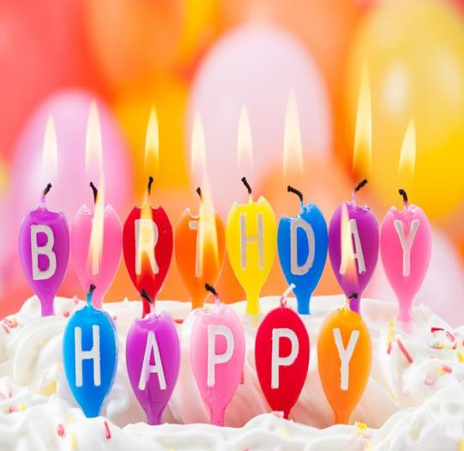
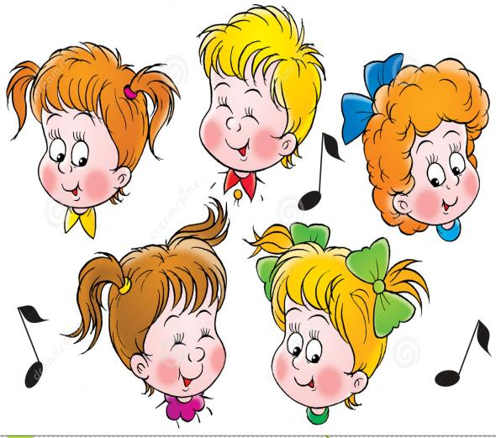
Just resd and talk

Slide 6
Just resd and talk
All:Make a wish and blow out the candles,Lisa.
Lisa:All right. Let me make a wish!
All:And now,cut the cake,Lisa.
Lisa:Ok.I have a piece of cake ,please!
All:Thank you,

Slide 7
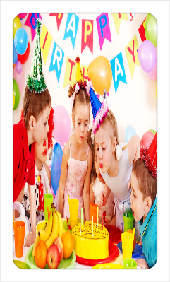
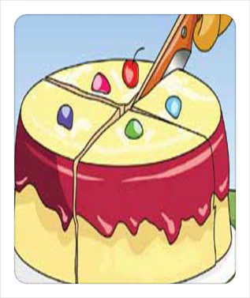
Just resd and talk

Slide 8
Read and Answer
1.What kind of cake would Lisa like?
She’d like a chocolate cake
2.What shape of cake does Lisa like?
she likes a hear-shaped cake
3..Why does Lisa choose a heart-shaped cake?
Because it shows Lisa’s love for her mother and father.

Slide 9
Pair-work (T or F)
1.Lisa wants to buy a chocolate star-shaped cake.
2.The cake can show her love for her parents
3.Lisa is a good girl in her mother’s eyes
F
T
T

Slide 10
A你想要什么种类的蛋糕，丽萨
B我想要一个巧克力蛋糕
A你想要什么形状的，
这个星星形状的蛋糕怎么样？
B Well，妈妈，我真的喜欢那个心形蛋糕
A那太棒了，它可以显示我们对你的爱
B谢谢，妈妈，它也可以显示我对你和爸爸的爱。
好女孩
A我能买一些冰淇淋和一些果冻吗？
B当然，而我会为你拿一些糖果和蔬菜派
A谢谢，妈妈，我将会有一场盛大的生日聚会。

Slide 11
Fill in the blanks
A; What of would like?
B; Like a cake.
A: what would you ?
B: How star- cake?
A: Well, Mum, I like that cake.
B: That’s ! It show love for
A: you ,mum, it can also my love you and dad
B: girl.

Slide 12
知识点拨
1.How about a cake?
How about going fishing?
How about （去购物）?
2.It can show our love
It shows our love
Show sb. Sth= show sth. to sb.
3.I’d like a star-shaped cake.划线部分提问
What would you like?

Slide 13
Some 既可用来修饰可数名词也可修饰不可数名词
Some jelly, ice cream, fruit, candy, tea ( un.) coffee, water，meat, bread, rice, milk
Some cakes, pies, apples, boxes, chocolate, flowers, stories, stamps,, maps, cars, colors, photo, cards (cn.)

Slide 14
观察句子特征
1.I will go to school变一般疑问句
He will go to work
2.Will =be going to do sth.将要
He will have a birthday party on January.=
He is going to have a birthday party
3.今天是丽萨在中国的第一个生日
Today is Lisa’s first birthday in China.

