Slide 1
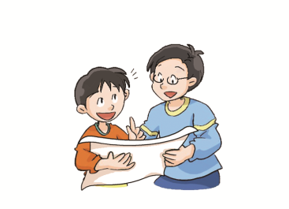
Oxford English
Module 4 The world around us
Around the city
WWW.PPT818.COM
Notes:
1

Slide 2
Let’s enjoy
Ming, Ming, what can you see?
I can see a small shop in the street.
Ming, Ming, what can you see?
I can see some cheese in front of me.
milk shop
cheese shop

Slide 3
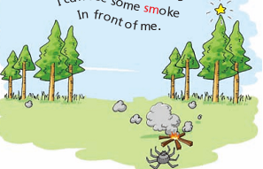
Let’s chant
Spider, spider, what can you see?
I can see a small star on the tree.
Spider, spider, what can you see?
I can see some smoke in front of me.

Slide 4
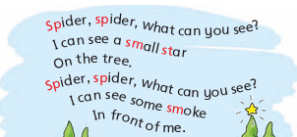
smell,
smooth,
smart ...
spell,
spoon,
sport ...
stand,
start,
story ...

Slide 5
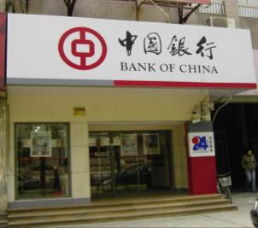
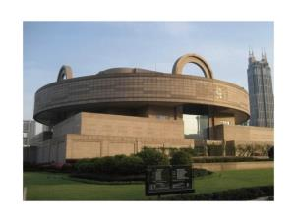
Ask and answer
How do you get to school from your home?
What’s on your way to school?

Slide 6
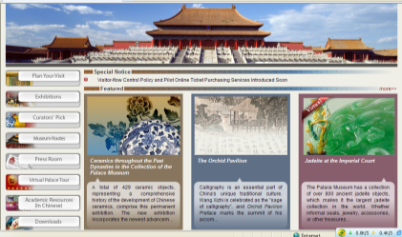
museum
The Palace Museum
Shanghai Museum
People can see and learn many interesting things there.

Slide 7
bank
People keep their money here.

Slide 8
Riddle
hotel
It’s a place.
People can stay here for some time.
They can eat and sleep here.
What can you do in a hotel?
Have a big dinner.
Have a party.
Have a meeting.
Have a wedding.
…

Slide 9
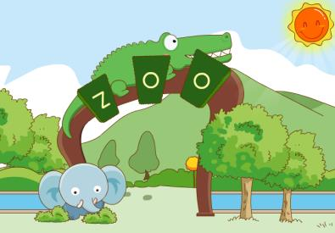
Riddle
It’s a place.
People can see many animals there ...
What animals do you like?
zoo

Slide 10
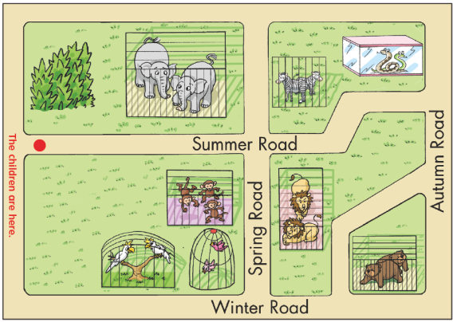
Choose and find
Group work: Find the animals
monkeys
?
bears
birds
Choose an animal you want to see.
2. Find partners.
3. Talk with your partners. How do you get there?

Slide 11
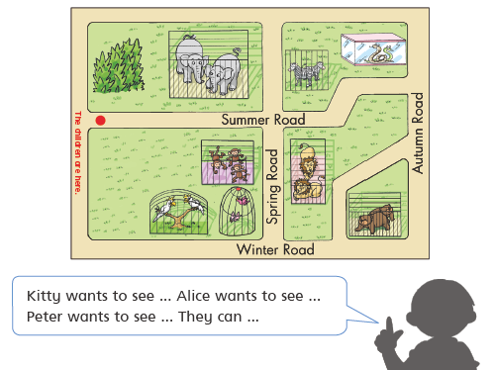

Slide 12
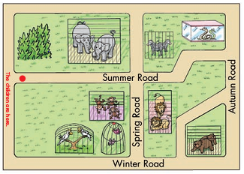
Ask and answer
What does Alice want to see?
How does she get there?
Walk along Summer Road and then turn right. The monkeys are on the right.

Slide 13
Ask and answer
What does Kitty want to see?
How does she get there?
Walk along and then turn right. Walk along Spring Road. The birds are .

Slide 14
Ask and answer
What does Peter want to see?
How does he get there?
Turn …
Walk along …
The bears are …

Slide 15
S1: What do you want to see?
S2: I want to see …
S1: How do you get there?
S2: Walk along …
Turn …
I see the … on my …

Slide 16
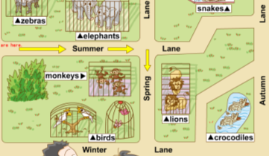
What do you want to see?
I want to see …
I want to see …
I want to see …
We can walk along … and then turn …
We can see the on the …
…
…

Slide 17
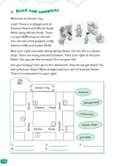
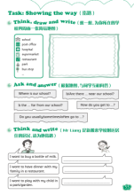
Homework
1. Read the dialogue on page 60.
2. Think and write about how you find
your favourite animal in the zoo.
3. Finish Workbook pages 54 and 55.

