Slide 1
Unit6 I’m tall.
人教精通版四年级上册
WWW.PPT818.COM

Slide 2
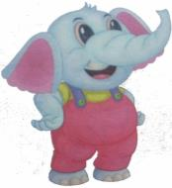
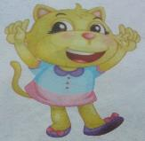
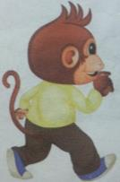
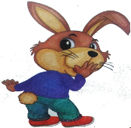
Review
Let's chant!
An elephant has big ears.
A cat has small ears.
A monkey has a long tail.
A rabbit has a short tail.

Slide 3
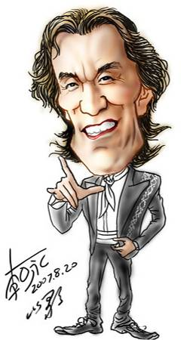
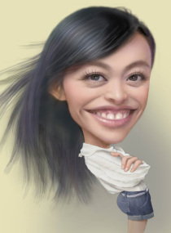
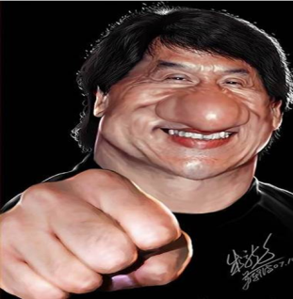
Review
Look and say
…
He has…
…
…
She has…
…
…
He has…
…

Slide 4
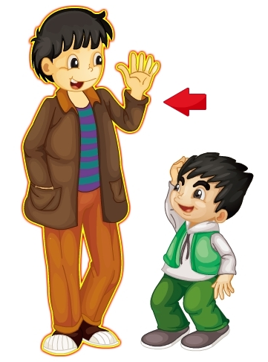
Let’s learn
Presentation
tall

Slide 5
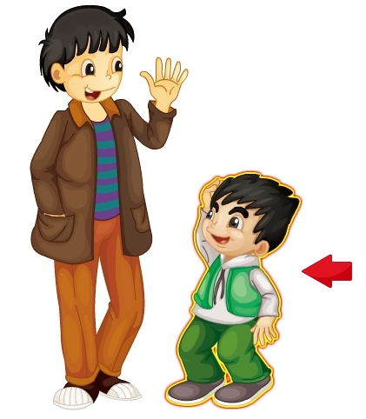
Let’s learn
Presentation
short

Slide 6
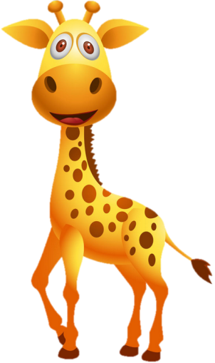
Look and say
Presentation
Hi, little mouse. Come here.
Look at me. I am tall.
Ha! Ha! How funny!
OK. I’m coming.
Look at me.
How tall I am! You are short.

Slide 7
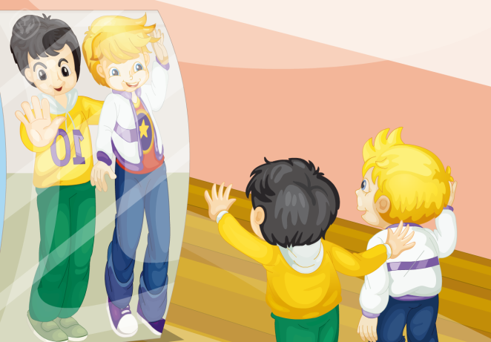
Look and say
Presentation
What are they talking about?

Slide 8
Look and say
Presentation
Who is tall, Peter or Gao Wei?
They’re both tall.

Slide 9
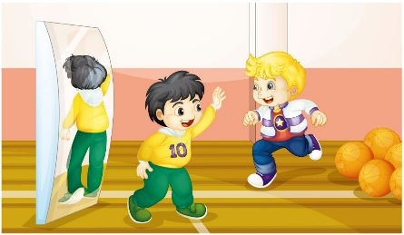
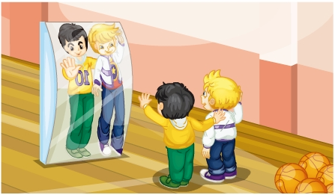
Presentation
Listen and imitate
1
2
Hi, Peter. Come here.
OK. I’m coming.
3
4
Look at me. How tall I am.
Ha, Ha! How funny!
Look! You’re tall, too.
Ha, Ha! We’re both tall!
5
6

Slide 10
Practice
Let’s read
1
2
3
Read together.
(齐读)
Read in roles.
（分角色读）
Read in groups.
(分组读）

Slide 11
Show time
两人一组试着来表演，其他同学来评价。
 | 模仿录音中的语音语调，有感情地朗读。
 | 可以脱离课本，适当改动其中部分，语音地道。
 | 适当添加内容，意思完整，有创新，表演生动。
Good
Great
Excellent

Slide 12
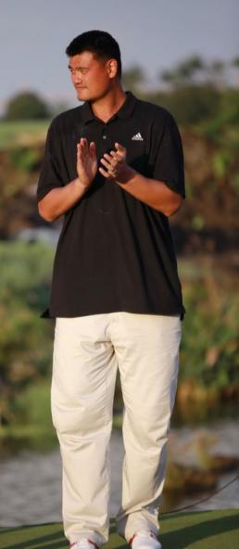
Practice
Act and say
I’m ... (tall/short).
Look at ...
How … I am.
Guess, who am I?

Slide 13
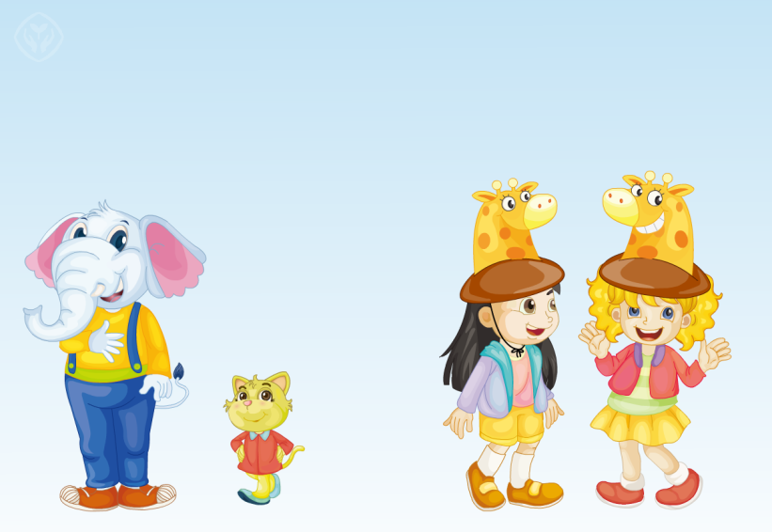
Practice
Let’s play
找朋友游戏：学生分为六人一组，找身高类似的同学作为partner，并用上本课所学的句子进行对话。

Slide 14
Practice
Read and write
1. big 2. tall
3. long 4. black
5. yes
small
short
short
white
no

Slide 15
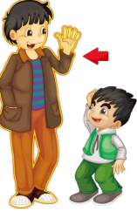
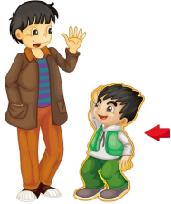
Practice
Look and write
看图补全对话。
A: Who’s this _____?
B: He’s my father.
A: How ____ he is!
B: Yes, he’s a basketball player.
A: ____ the boy your brother?
B: Yes, he’s my little brother.
A: He’s _____.
B: Right.
man
tall
Is
short

Slide 16
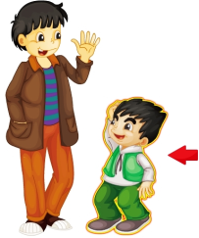
Summary
本课所学的重点单词和句型是：
I’m …
You’re …
tall
short

Slide 17
Homework
1. 跟读Just talk部分的课文动画或录音，并注意语音、语调。
2.用本课所学的知识，试着给自己的家人描述一下你的同桌或其他朋友。
3. 预习Lesson34。
Close

