Slide 1
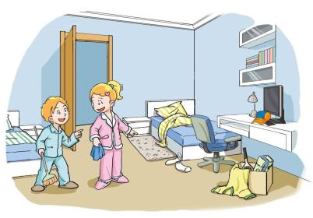
1
Tidy up!
WWW.PPT818.COM

Slide 3
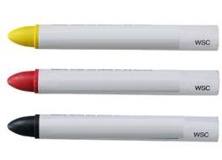
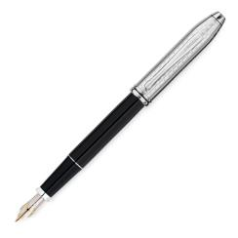
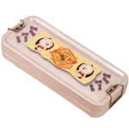
Look and read
crayon
pencil
pen
book
rubber
ruler
pencil box

Slide 4
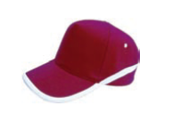
Look and spell
crayon
cap
umbrella
socks

Slide 5
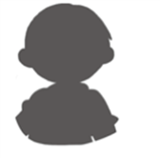
Make a dialogue
Is this your book?
Is this yours?
Yes, it’s mine.
It’s my book.
Is that your bag?
Is that yours?
No, it’s not mine.
It’s your bag.

Slide 6
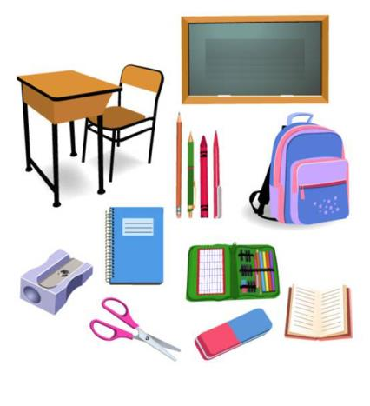
Is that your ____?
Is that yours?
Yes./No, it’s not mine.

Slide 7
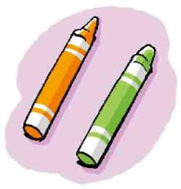
Read a chant
My crayon. Your crayon. These are our crayons.
His crayon. Her crayon. Those are their crayons.
This is mine. That is yours. These are ours.
This is his. That is hers. Those are theirs.
These are our crayons. They are ours.
Those are their crayons. They are theirs.

Slide 8
Think and read
人称代词 | 形容词性物主代词 | 名词性物主代词
I | my | mine
you | your | yours
he | his | his
she | her | her
it | its | /
we | our | ours
they | their | theirs

