Slide 1
What colour is it?
第5课时
WWW.PPT818.COM

Slide 2
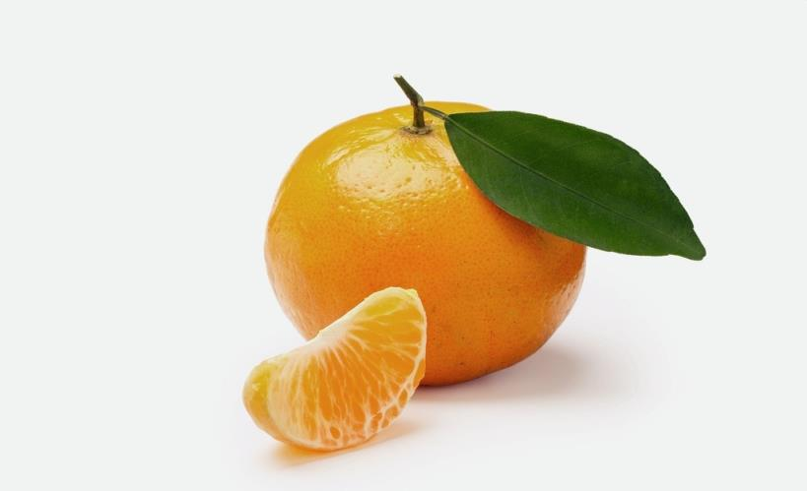
The orange is orange.

Slide 3
The rainbow is pink, blue, green, yellow, orange and red.

Slide 4
Let’s draw a kite.

Slide 5
Colour it pink.

Slide 6
Colour it pink and orange.

Slide 7
Color it pink, orange and grey.

Slide 8
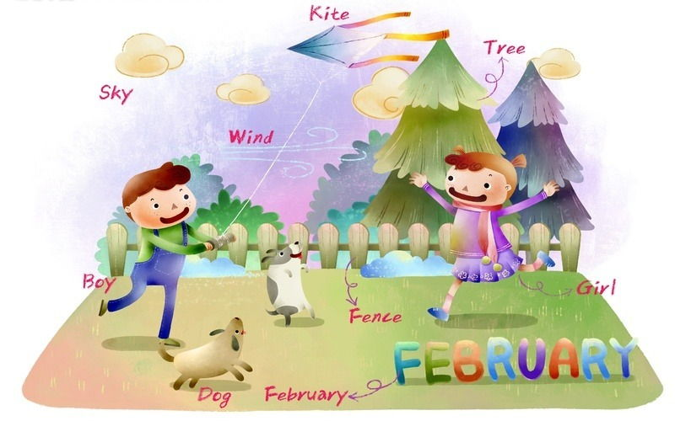
Let’s fly it.
Great!

Slide 9
Let’s chant
Red and yellow and pink and green, purple and orange and blue.
I can sing a rainbow, sing a rainbow, sing a rainbow now.

Slide 10
Gao Wei: Let’s draw a kite.
Lisa: OK!
Gao Wei: Colour it pink, orange and grey.
Lisa: All right.
Gao Wei: Let’s fly it.
Lisa: Great!

Slide 11
Let’s sing again.
Colour song

Slide 12
Thank You.

