Slide 1
UNIT 5 Lesson 3
How much is this shirt?
WWW.PPT818.COM

Slide 2
sing a song
Eleven, twelve, thirteen little
pandas
Fourteen, fifteen, sixteen little
pandas.
Seventeen, eighteen, nineteen little
pandas.
Twenty little pandas dance.

Slide 3
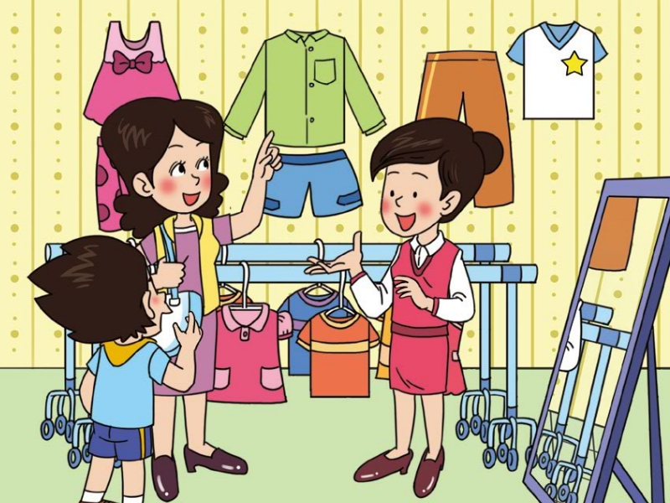
￥100
How much is this shirt？
It‘s one hundred yuan.

Slide 4
Chant
How much, how much
How much is this shirt?
One hundred, one hundred
It‘s one hundred yuan.

Slide 5
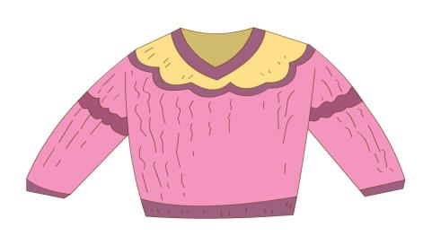
￥58
How much is the sweater?
It‘s fifty-eight yuan

Slide 6
63
78
59
92
47

Slide 7
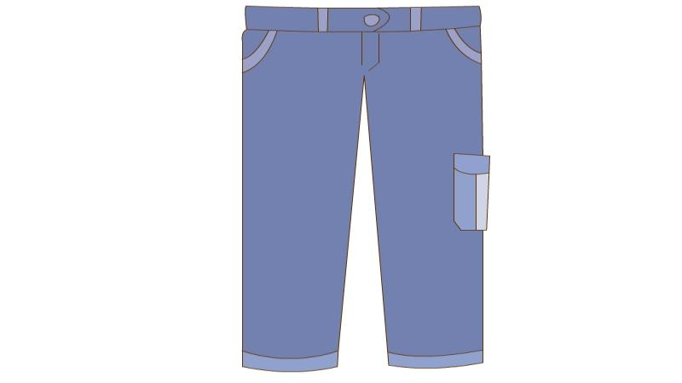

Slide 8
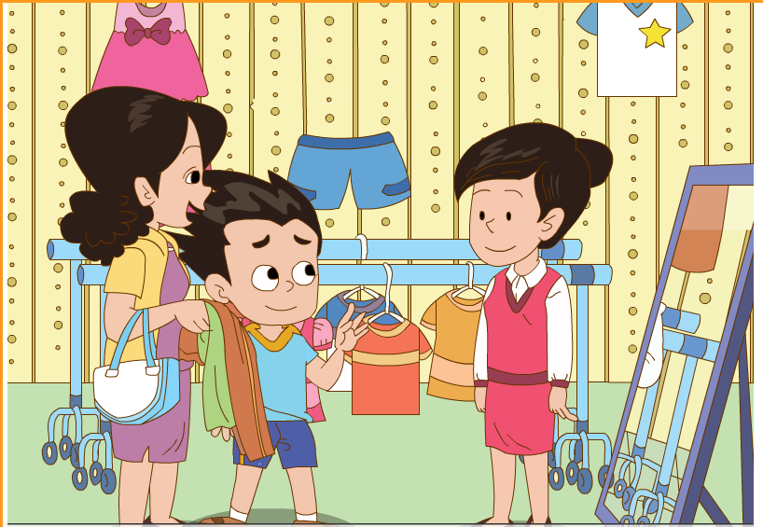
How much are the trousers?
They‘re sixty-seven yuan.
￥67

Slide 9
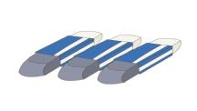
Pairwork
---How much are the…?
---They‘re … yuan.

Slide 10
Watch and answer
1.How much is the shirt?
2.How much are the trousers?

Slide 11
Questions
1.How much is the shirt?
It‘s one hundred yuan.
2.How much are the trousers?
They‘re fifty-eight yuan.

Slide 12
Watch and repeat

Slide 13
Pairwork
Read the text in roles and
show in the class.
小组内分角色朗读课文，并
在班里展示。

Slide 14
Welcome to my shop
---Excuse me, do you have---?
---Yes, we do.
---How much is/are the---?
---It's / They're …
---OK, I'll take it./them.

Slide 15
Homework
1、Read the text after the tape.
2、Use “How much is---/How much are ---?” to ask and answer.

