Slide 1
UNIT 5 Music
人教版高中英语必修二
Section A Listening and Speaking
WWW.PPT818.COM

Slide 2
生活的苦难压不垮我,我心中的欢乐不是我自己的,我把欢乐注进音乐,为的是让全世界感到欢乐。
——莫扎特
Mozart:the greatest musician of all time
Mozart was a composer,possibly the greatest musician of all time.He only lived 35 years and he composed^{①} more than 600 pieces of music.
Mozart was born in Salzburg,Austria on January 27,1756.His father,Leopold,was a bookbinder.He was also a violin teacher and became famous when he published^{②} a method of study for the violin.

Slide 3
Mozart composed his first song when he was four years old even before he had learned to read.Shortly before his fifth birthday he was able to learn a scherzo in 30 minutes.He published his first composition when he was eight years old.
Once he picked up a violin and though he had never had a violin lesson,he was able to sight read perfectly a piece written for the violin.At a later time while visiting Rome he heard a choral work being performed and was able to remember it and write it down note for note.His father was amazed.

Slide 4
Leopold realized the extraordinary capabilities of his son and knew people would pay to see him perform^{③}.So the family went on a tour that would take them to many countries.Between the ages of seven and fifteen,the young Mozart spent half of his time on tours.During these tours,Mozart heard,absorbed^{④},and learned various European musical idioms,eventually crystallizing(使结晶) his own mature style.
By the time he was 14,Mozart had composed many pieces for the harpsichord(大键琴),piano and violin,as well as for orchestras.While he was still a teenager,Mozart was already a big star and toured Europe giving concerts^{⑤}.He died in 1791.

Slide 5
词海拾贝
①compose vt.创作
②publish vt.发表
③perform vt.表演
④absorb vt.吸收
⑤concert n.音乐会
典句欣赏
Mozart composed his first song when he was four years old even before he had learned to read.
翻译:莫扎特四岁时创作了他的第一首歌,这甚至是在他学会阅读之前。
分析:本句是一个复合句。Mozart composed...是主句,when和before引导的都是时间状语从句。

Slide 6
理解诱思
1.What do we know about Mozart when he was a child?
答案:He showed great talent for music.
2.What do you think of Mozart?
答案:He was one of the greatest musicians of all time.

Slide 7
Ⅰ
Ⅱ
Ⅲ
classical
energy
soul
stringed

Slide 8
Ⅰ
Ⅱ
Ⅲ
弦乐器
世界语言
表演
造句
触动心灵
跟着……跳舞
感觉像;想要
与……相同
给某人能量
使某人想起;提醒某人某事

Slide 9
Ⅰ
Ⅱ
Ⅲ
Ⅱ.释义匹配
1.classical A.the physical and mental strength that make you enable to do things
2.energy B.belonging to a traditional style or set of ideas
3.soul C.a strong thread made of several threads twisted together
4.string D.the part of a person that is not physical,and that contains their character,thoughts,and feelings
答案:1.B 2.A 3.D 4.C

Slide 10
Ⅰ
Ⅱ
Ⅲ
Ⅲ.介词填空
1.He played another video so that people could dance the music.
2.With my working-class background I feel a fish out of water among these people.
3.The weather of this year is not the same that of the past years.
4.If you hadn’t reminded me this matter,I would certainly have forgotten it.
5.There is a reason every important thing that happens.
to
like
as
of
for

Slide 11
重点词汇
重点句式
随堂练习
1.energy n.能源;能量;精力
【课文原句】I like to listen to it when I exercise.It gives me energy.
我锻炼时喜欢听,它给我能量。

Slide 12
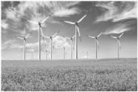
重点词汇
重点句式
随堂练习
【词汇精讲】energy是名词,意为“能源;能量;精力”。
We will also have to rely more on renewable energy,
such as solar and wind power.
我们也必须更多地依靠像太阳能和风能这样的可再生能源。
When you concentrate on one task,you will find you have energy that you didn’t even know you had.
当你集中精力于一项任务时,你会发现你拥有甚至自己都不知道的能量。
While sitting in the classroom and doing my papers,I felt confident and was full of energy.
我坐在教室里做试卷时感到信心十足、精力旺盛。

Slide 13
重点词汇
重点句式
随堂练习
【词汇拓展】
【易混辨析】

Slide 14
重点词汇
重点句式
随堂练习
It may take a few weeks for you to build up your strength again.
可能需要几个星期你才能恢复体力。
The force of the explosion broke the windows of several buildings.
爆炸的冲击力震碎了几栋楼房的窗户。
Human societies have the power to solve the problems confronting them.
人类社会有能力解决面临的问题。

Slide 15
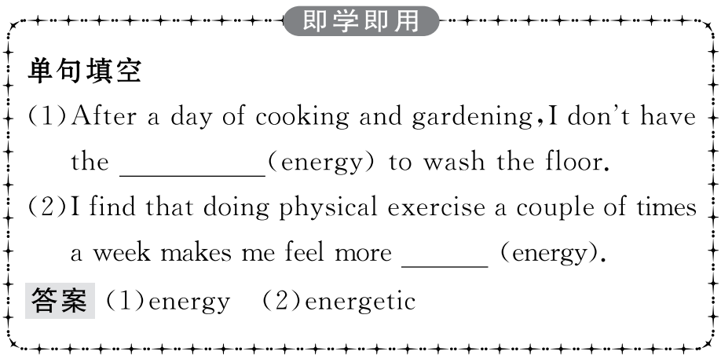
重点词汇
重点句式
随堂练习

Slide 16
重点词汇
重点句式
随堂练习
2.feel like想要;摸起来像
【课文原句】Classical music makes me feel like I’m sitting beside a quiet stream and enjoying nature.
古典音乐让我觉得像坐在一条宁静的溪流旁,享受着大自然。
【词汇精讲】feel like是动词短语,意为“想要;摸起来像”,后面可接名词、代词或动词-ing形式作宾语。
I am very thirsty and feel like a drink now.
我很渴,现在想喝点饮料。
I feel like going rock climbing with you this weekend.
这周末我想和你一起去攀岩。

Slide 17
重点词汇
重点句式
随堂练习
【易混辨析】
I would like to have a copy of dictionary.
我想买一本字典。
What would you like to do?
你想做什么?

Slide 18
重点词汇
重点句式
随堂练习

Slide 19
重点词汇
重点句式
随堂练习
This will help you make it easier to understand.
这有助于你使它更容易理解。
【句式剖析】句中为“make it+adj.+for sb to do sth”句型, 其中it作形式宾语。
Berners-Lee made it possible for everyone to use the Internet,not just universities and the army.
伯纳斯·李使每个人都能使用因特网,而不仅仅是大学和军队使用。

Slide 20
重点词汇
重点句式
随堂练习
【句式拓展】(1)make+it+形容词/名词+that从句
make+it+形容词/名词+to do不定式
make+it+no good/no use/no value...+doing sth
(2)常用于这种句型的动词:make,think,consider,find,feel等。
Susan made it clear to me that she wished to make a new life for herself.
苏珊清楚地跟我表明她希望为自己创造新的生活。
I consider it no use quarrelling with him about it.
我认为就这件事情和他争吵是没有用的。

Slide 21
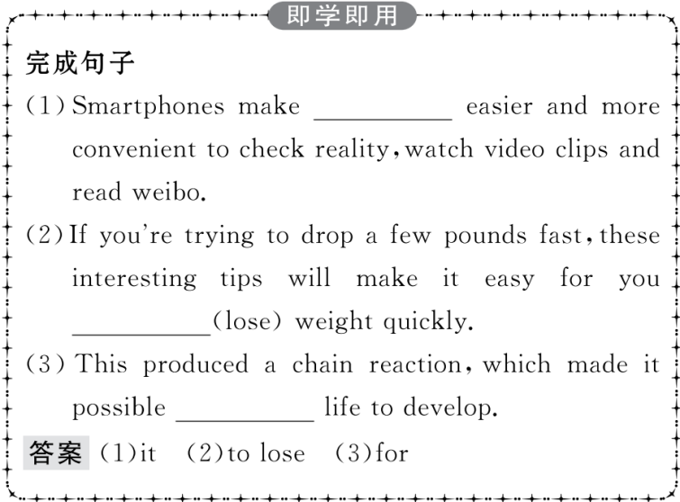
重点词汇
重点句式
随堂练习

Slide 22
重点词汇
重点句式
随堂练习
Ⅰ.选词填空
1.I was moved because the music my soul.
答案:touched
2.Solving the problem is very important at present.
答案:energy
3.Take a friend’s recommendation even if it doesn’t very interesting.
答案:sound
4.You’ll better after a good night’s sleep.
答案:feel
5.There must agreement of a verb and a subject in person and number.
答案:exist
touch,exist,energy,sound,feel

Slide 23
重点词汇
重点句式
随堂练习
Ⅱ.单句填空
1.How does this kind of music make you (feel)?
答案:feel
2.Take this map with you.It will be (help) to you.
答案:helpful
3.By using an experiment,he made it (easy) for us to understand.
答案:easier
4.I am thirsty now and I feel like (have) a cup of tea.
答案:having
5.The president agreed,adding that he hoped for a (peace) solution.
答案:peaceful

