Slide 1
Unit 3
I am more outgoing than my sister.
Section B
WWW.PPT818.COM

Slide 2
Free talk:
What is a good friend?

Slide 3
A good friend…
is good at sports.
is good at school work.
is popular at school.
likes to do the same things as me.
has cool clothes and hair style.
makes me laugh.
is more outgoing than me.
has good grades.
likes telling jokes.
keeps secrets（秘密）……
My view

Slide 4
2a Write the comparative forms of the following
adjectives. Then use them to write five sentences
about you and your friends.
popular________ funny ________
quiet ________ friendly ________
shy ________ serious ________
outgoing ___________ smart ________
hard-working ________________________
more popular
funnier
quieter
friendlier
shyer
more serious
more outgoing
smarter
more hard-working

Slide 5
Sample:
My friend David is more hard-working than
me, but I am funnier than him.
write the rest sentences by yourself.
__________________________________________________________
__________________________________________________________
__________________________________________________________
__________________________________________________________

Slide 6
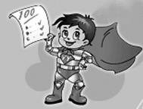
New words
mirror n. 镜子
kid n. 小孩；年轻人
grade n. 成绩等级；评分等级
saying n. 谚语；格言；警句
heart n. 内心；心脏
hand n. 手

Slide 7
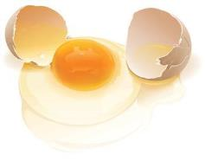
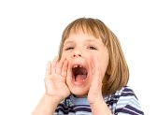
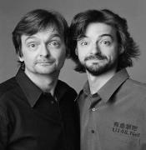
break v. (使)破；裂；碎；损坏
laugh v. 笑；发笑
n. 笑声
arm n. 手臂；上肢
loud adj. 响亮的；大声的
similar adj. 相像的；类似的

Slide 8
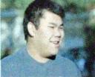
Read the passages quickly and match the person with the right ideas.
Friends are like books —you don’t need a lot of them.
Huang Lei
A true friend reaches for your hand and touches your heart.
Mary Smith
It’s not necessary to be the same. My best friend is quite different from me.
Jeff Green

Slide 9
My mother told me a good friend is
like a mirror. I’m quieter and more
serious than most kids. That’s why
I like reading books and I study harder in class. My best friend Yuan Li is quiet too, so we
enjoy studying together. I’m shy so it’s not easy for me to make friends. But I think friends are like books- you don’t need a lot of them as long as they’re good.

Slide 10
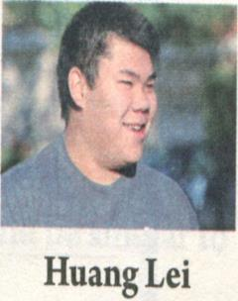
It’s not necessary to be the same.
My best friend Larry is quite
different from me. He is taller
and more outgoing than me.
We both like sports, but he plays tennis better, so he always wins. However, Larry often helps to bring out the best in me. So I’m getting better at tennis. Larry is much less hard-working, though. I always get better grades than he does, so maybe I should help him more.

Slide 11
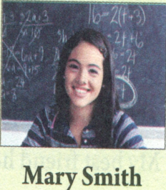
I don’t really care if my friends are
the same as me or different. My
favorite saying is. “ a true friend
reaches for your hand and touches
your heart.” My best friend Carol is really kind and very funny. In fact, she’s funnier than anyone I know. I broke my arm last year but she made me laugh and feel better. We can talk about and share everything. I know she cares about me because she’s always there to listen.

Slide 12
Read the passage carefully and find the differences and similarities between friends.
differences:
I’m quieter and more serious than most kids.
He is taller and more outgoing than me.
He plays tennis better.
Larry is much less hard-working.
I always get better grades than he does.
She’s funnier than anyone I know.

Slide 13
Similarities:
My best friend Yuan Li is quiet, too.
We both like sports.
We can talk about and share everything.

Slide 14
2c Are the statements true (T) or false (F)?
Jeff is less serious than most kids.
Jeff and Yuan Li are both quiet.
Jeff thinks it is easy for him to
make friends.
4. Huang Lei is taller than Larry.
F
T
F
F

Slide 15
5. Huang Lei isn’t as good at tennis as Larry.
6. Larry works harder than Huang Lei.
7. Mary thinks her friends should be the
same as her.
8. Carol broke her arm last year and Mary
made her feel better.
T
F
F
F

Slide 16
2d How do you and your friends compare with
the people in the article? Write five sentences.
I’m different from Jeff because I'm louder
than the other kids in my class. My best
friend is similar to Larry because she’s
less hard-working than me.
______________________________________

Slide 17
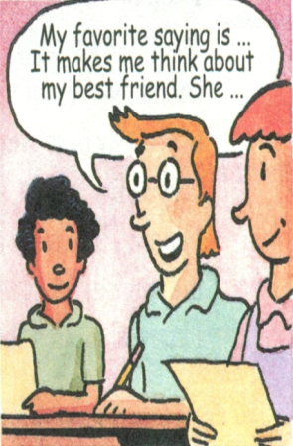
2e Which saying is your favorite? Which friend do you think about when you read this saying? Why? Tell your partner about it.
1.A good friend is like a mirror.
2. Friends are like books- you
don’t need a lot of them as
long as they’re good.

Slide 18
3. My best friend helps to bring out the best in me.
4. A true friend reaches for your hand and touches your heart.

Slide 19
1.Is it easy for Jeff to make friends?
2.What’s the idea of Jeff about friends?
3.Who’s Huang Lei’s best friend?
4.Does Larry get better grades than
Huang Lei?
5.What’s Mary’s favorite saying?

Slide 20
Language points
1. I’m quieter and more serious than most kids.
serious adj. 严肃的；稳重的
比较级形式为more serious。
e.g. Mr. Bai is more serious than Mr. Zhao.
白先生比赵先生更严肃。

Slide 21
2. That’s why I like reading books and I study
harder in class.
这便是我喜欢看书而且在班里学习更加努
力的原因。
That‘s why… 可视为一个固定句式，表示 “ 这便是为什么……”、 “ 这就是……的
原因”， why的后面一般接句子why I like
reading books and I study harder in class”
在句中作 that 的表语。

Slide 22
3. You don’t need a lot of them as long as
they’re good. 朋友不在多而贵在好。
此句中“ long” 为副词， 与as…as…构
成一个固定搭配 as long as, 用来连接句
子，表示 “只要……”。 又如：
We can talk about this as long as you want.
只要你想谈，我们就可以谈谈这事。
It’s fine as long as you’re happy.
只要你高兴就好。

Slide 23
4. It’s not necessary to be the same.
necessary adj. 必需的；必要的
It’s (not) necessary to do sth.
e.g. It’s necessary to brush your teeth every day.
每天刷牙是有必要的。

Slide 24
5. My best friend helps to bring out the best in me.
我最好的朋友能帮我激发出自己的所能。
bring out 是个习语，“使显现；使表现出”
bring out the best/ worst in someone 译为“ 把
某人最好的（或最坏的）一面表现或显露出
来”。 又如：
In the basketball game, it’s important forthe players
to play together and bring out the best in each other.
在篮球比赛中，队员们密切协作， 是大伙都
发挥到极致是很重要的。

Slide 25
6. So I’m getting better at tennis.
因此，我打网球打得越来越好了。
be good at sth./doing sth.
be better at
get good at get better at

Slide 26
7. I don’t really care if my friends are the same
as me or different.
“ if ” 译为“ 是否” 而非“ 如果”。 If 后
所引导的句子是主句 I don’t really care 的
谓语动词care 的宾语， 故称作“ 宾语从句”
I don’t care if he likes or not-I’m coming.
我不管他喜欢不喜欢——我会来的！
Can you tell me if I’m right, Mr.. Green?
格林先生， 您能告诉我我是正确的吗？

Slide 27
8. A true friend reaches for your hand and
touches your heart. 一个真正的朋友
是在需要时给你帮助，使你感动。
此句中“ hand”引申为“ 帮助， 援助”；
“heart” 则为“情感；感受” 例如：
Can you give me a hand?
你能他帮我一把吗?

Slide 28
The movie touched the hearts of all the people
at the cinema.
这部电影让在场的所有观众动容。
记一记
reach for your hand （伸手帮你一把）
touch your heart （令你感动）

Slide 29
9. I know she cares about me because she’s
always there to listen.
我知道她很在乎我，因为她随时能够听我倾诉。
care about v. 担心 。相当于：be worried, be
interested 指：忧虑、担心、关心、惦念 例句: I really care about my work.
我真的关心我的工作。

Slide 30
一、句型转换
1. Peter is thinner than Sam.
(同义句转换)
2. My sister is better at study than I.
She is clever. (同义句转换)
Sam is fatter than Peter.
My sister is much smarter than me at study.

Slide 31
3. I study science very well. (同义句转换)
4. Miss Li is popular in our class. Mr.
Wang is more popular.(同义句转换)
I am very good at science.
Mr. Wang is more popular
than Miss Li.

Slide 32
二、用比较级形式填空
newer
1.Tom’s bike is new, but John’s bike is ______.
2.Tom’s schoolbag is big, but John’s
schoolbag is _________.
3.Tom’s house is small, but John’s house
is even _________.
4.Tom’s coat is long, but John’s coat is
even _________.
5.Tom’s desk is good, but John’s desk is ______.
bigger
smaller
longer
better

Slide 33
younger
6. He is ________ (young) than I am.
7. Mr. Smith is much _____ (old) than his wife.
8. Chicago is ______ (big) than Paris.
9. This book is ______ (good) than that one.
10. The weather this winter is _______ (bad)
than that of last winter.
older
bigger
better
worse

Slide 34
Thank You!

