Slide 1
Unit 3 Winter in Canada
Lesson 17 I Like All Seasons!
WWW.PPT818.COM

Slide 2
Warming up
1. Sing the song together.

Slide 3
Warming up
2.Play a guessing game.
What do you like to do?
I like/love to…

Slide 4
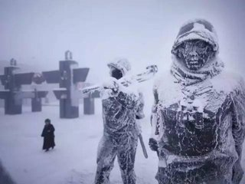
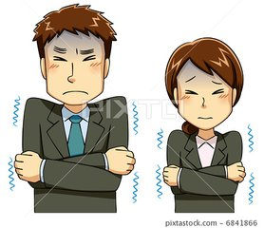
Presentation
1.（1）看图， 联想感知。

Slide 5
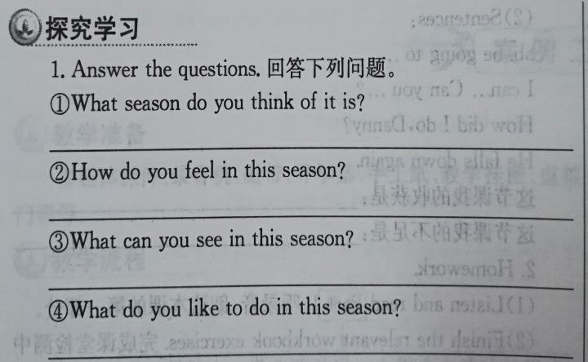
Presentation
1.（2）听录音，完成第1题。
I think it is winter.
I feel cold.
I can see snow.
I like to make snowman.

Slide 6
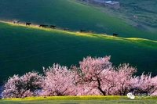
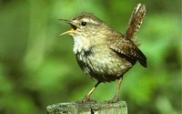
Presentation
2.（1）what can you see?

Slide 7
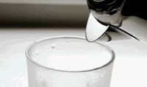
Presentation
3. which do you want?

Slide 8
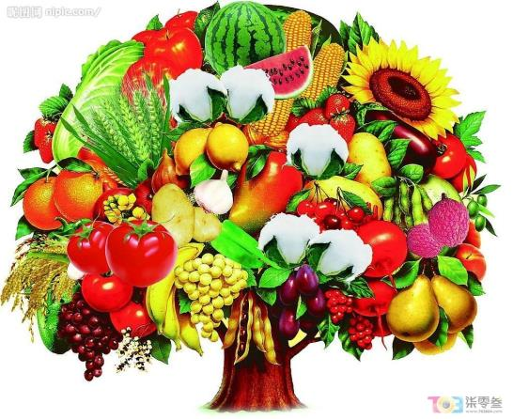
Presentation
4.Do you know what season it is?

Slide 9
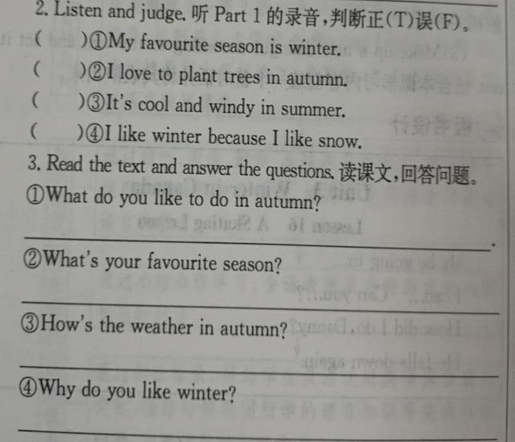
Practice
F
F
F
T
I like to fly a kite.
My favourite season is autumn.
It’s cool and windy.
Because I like the snow.

Slide 10
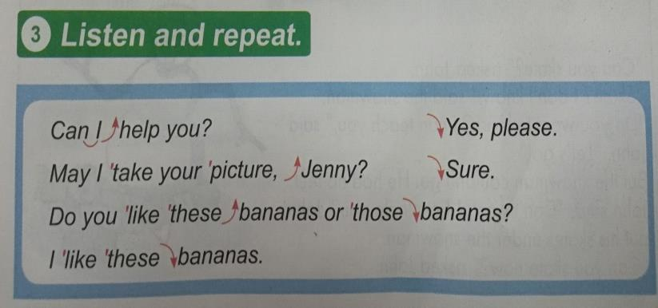
Practice

Slide 11
Consolidation
Name | season | Like | Like to do

Slide 12
Summing up
1.Words:
winter, warm, spring, summer, autumn, cool,
windy, make, snowmen, plant, trees, fly a kite
swim in the sea
2. Sentences:
I like to make snowman.
I love to plant trees.
I love to swim in the sea.
I like to fly a kite.
My favourite season is autumn.
It’s cool and windy.
3.
这节课我的收获是：_____________
这节课我的不足是：_____________

Slide 13
Homework
1.听录音，朗读本课的第一部分
2.完成相关习题
3.写一写你最喜欢的季节并说明理由。

