Slide 1
精通版六年级-上册-第一单元
Unit1
I go to school at 8:00.
WWW.PPT818.COM

Slide 2
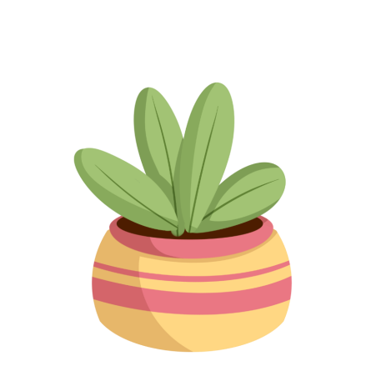

Slide 3
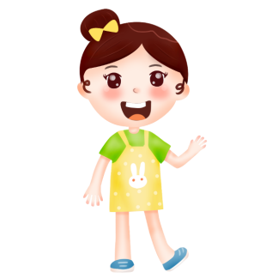

Slide 4
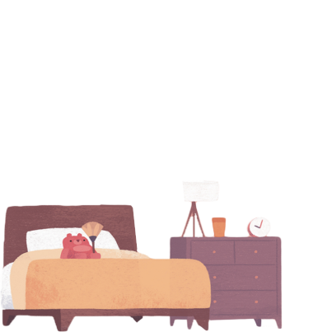
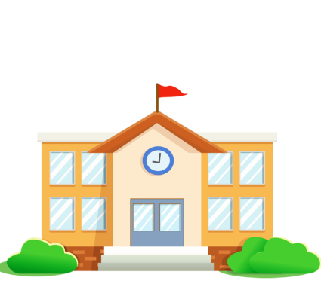
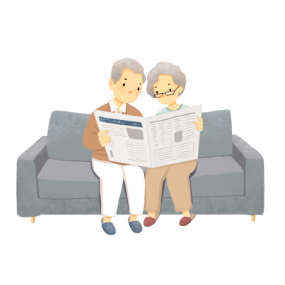
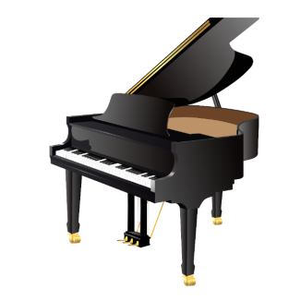
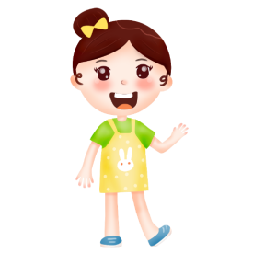
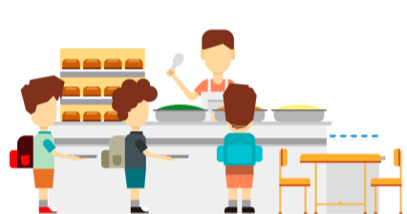
Alice gets up at seven o'clock every morning.
Alice goes to school at half past seven.
Alice has lunch at school every day.
Alice often plays the piano after school.
Alice often visits her grandparents.

Slide 5
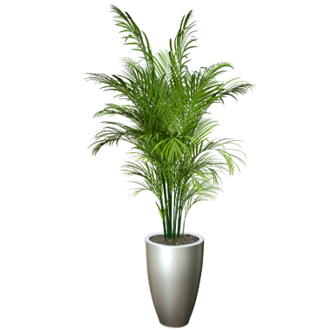
Alice gets up at seven o'clock every morning.
Alice goes to school at half past seven.
Alice has lunch at school every day.
Alice often plays the piano after school.
On Saturdays, Alice often visits her grandparents.

Slide 6
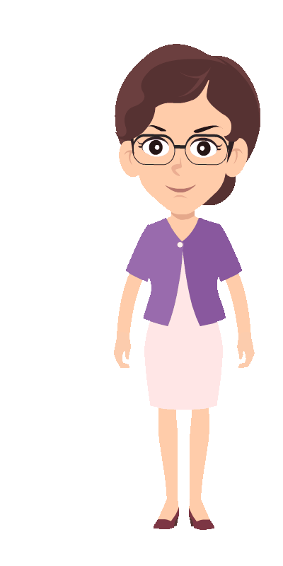
Alice gets up at seven o'clock every morning.
Alice goes to school at half past seven.
Alice has lunch at school every day.
Alice often plays the piano after school.
On Saturdays, Alice often visits her grandparents.
第三人称单数形式

Slide 7
动词第三人称单数

Slide 8
第三人称单数是语言中，对对话双方外其它某一个人指示时使用的代词。简而言之，就是除了我和你以外的某一个人。eg:he,she,it, Alice, Mr. Wang, my mother and so on.
当句子中的主语为第三人称单数时，谓语动词就要发生变化，不能使用原型,必须使用动词第三人称单数形式，简称三单。

Slide 9
Alice gets up at seven o'clock every morning.
get- gets
Alice goes to school at half past seven.
go - goes
Alice has lunch at school every day.
have-has
Alice often plays the piano after school.
play-plays
On Saturdays, Alice often visits her grandparents.
visit-visits

Slide 10
动词第三人称单数的变化规律有哪些

Slide 11
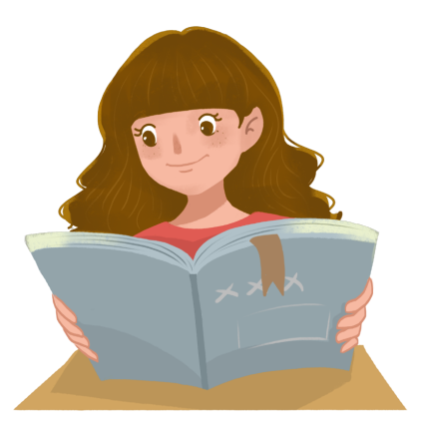
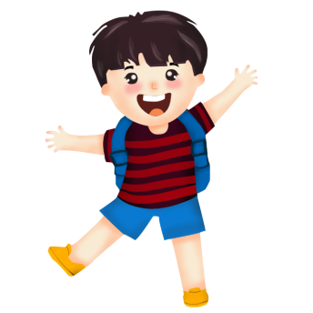
一般情况下，大多数实义动词在词尾加-s;
read→reads
come→comes
My sister usually reads English in the morning.
Bob comes from England.
鲍勃来自英国。
我妹妹通常早晨读英语。

Slide 12
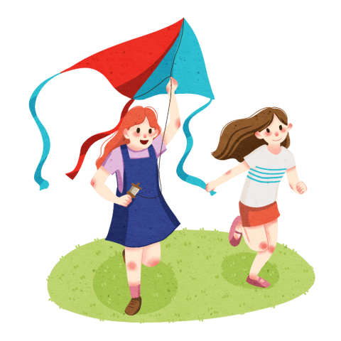
以辅音字母加y结尾的动词，要先将y变为i然后再加-es;
study→studies
fly→flies
Li Lei studies late every day.
Lucy flies a kite on weekends.
李雷每天都学习得很晚。
露西在周末放风筝。

Slide 13
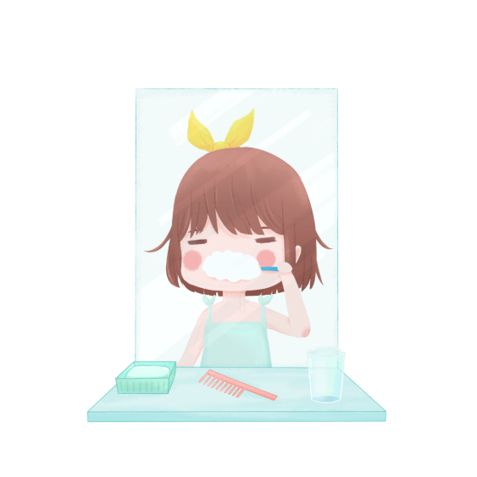
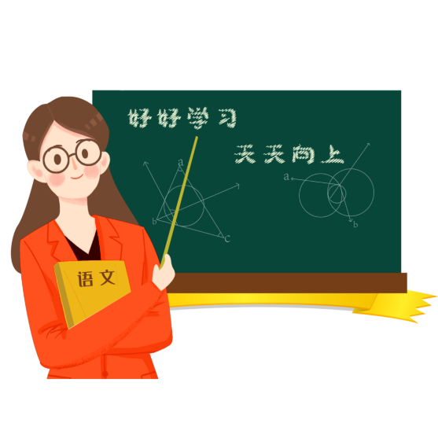
以s,x,ch,sh或字母o结尾的动词在词尾加-es;
teach→teaches
brush→brushes
Miss Wang teaches us Chinese.
Lily brushes her teeth every day.
王老师教我们语文。
莉莉每天刷牙。

Slide 14
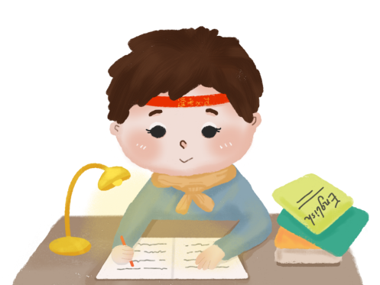
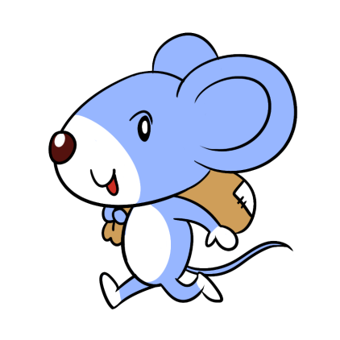
以s,x,ch,sh或字母o结尾的动词在词尾加-es;
go→goes
do →does
The little mouse often goes to the kitchen at night.
Gao Wei does his homework every day.
这只小老鼠晚上经常去厨房。
高伟每天做作业。

Slide 15
be的三单是is
have的三单是has
She often has dinner at 7:00.
她经常在七点吃晚餐。

Slide 16
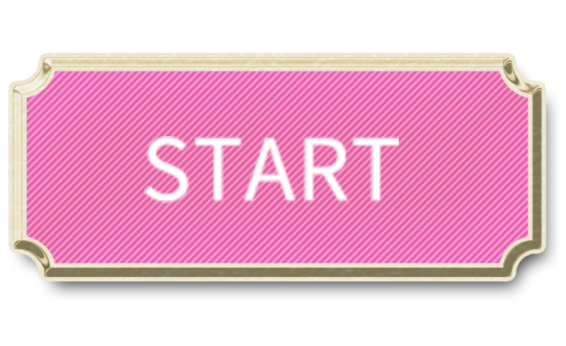
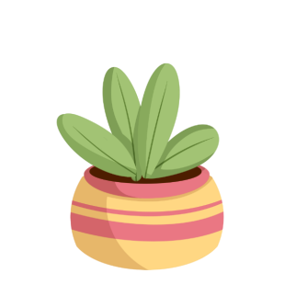

Slide 17
play
studies
sing
eat

Slide 18
goes
has
does
watch

Slide 19
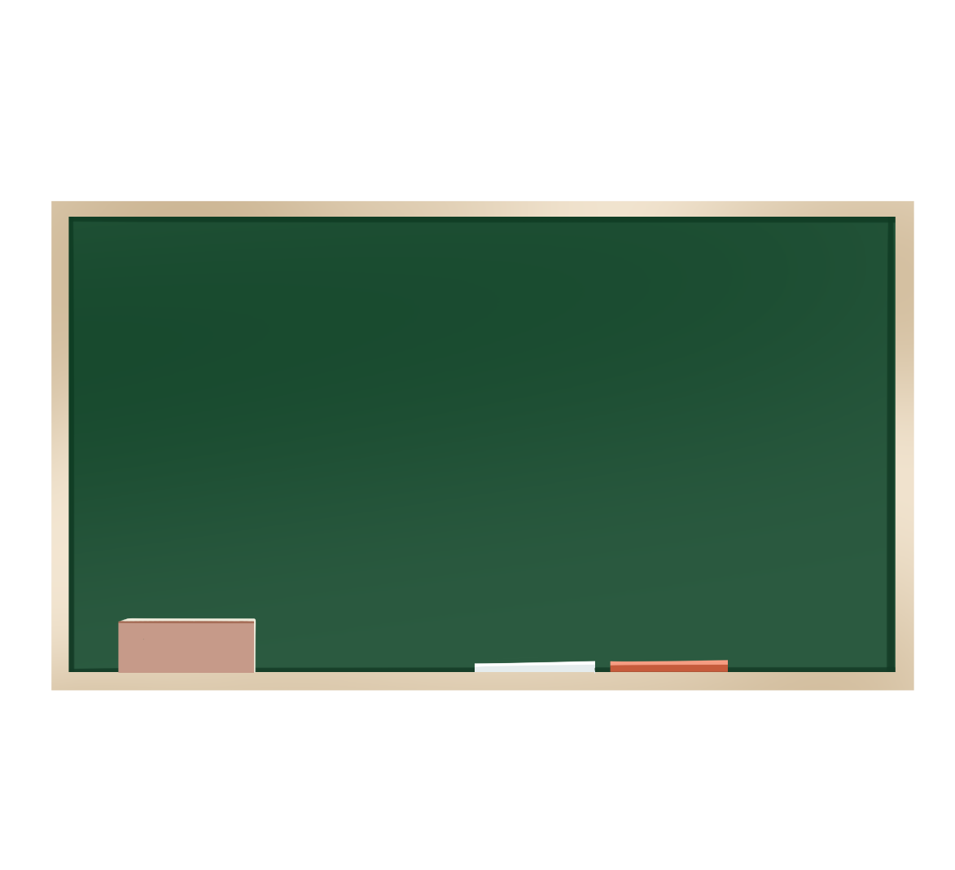
Test
draws
1.My father often ________(draw)in the park.
watch
2.We usually_______( watch) TV on weekends.
goes
3.Nick _______(go) to the bookshop every week.
has
4.He often ________(have) some fruits after dinner.
rises
5.The sun _______(rise) in the east.

Slide 20
动词三单现在时，一般词尾加S；
s,x,ch,sh在词尾，直接加上es；
词尾若是字母O，加上es不用愁；
词尾若是辅+y，变y为i是正规；
have, be三单很特殊，has, is要记熟！

Slide 21
Thank you

