Slide 1
Unit 6 Seasons
Surfing in Sydney
WWW.PPT818.COM

Slide 2
Learning Aims
1.掌握单词:surfing, mate, reach, surfboard, degree, sea, popular, surfer
短语:G’day mates, be different from…, don’t have to, ride the waves, so many, etc.
2.掌握和运用关于在澳大利亚冲浪的句型:
3.了解澳大利亚的气候特征和特有活动。

Slide 3
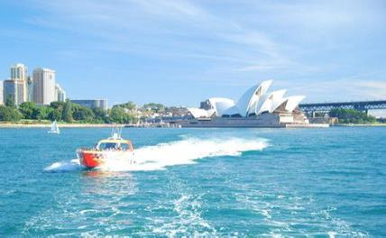
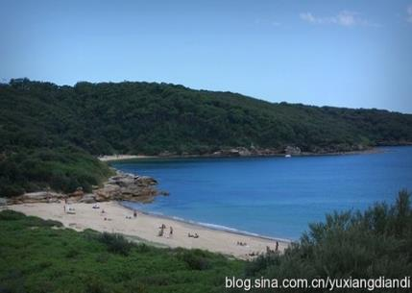
Lead in
What do you know about Australia?
It’s in the south of the earth.
It has many beautiful beaches.
People can surf in the sea.
People can swim in the sea.
We can go boating on the sea.
People can play on the beach.

Slide 4
Presentation
New words
surf v. =ride the waves surfing n.
1.冲浪,冲浪运动
2.朋友；伙伴
4.艾伦(人名)
5.到达；达到
6.度数，度
7.海洋，海
8. 冲浪板
9. 流行的；普及的
10. 冲浪者
mate n.
PPT模板：www.1ppt.com/moban/ PPT素材：www.1ppt.com/sucai/
PPT背景：www.1ppt.com/beijing/ PPT图表：www.1ppt.com/tubiao/
PPT下载：www.1ppt.com/xiazai/ PPT教程： www.1ppt.com/powerpoint/
资料下载：www.1ppt.com/ziliao/ 范文下载：www.1ppt.com/fanwen/
试卷下载：www.1ppt.com/shiti/ 教案下载：www.1ppt.com/jiaoan/
PPT论坛：www.1ppt.cn PPT课件：www.1ppt.com/kejian/
语文课件：www.1ppt.com/kejian/yuwen/ 数学课件：www.1ppt.com/kejian/shuxue/
英语课件：www.1ppt.com/kejian/yingyu/ 美术课件：www.1ppt.com/kejian/meishu/
科学课件：www.1ppt.com/kejian/kexue/ 物理课件：www.1ppt.com/kejian/wuli/
化学课件：www.1ppt.com/kejian/huaxue/ 生物课件：www.1ppt.com/kejian/shengwu/
地理课件：www.1ppt.com/kejian/dili/ 历史课件：www.1ppt.com/kejian/lishi/
Aaron
reach v.
degree n.
sea n.
surfboard n.
popular adj.
surfer n.

Slide 5
Match the words with the correct meanings.
practice
reach a big body of water
popular a word to describe temperature
degrees get to; arrive at
sea be liked by many people

Slide 6
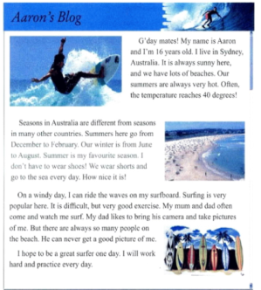
Presentation
Listen to the text and finish Exercise 1 in Let’s Do It.
(1)Aaron is (16/18) years old.
(2)Aaron lives in (Canada/Australia).
(3)Aaron’s favourite season is (winter/summer).
(4)Surfing (is/isn’t) very popular in Sydney.
(5)Aaron’s father (can/can’t) get a good picture of him.

Slide 7
Presentation
Read the passage and answer the following questions.
(1)What is the temperature in summer in Australia?
(2)What is the summer month in Australia?
(3)What’s Aaron’s favourite season?
(4)Who often watches Aaron surf?
40 degrees.
PPT模板：www.1ppt.com/moban/ PPT素材：www.1ppt.com/sucai/
PPT背景：www.1ppt.com/beijing/ PPT图表：www.1ppt.com/tubiao/
PPT下载：www.1ppt.com/xiazai/ PPT教程： www.1ppt.com/powerpoint/
资料下载：www.1ppt.com/ziliao/ 范文下载：www.1ppt.com/fanwen/
试卷下载：www.1ppt.com/shiti/ 教案下载：www.1ppt.com/jiaoan/
PPT论坛：www.1ppt.cn PPT课件：www.1ppt.com/kejian/
语文课件：www.1ppt.com/kejian/yuwen/ 数学课件：www.1ppt.com/kejian/shuxue/
英语课件：www.1ppt.com/kejian/yingyu/ 美术课件：www.1ppt.com/kejian/meishu/
科学课件：www.1ppt.com/kejian/kexue/ 物理课件：www.1ppt.com/kejian/wuli/
化学课件：www.1ppt.com/kejian/huaxue/ 生物课件：www.1ppt.com/kejian/shengwu/
地理课件：www.1ppt.com/kejian/dili/ 历史课件：www.1ppt.com/kejian/lishi/
December, January and February.
Summer.
Aaron’s mum and dad.

Slide 8
Language points
1.It is always sunny here, and we have lots of beaches. (1段第3行)
lots of=a lot of意为“许多”,修饰可数名词复数和不可数名词,可换成 many或much。
Yesterday he ate a lot of/lots of /much fish.
昨天他吃了许多鱼肉。

Slide 9
2.Often, the temperature reaches 40 degrees! （1段最后1句）
辨析: reach, arrive,get
(1)reach 通常是及物动词(较 get 更正式),其后可直接跟地点名词作宾语(不能用介词)。
He reached Beijing yesterday.
他昨天到达北京。
reach 之后也可接 here, there, home 等副词。
When did he reach home yesterday?
昨天他什么时候到家的?

Slide 10
(2)reach 除可表示到达某地外,还用于其他意义的到达。
He has reached school age.
(3)arrive 之后通常接介词 at (一般用于较小的地方)或 in (一般用于较大的地方)。
We arrived at the station five minutes late.
They will arrive in Paris next Monday.
(4)get 之后通常接介词 to。
When we got to the park, it began to rain.

Slide 11
3.Seasons in Australia are different from seasons in many other countries. （2段第1句）
be different from意为“和……不同”。different用作形容词,意为“不同的”。
My pen is different from yours.
difference用作名词,意为“不同之处”;differently用作副词,意为“不同地”。
There are many differences between the two dresses.

Slide 12
4.I don’t have to wear shoes! （2段倒数第3句）
have to意为“必须;不得不”,接动词原形。
It’s late.I have to go home now.
天晚了。我现在不得不回家。
don’t have to意为“不必”,它的同义词是needn’t 。
You don’t have to take a bus to school.I can drive you there.
你不必乘公共汽车去上学。我能开车送你去那里。

Slide 13
5.My mum and dad often come and watch me surf. （3段第2行）
watch sb.do sth.意为“观看某人做某事”。
I watched him go, and then I went home.
(1)watch sb./sth.doing sth.意为“看某人/某物正在做某事”,-ing形式表示正在进行的动作或活动。
She watched the children playing in the yard.
(2) 其他类似用法还有:see sb.do/doing sth. 看见某人做/正在做某事,hear sb.do/doing sth.听见某人做/正在做某事。
I hear him singing.

Slide 14
Exercises
I. 单项填空
1. The weather in Fujian is ________ that in Beijing.
A. different with B. the same of
C. different from D. the same to
2. I like going for a picnic ________ a fine day.
A. in B. on C. during D. at
3. His mother often watches him ________ football on the playground.
A. play B. plays C. played D. playing

Slide 15
4. Gina hopes ________ a doctor in the future.
A. be B. to be
C. being D. is
5. There are beautiful beaches. There are ________ people on weekends.
A. lot of B. so many
C. so much D. too much

Slide 16
Ⅱ. 完成句子
1. 在夏天天气一直很热。
It is ________ ________ ________ in summer.
2. 篮球运动在中国很流行。
Basketball is very ________ ________ China.
3. 我照了一张我姐姐的照片。
I ________ _____ ________ _____ my sister.
always very hot
popular in
took a picture of

Slide 17
4. 冲浪是很好的运动，但是很难。
________ is very ________ ________ ，but it is very difficult.
5. 青岛有许多海滩。
There are ________ ________ ________ in Qingdao.
Surfing
good exercise
lots of beaches

Slide 18
单词:surfing, mate, reach, surfboard, degree, sea, popular, surfer 短语:G'day mates, be different from…, don’t have to, ride the waves, etc.
Sum up

Slide 19
Homework
Work in groups. In your opinion, what is the most popular sport in China? Can you play it in any season? Discuss and present your answers to the class.

