Slide 1
陕旅版英语五年级上册
Unit4 At Table
第4课时
WWW.PPT818.COM

Slide 2
教学目标：
1. 能听懂、会读Read a story部分的小故事，能和同学合作用自己的语言为该故事加入自编的对话内容，并进行表演。
2. 能在教师的引导下学习和掌握Read the words语音部分，通过以旧引新的方式总结归纳字母Oo在重读开音节和重读闭音节中的读音规则并试读更多的生词。

Slide 3
Free talk
What is your favorite food, rice, noodles or hamburgers?
Who often use chopsticks, people in China or people in the USA?
Can you use chopsticks?
You want to have some soup. What can you use?

Slide 4
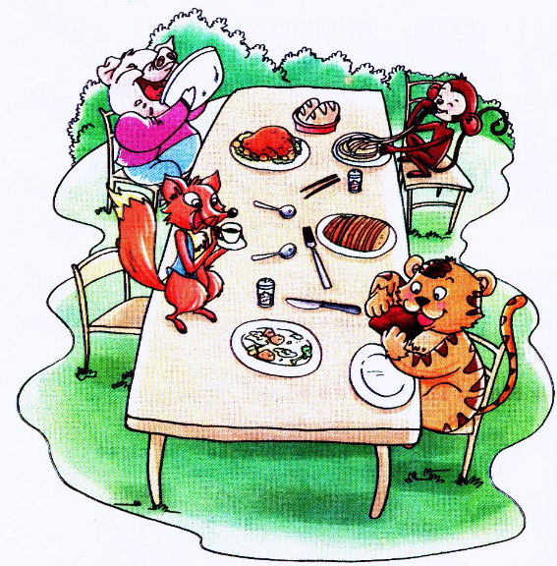
Look at this picture. What can you see?

Slide 5
听课文录音，回答下列问题：
Question 1: How many animals are there?
Question 2: Who are they?
Question 3: What are they doing?
Question 4: Who can’t use the chopsticks / spoon / knife and fork well?

Slide 6
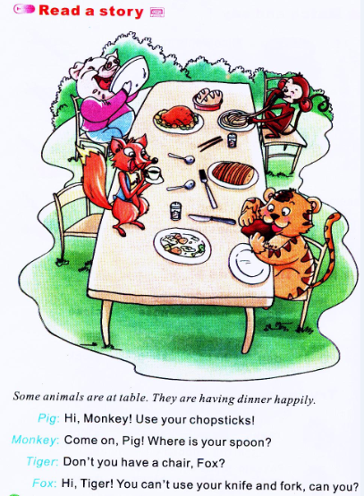

Slide 7
Answers：
Question 1: How many animals are there?
Question 2: Who are they?
Question 3: What are they doing?
Question 4: Who can’t use the chopsticks / spoon / knife and fork well?

Slide 8
Role play
四人一组进行故事的编排、表演!
同学们表演的时候要注意语音语调哦！

Slide 9
读一读

Slide 10
你能总结字母Oo的发音规律了吗？
读字母本身的音[əʊ]
读作短元音[ɒ]

Slide 11
