Slide 1
Unit 5 Helping our parents
五年级(下)
WWW.PPT818.COM

Slide 2
Read and find
Who will put the kettle on? Who will take it off ?
Polly, put the kettle on. Polly, put the kettle on.
Polly, put the kettle on. We’ll all have tea.
Susie, take it off again. Susie, take it off again.
Susie, take it off again. They’ve all gone away.
Polly
Susie
他们都已经走了。

Slide 3
Song time

Slide 4
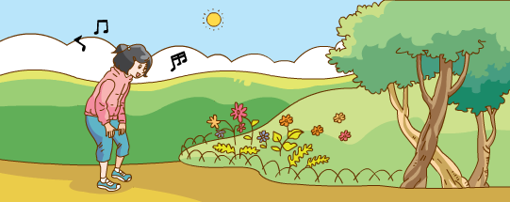
Sound time
sing spring watching growing
grow-growing 生长；种植

Slide 5
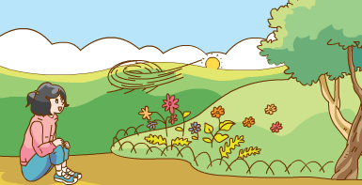
Listen and fill
你能根据听到的词填小诗吗？
morning
sing
In the , I like to .
growing
And watch the flowers .
evening
In the , I like to sit
blowing
And listen to the wind .

Slide 6
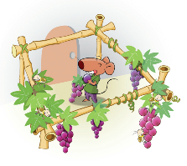
Cartoon time
1.
happy

Slide 7
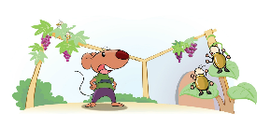
Cartoon time
2.
pest-pests(复数)
害虫
happy angry

Slide 8
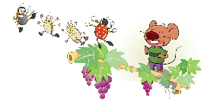
Cartoon time
3.
四人一组猜想Bobby、Ladybirds和Pests之间会说什么，一起来演一演吧！
ladybird

Slide 9
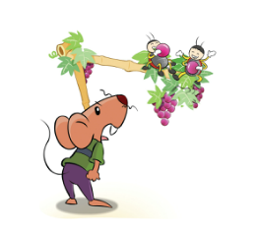
Cartoon time
4.

Slide 10
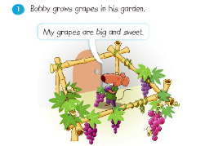
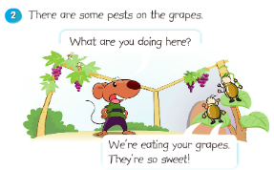
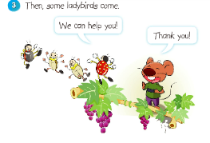
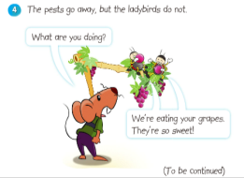
Cartoon time
Who will come next? 接下来谁会来呢？
未完待续

Slide 11
Homework
1. Act out the story in Cartoon time.
2.Finish writing.

