Slide 1
Unit 3 Safety
Never Catch a Dinosaur
WWW.PPT818.COM

Slide 2
学习目标
objectives
To learn some words : rule, branch, training
To describe an accident.
To know it’s good to listen to other’s warnings about safety tips.

Slide 3
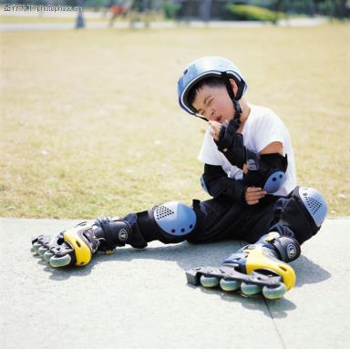
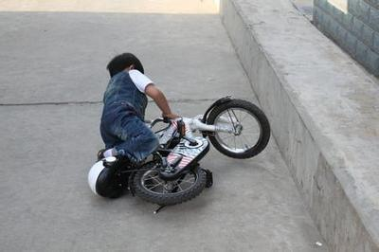
Lead in
Have you ever had some accidents?

Slide 4
Free talk
Have you ever learned a lesson from an accident?
Is it important to listen to other people’s warnings? Why or why not?

Slide 5
Pre-reading
rule
[ruːl]
n. What can, should or must be done in certain circumstances (情况) .
规则、规章
e.g. It's against the rule to pick up the ball.
捡球是犯规的。

Slide 6
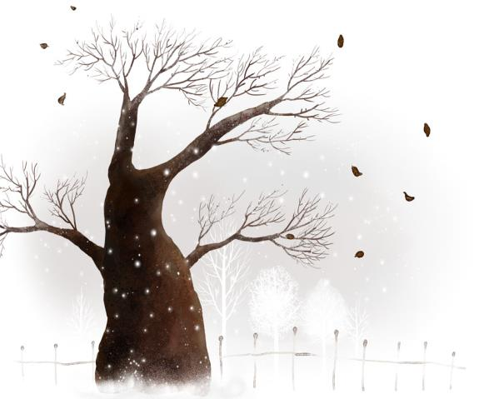
branch
[brɑ:ntʃ]

Slide 7
training
['treɪnɪŋ]
n. It is physical exercise that you do regularly (有规律的)in order to keep fit or to prepare for an activity such as a race. 训练、培养
e.g. Tom broke a toe in training.
汤姆在训练中折断了一根脚趾。

Slide 8
Listen to the 1st and 2nd paragraphs of the letter and tell true (T)or false (F).
Danny felt terrible because of his carelessness. ( )
It was lucky for Brian to catch a falling dinosaur. ( )
T
F

Slide 9
While-reading
Read rest of the letter and do the following tasks. (第1, 4题补全句子，第2, 3题回答问题，第5题翻译。)
He climbed _______ and ________. He thought he ___________ the sky.
Why did Li Ming fall?
How long did it take Li Ming to recover?
Li Ming couldn’t _________ ping- pong training that year.
Now, I always listen to my mother’s warnings about safety.

Slide 10
Read rest of the letter and do the following tasks. (第1, 4题补全句子，第2, 3题回答问题，第5题翻译。)
higher
higher
He climbed _______ and ________. He thought he _________________ the sky.
2. Why did Li Ming fall and get injured?
almost touched
Because the branch broke and his mother failed to catch him.

Slide 11
Read rest of the letter and do the following tasks. (第1, 4题补全句子，第2, 3题回答问题，第5题翻译。)
3. How long did it take Li Ming to recover?
4. Li Ming couldn’t _________ ping- pong training that year.
Now, I always listen to my mother’s warnings about safety.
It took Li Ming 3 months to recover.
attend
现在，我总是听从妈妈有关安全的警告。

Slide 12
Retell the accident happened to Li Ming!
Keywords:
seven years old, park, tree, tried to stop
high, touch the sky
branch broke, fell, hit the ground
leg, broken, three months, attend training

Slide 13
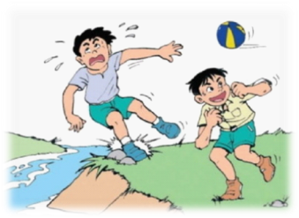
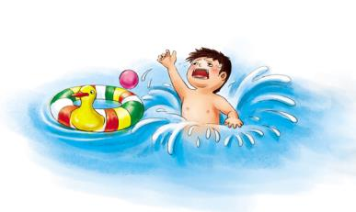
Post-reading
What other safety rules for teenagers can you think of?

Slide 14
Here are some safety rules for teenagers. Read them and fill in the blanks with the words in the box.
money number parents evening
When you are going out, please remember the following things:
• Always tell your ________ where you are going and when you expect to be home.
• Don’t carry a lot of ________ with you.
• Try not to walk on quiet and dark streets in the ________.
• Make sure you know what ________ to call for the police, ambulance and so on.
parents
money
evening
number

Slide 15
Here are some safety rules for teenagers. Read them and fill in the blanks with the words in the box.
side leave cigarettes pocket
When you are at school, you should follow these rules:
• Walk on the right-hand ________ of the stairs.
• Don’t bring __________ or alcohol to school.
• Don’t carry sharp things like knives or scissors in your ________.
• Report to your teacher if you want to ________ during school hours.
side
cigarettes
pocket
leave

Slide 16
How to develop rules
Children and teenagers appreciate being involved in the rule-making process (过程).
Taking part in discussions about rules won’t necessarily stop young people from breaking them. It will, however, help them understand what the rules are and why they’re needed.
It’s useful to write down a set of rules about how teenagers are expected to behave. Writing them down makes them clear, and can also prevent arguments about what is or isn’t allowed. Sticking the rules on the wall, or in another prominent (突出的)spot, can help younger children be constantly aware of them.
Qs：1. Why do the children and teenagers like the rule- making?
2. Where should the rules be put?

Slide 17
Activity
Task 2
Your school will have a new chemistry lab. Work together and design 10 safety rules for the new lab. (poster)
Task 1
Work together, think and design 10 safety rules in the classroom for your class. Make a poster.

Slide 18
Homework：
1. Do exercises of Lesson 18 in the exercise book.
2. Write down the retelling in the exercise book.
3. Better your poster of the safety rules.

Slide 19
Thank you !

