Slide 1
My friends
WWW.PPT818.COM

Slide 2
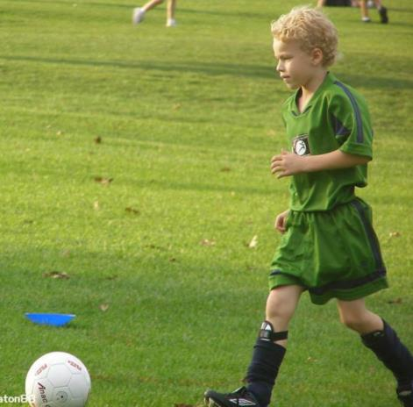
This is my friend ，Tom.
He is short and thin,
but he is strong.
He has a green T-shirt and green shorts.
He can play football.

Slide 3
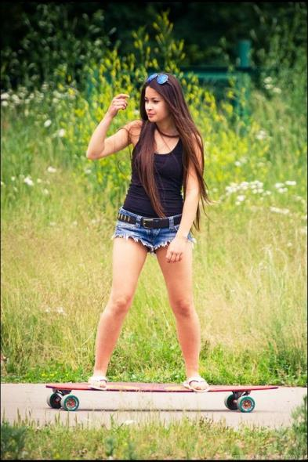
This is my friend，Alice.
She is tall and thin.
She has long hair，
and she is beautiful.
She has a pair of blue shorts.
She can skate.

Slide 4
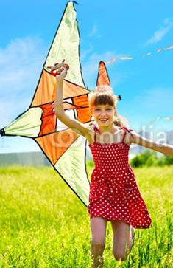
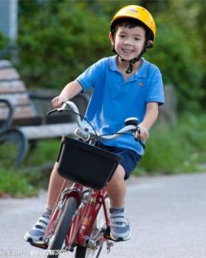
They are my friends ，Peter and his cousin Sally.
Peter has a blue T-shirt.
He can ride a bike.
Sally has a red dress.
She can fly a kite.

Slide 5
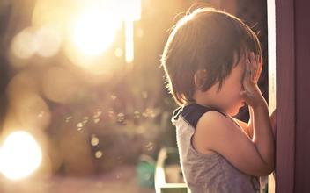
Guessing Game: Who is he/she?
描述一位同学的外貌及特征、衣着和特长，
请大家猜猜他/她是谁

Slide 6
He/ She is______( tall, thin, nice, …).
He/ She has _____(long hair,eyes, …).
He/she has a/an______ (colours) ______ (shirt, skirt, jeans, shorts,…).
He/she can_____(swim, run fast,…).

Slide 7
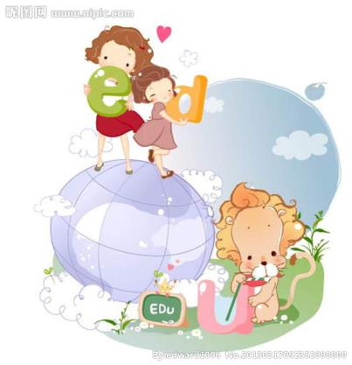
Homework:
写一篇介绍自己朋友的短文。内容要求包括：描述外貌及特征、衣着和特长。

