Slide 1
Unit 11
I want be a painter
WWW.PPT818.COM

Slide 2


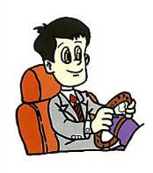

Sing along P32
I Want to Be …
I want to be a teacher, I want to be a teacher.
I want to be a teacher when I grow up.
I want to be a teacher, I want to be a teacher.
I want to be a teacher when I grow up.
(doctor, driver)

Slide 3
sing
I Want To Be...
I want to be a driver, I want to be a driver,
I want to be a driver when I grow up.
I want to be a driver, I want to be a driver,
I want to be a driver when I grow up.

Slide 4

Brain Storm
头脑风暴
Say out the words about occupations
(职业) you know.

Slide 5
doctor

Slide 6
policeman

Slide 7
nurse

Slide 8
teacher

Slide 9
cook

Slide 10




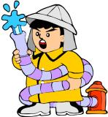


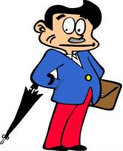
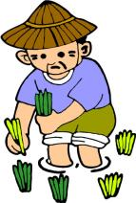


经理

Slide 11



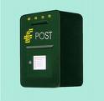



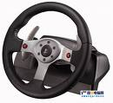

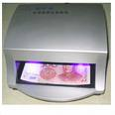
Who will use the tools ?
③
②
④
①
⑦
⑥
⑧
⑤
⑨
⑩

Slide 12

Please guess the job!

Slide 13
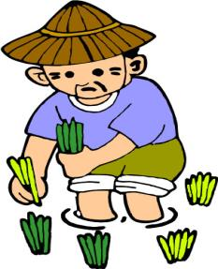
Please guess the job!

Slide 14
Please guess the job!

Slide 15

Please guess the job!

Slide 16

Please guess the job!

Slide 17
Please guess the job!

Slide 18
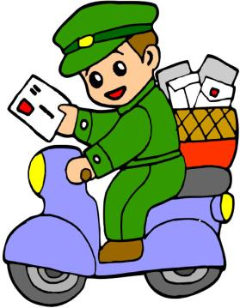
Please guess the job!

Slide 19

Please guess the job!

Slide 20
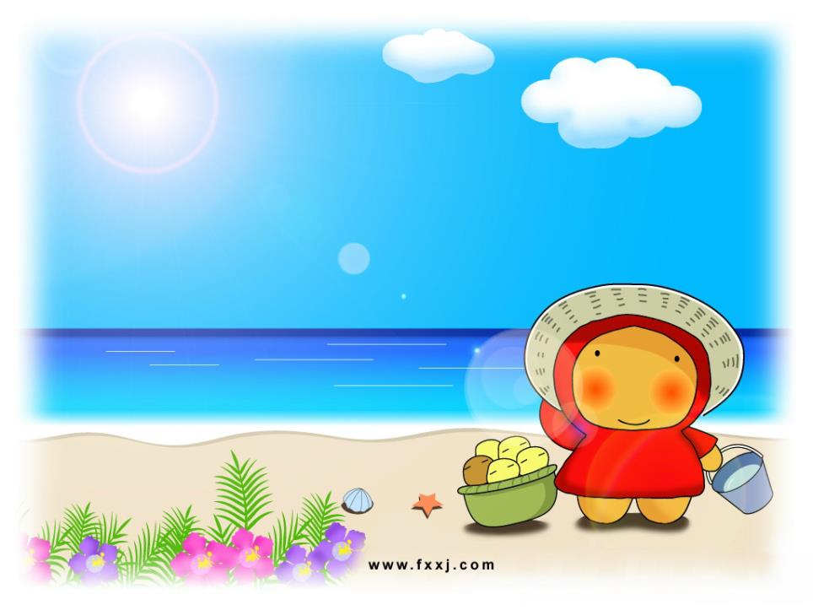
Watch and Guess

Slide 21
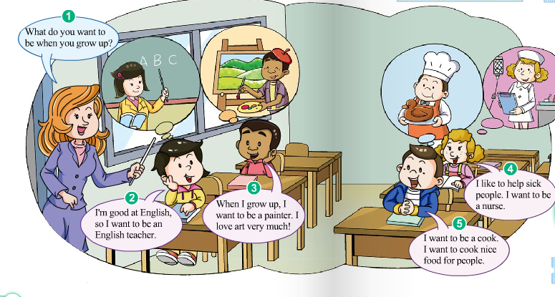
1. Who are they?
2. Where are they?
3. What are they doing?
4. What do they want to be when they want to be?

Slide 22
Let's Listen!
Listen and try to get the key information

Slide 23
Listen and Match

Slide 24
Let's Play!
Let's play a guessing game.

Slide 25


DetationMatch
Let’s Play
Guessing Game
Bom Game

Slide 26
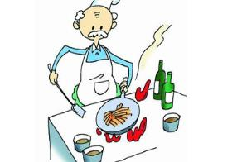


A: What do you want to be when you grow up?
B: I want to be a (an) …
I ...

Slide 27
Let's Read!
Find out what they want to be when they grow up.

Slide 28
Let's Retell!

Slide 29
A: What do you want to be when you grow up?
B: I'm ... at... ,so I want to be an ...
C: When I..., I want to a ...
I love ...
D:I like to help ...
I want to be ...
E: I want to be a ...
I want to cook ... for...

Slide 30
Performance

Slide 31
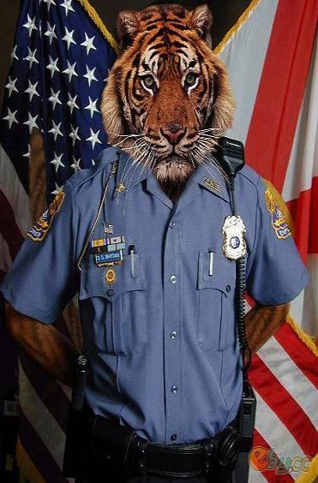
Let's act
Mr tiger, what do you want to be when you grow up?
I want to be a ...
I ...

Slide 32
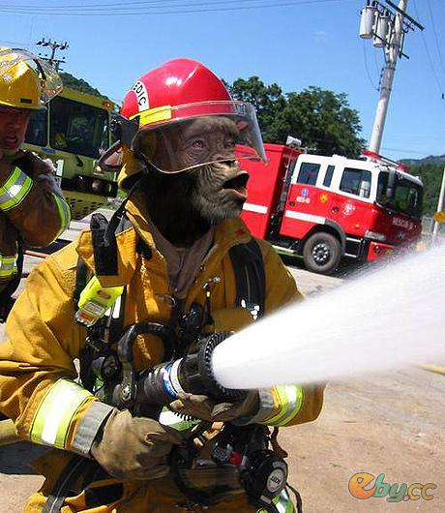
Let’s write!
Mr monkey, what do you want to be when you grow up?
I want to be a ...
I ...

